Slide 1
Adoptive cell therapy(ACT) using tumor infiltrating Tcells(TILs) Madi Lab Department of Pathology, School of Medicine Tel Aviv University

Slide 2
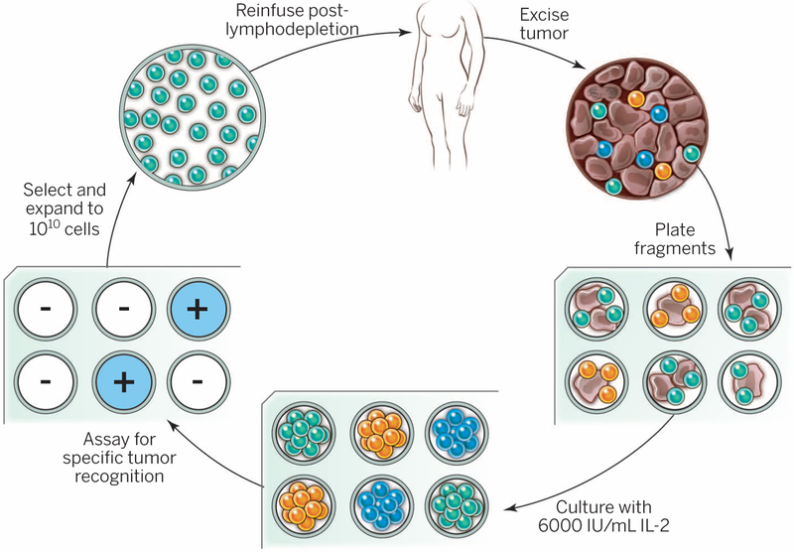
The schema as we know it
What is your schema?
Notes:
The resected melanoma specimen is digested into a single-cell suspension or divided into multiple tumor fragments that are individually grown in IL-2. Lymphocytes overgrow, destroy tumors within 2 to 3 weeks, and generate pure cultures of lymphocytes that can be tested for reactivity in coculture assays. Individual cultures are then rapidly expanded in the presence of excess irradiated feeder lymphocytes, OKT3, and IL-2. By approximately 5 to 6 weeks after resecting the tumor, up to 10¹¹ lymphocytes can be obtained for infusion into patients.
Lymphodepletion first for persistence.

Slide 3
Generation and expansion of unselected/young TIL
fragmentation, enzymatic digestion, and cell remnants technique were used to isolate TIL from surgically resected metastatic lesions.
TIL cultures were ex vivo expanded in 2 major steps:
(i) PreRapid Expansion Procedure (Pre-REP); Purified TIL cultures were established in approximately 2 weeks. Those shortterm cultured ("young") TIL were neither assayed nor selected ("unselected") on the basis of their interferongamma secretion after antigenic stimulation, as this assay was previously shown to be insufficient in predicting clinical efficacy. The obtained TIL cultures were cryopreserved or entered directly into the second step of expansion. The cut-off for an established TIL culture was defined as 80*10e6 cells, because about 50*10e6 TIL are required to initiate REP, the next expansion step, and another 30*10e6 TIL to compensate for the loss of cells during cryopreservation and thawing.
(ii) REP; approximately 50*10^6 unselected TIL were expanded to treatment levels in a large-scale expansion procedure using anti-CD3 antibody, rhIL-2 and irradiated feeder cells of healthy donors in gas-permeable bags or GRex flasks. Within 14 days, cultures expanded by about 1,000 to

Slide 4
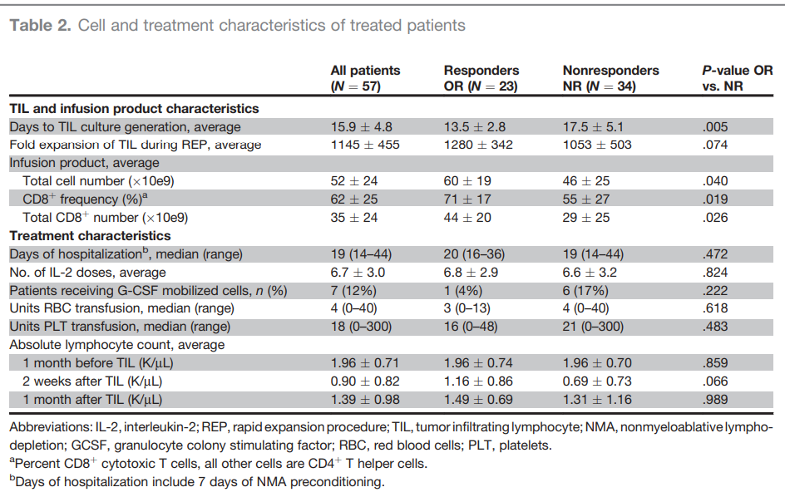
Predictor variables

Slide 5
Our data
4 responders & 4 non responders from Ella institute
Melanoma
History of immunotherapy – No
Site of TIL harvest ?

Slide 6
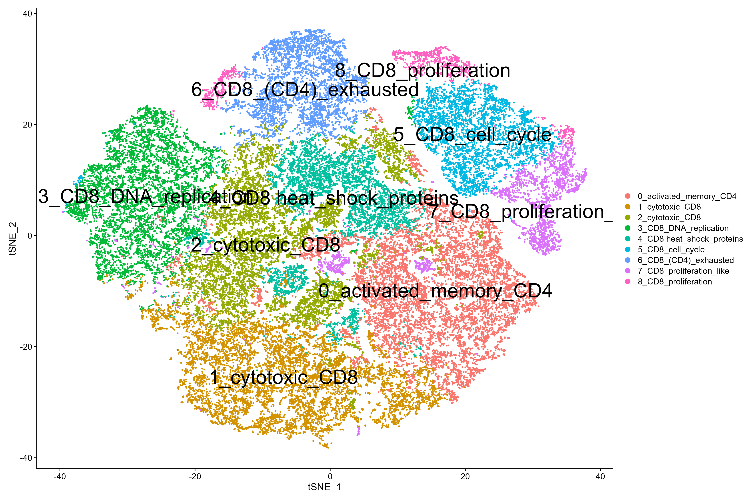
tSNE

Slide 7
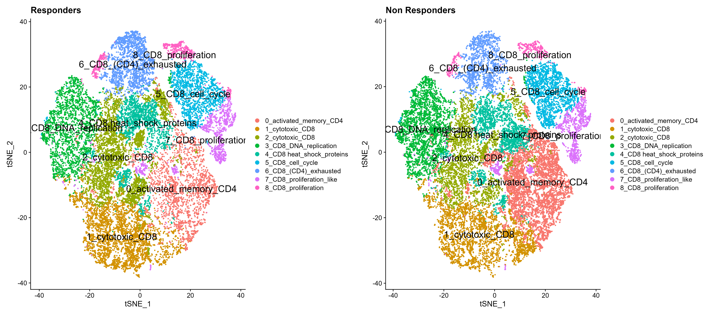
tSNE : by response

Slide 8
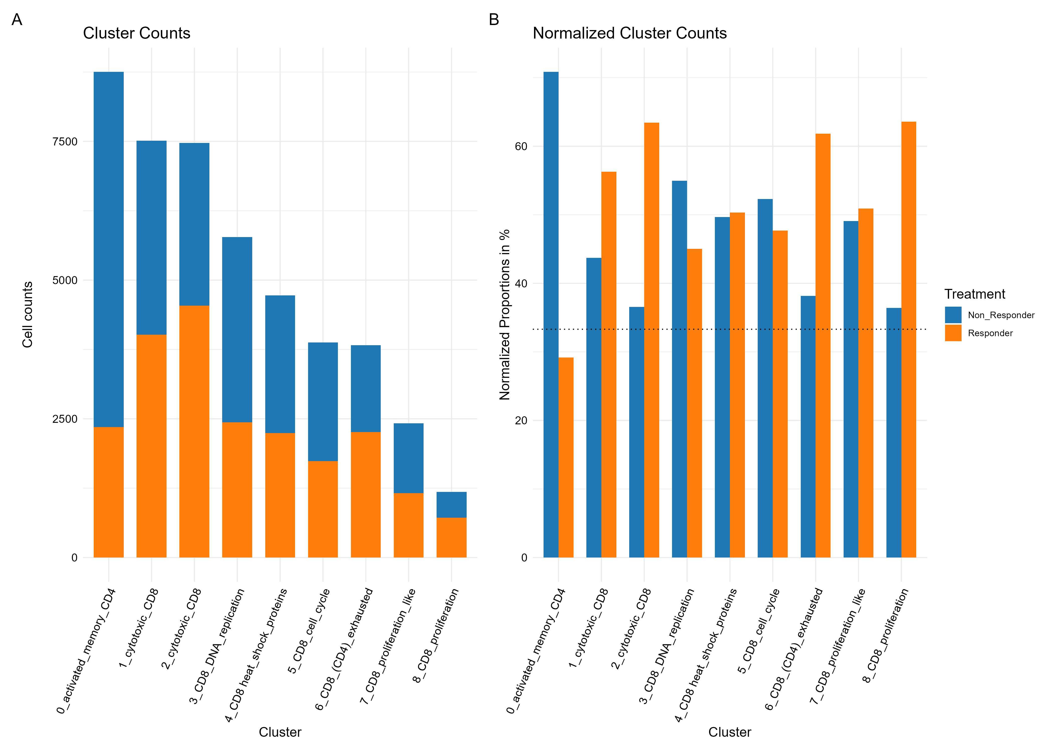

Slide 9
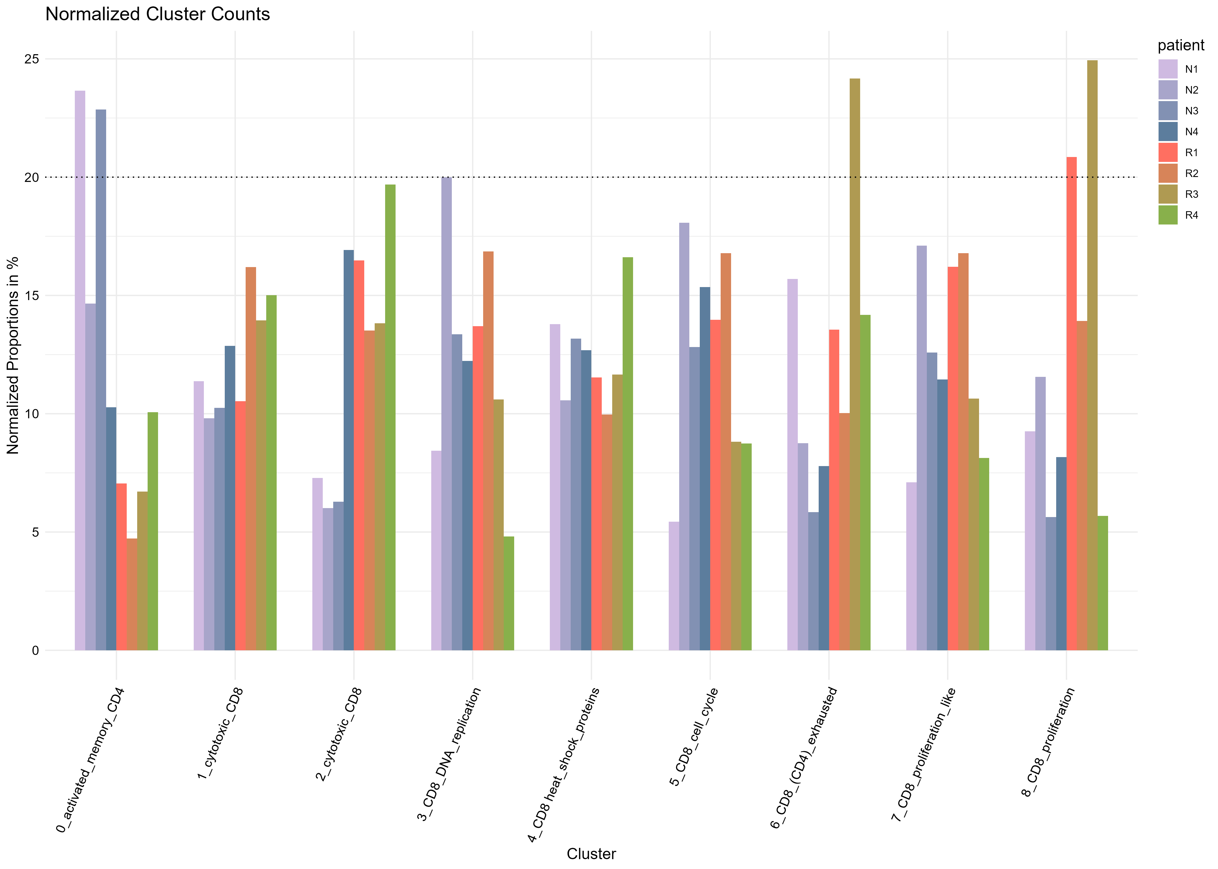
Contribution per patient

Slide 10
Higher CD8/CD4 ratio in responders
In responders : 12.278
In non-responders : 0.708

Slide 11
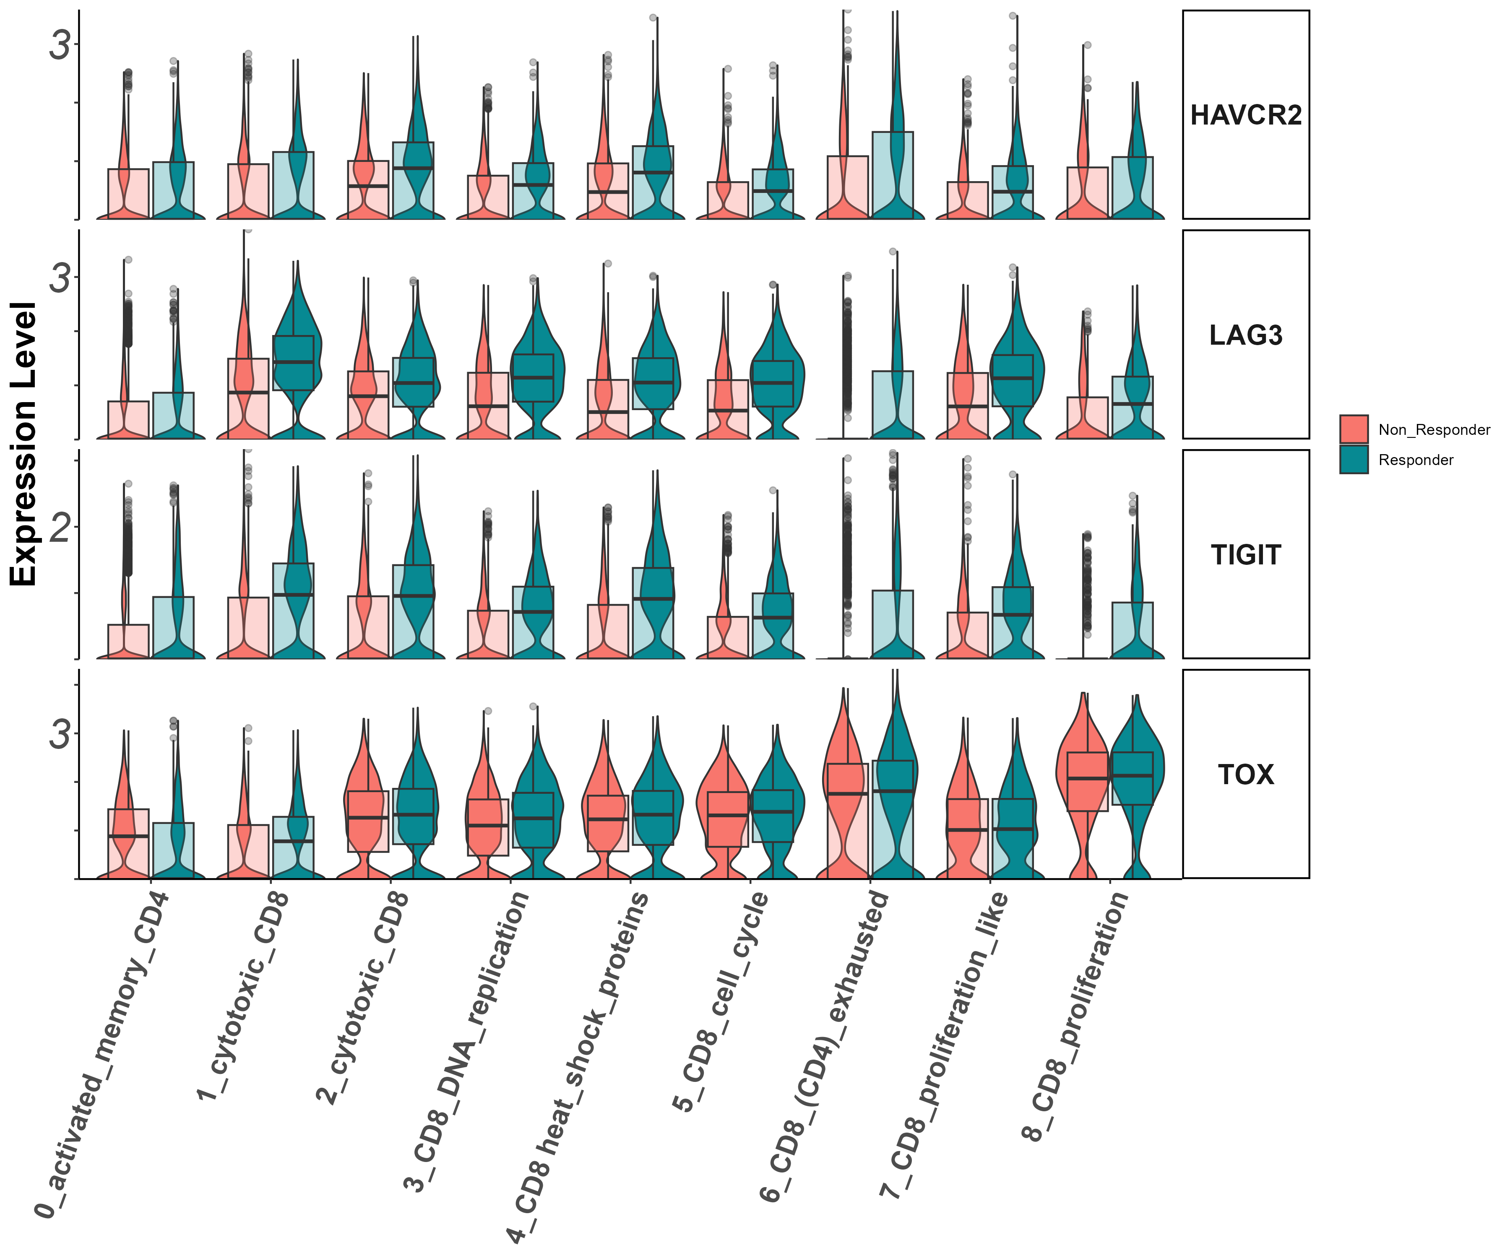
exhaustion markers
Tigit, Lag3, Havcr2, Tox

Slide 12
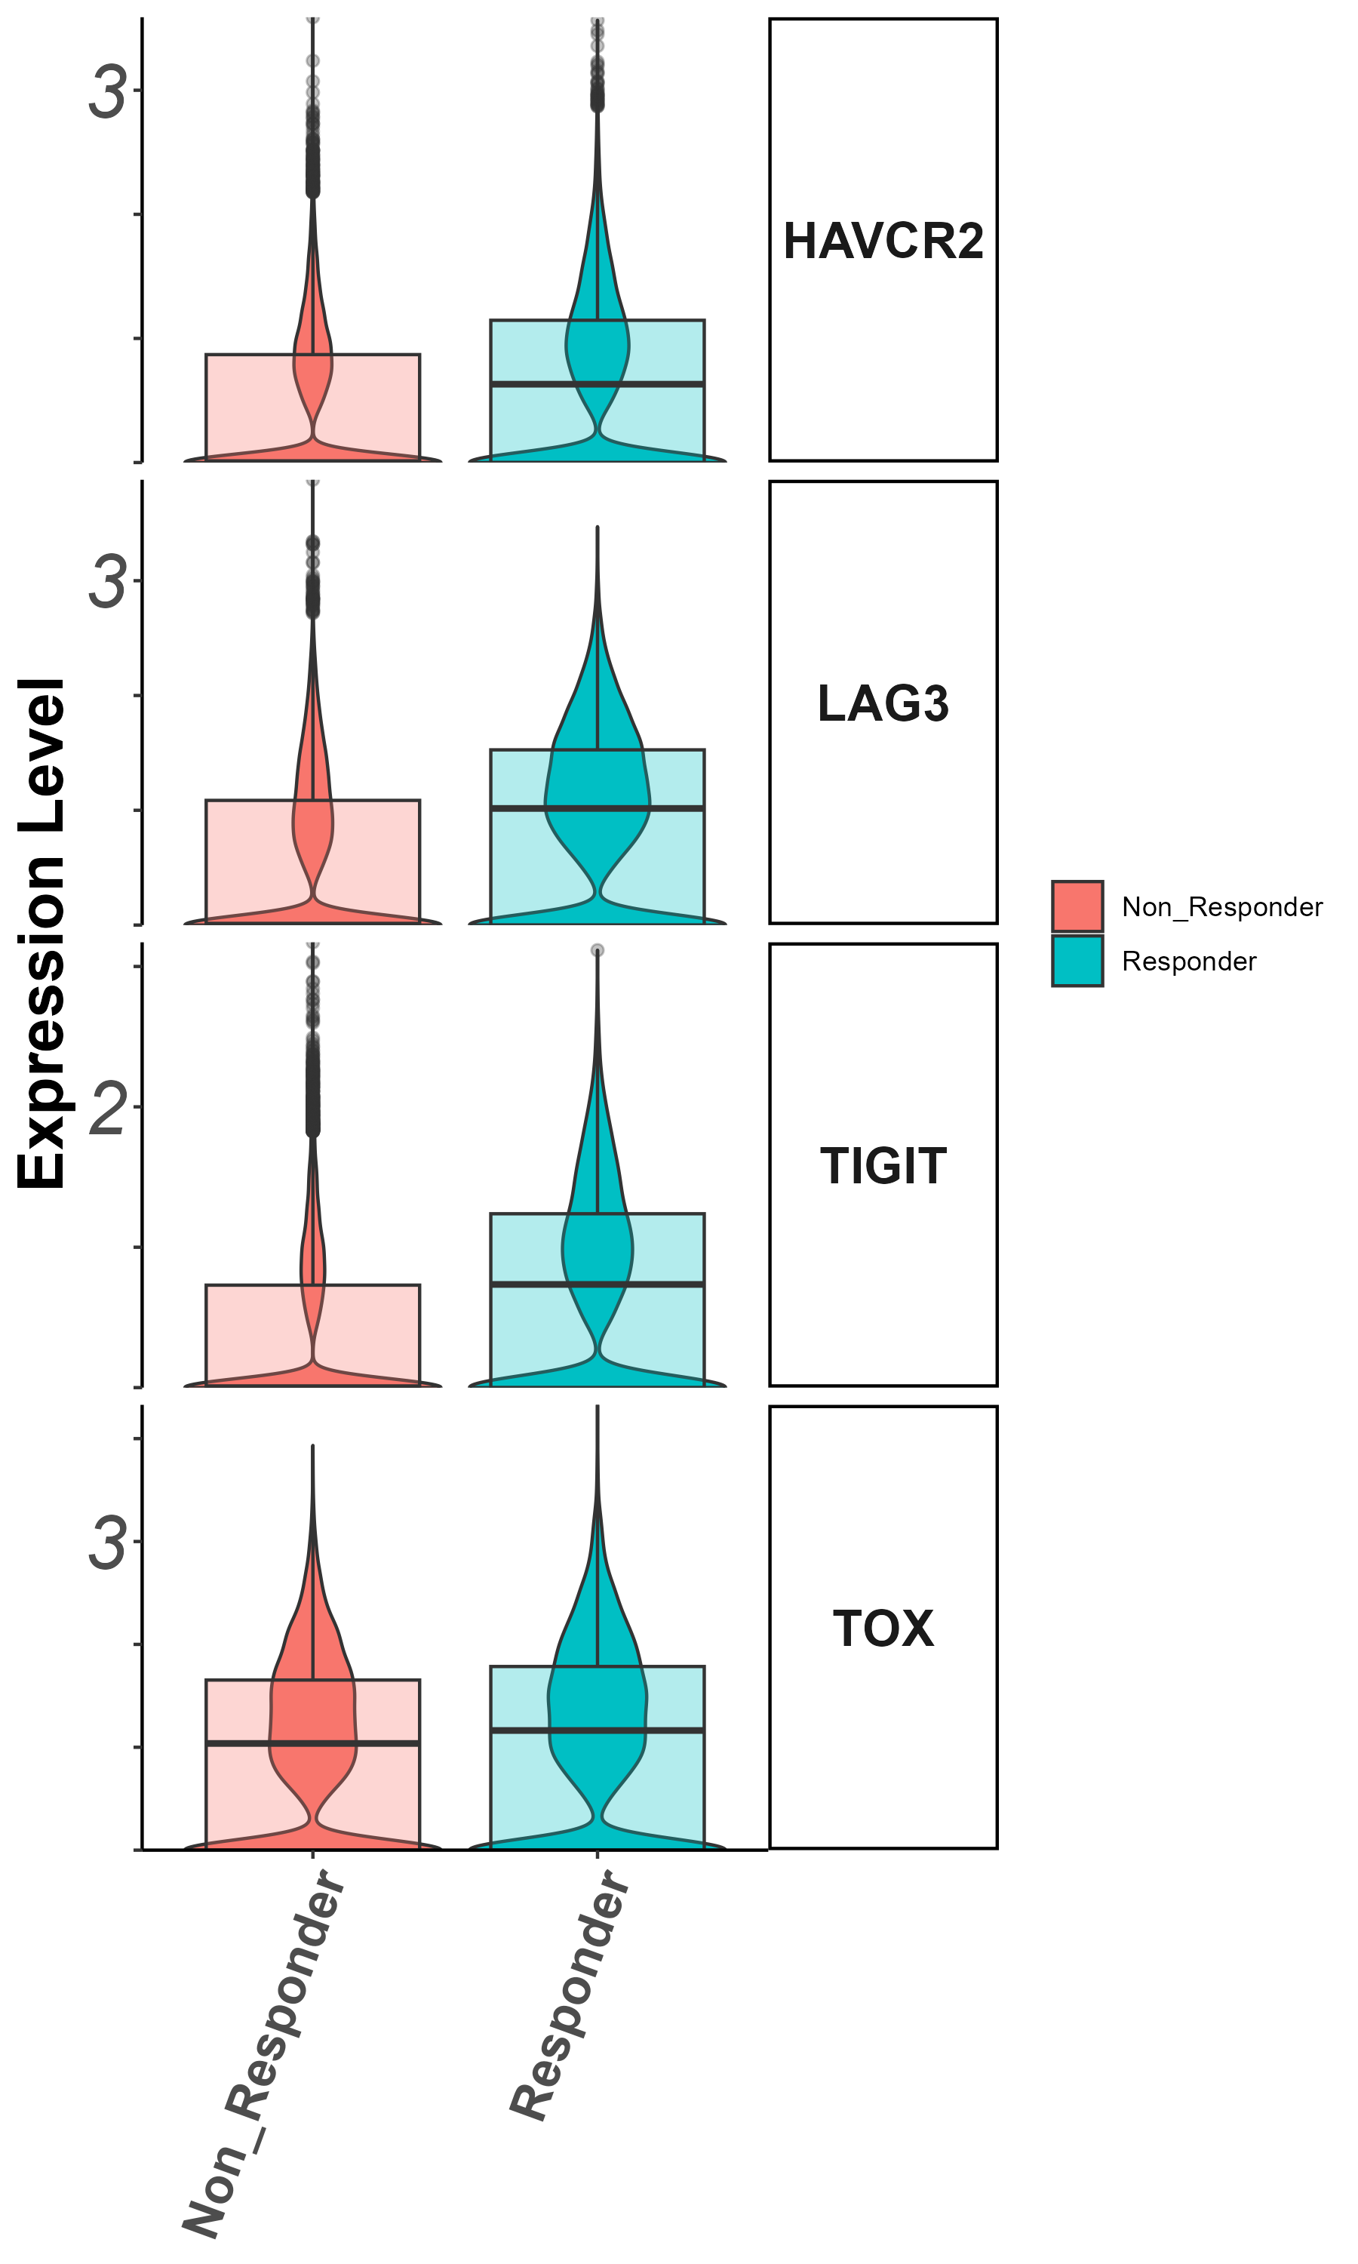
exhaustion markers
Tigit, Lag3, Havcr2, Tox

Slide 13
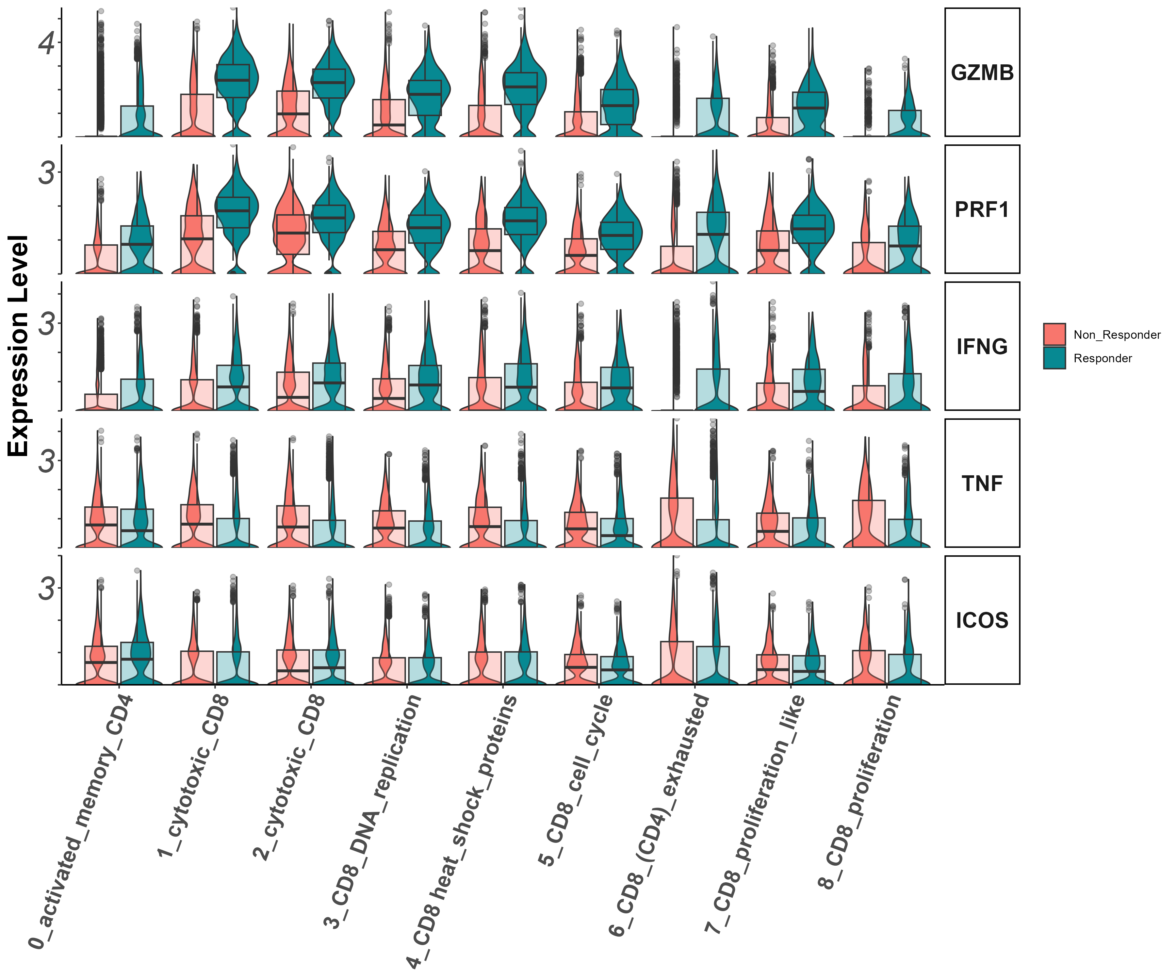
Effector markers
Gzmb, Prf1, Ifng, Tnf, Icos

Slide 14
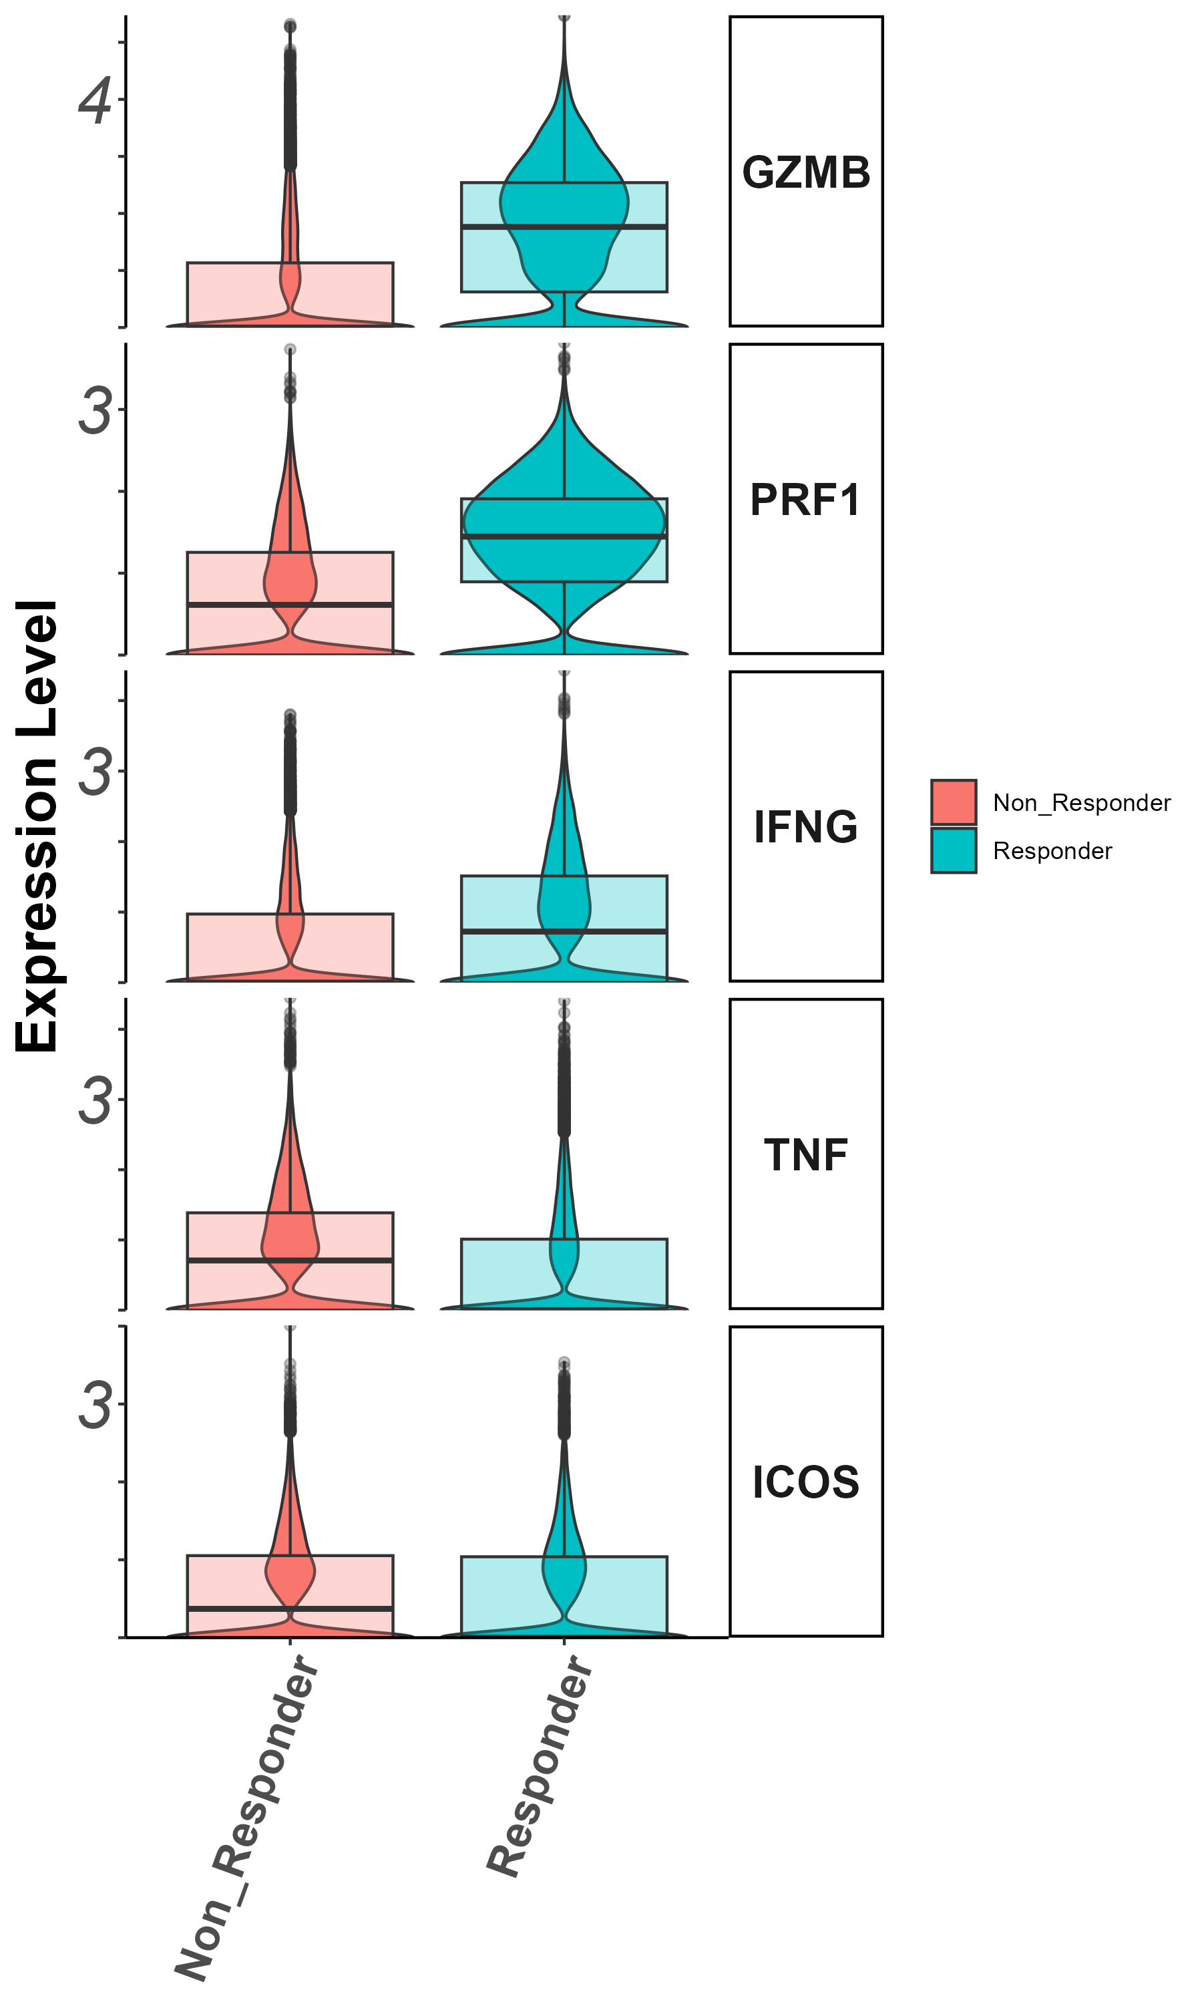
Effector markers
Gzmb, Prf1, Ifng, Tnf, Icos

Slide 15
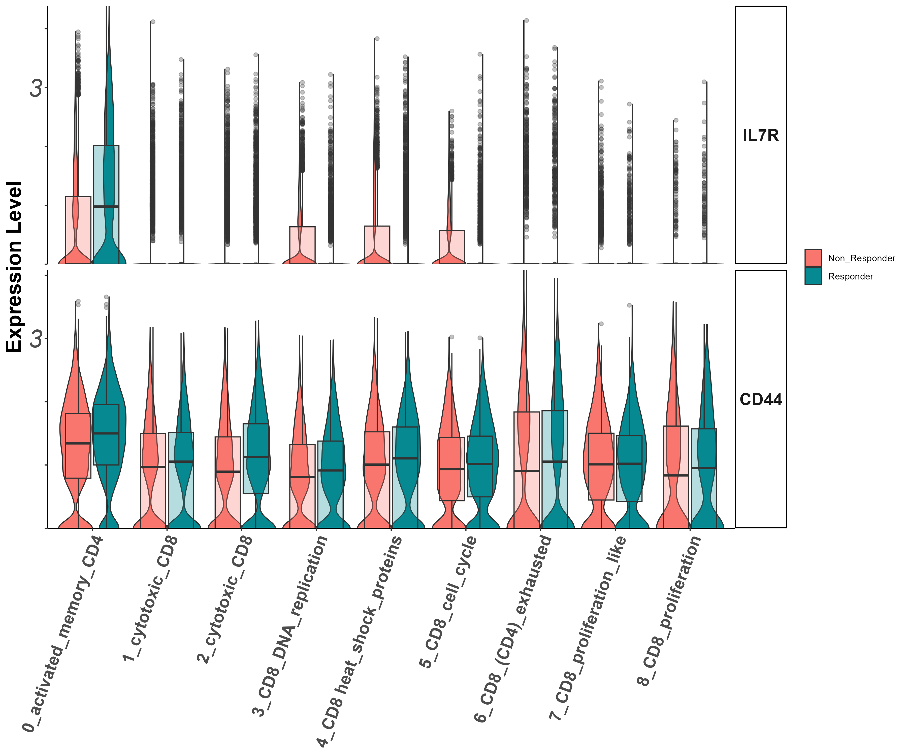
Stem/persister/naïve markers
Il7r, CD44, CD39, CD69

Slide 16
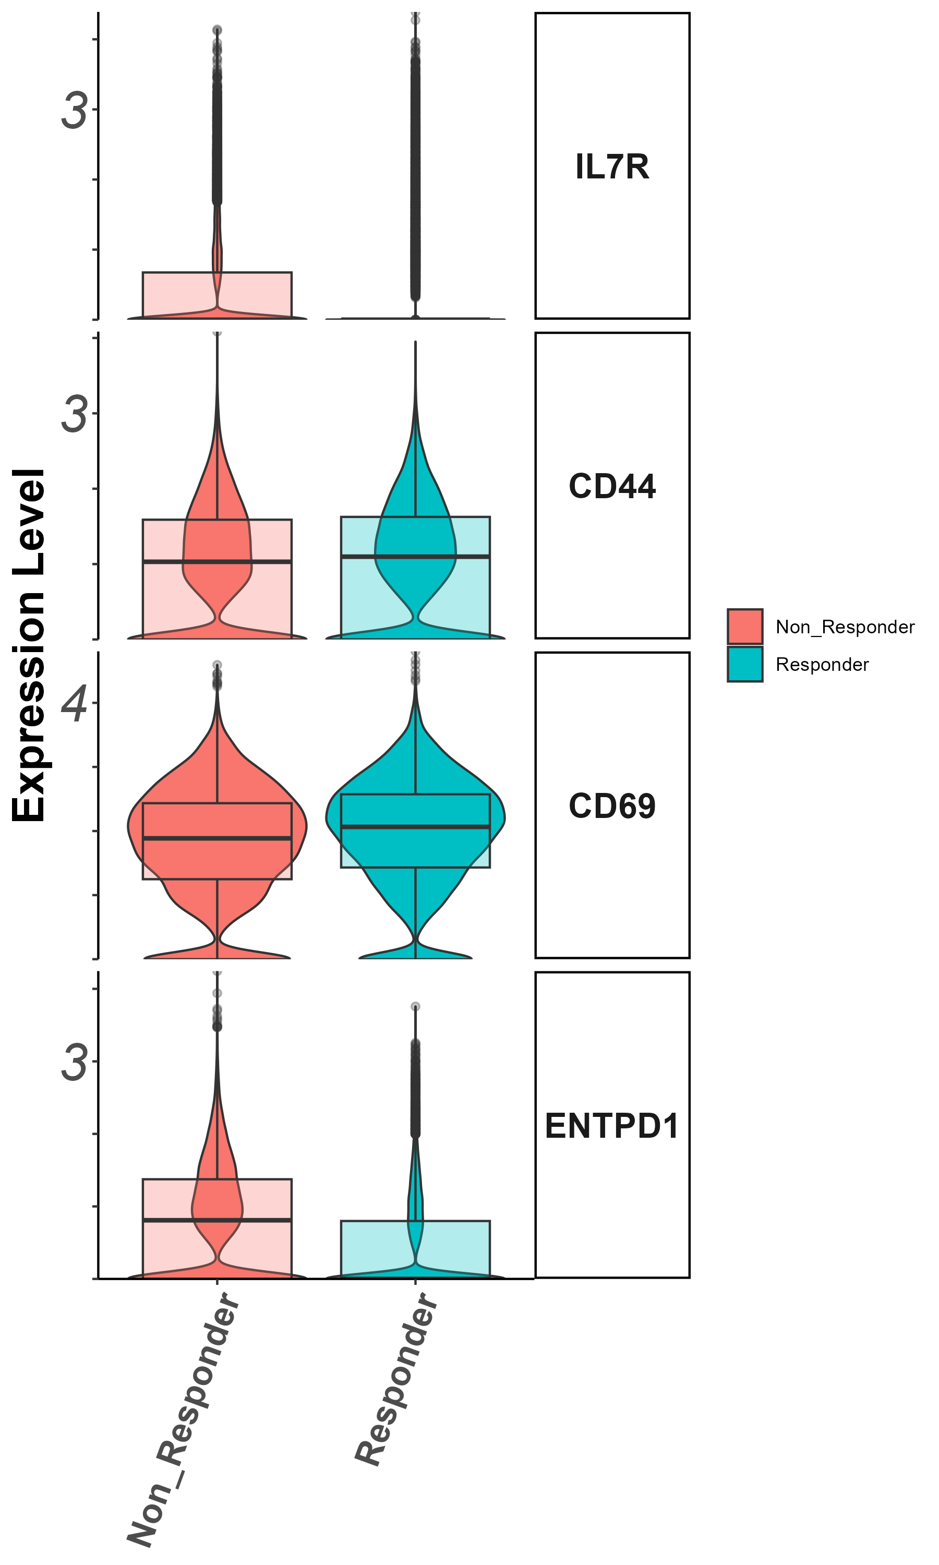
Stem/persister/naïve markers
Il7r, CD44, CD39, CD69

Slide 17
Summary – all cells
Patients are coherent in response groups in large clusters.
Non responders show lower CD8/CD4 ratio.
Higher expression of activation and effector markers in responders vs. non-responders.

Slide 18
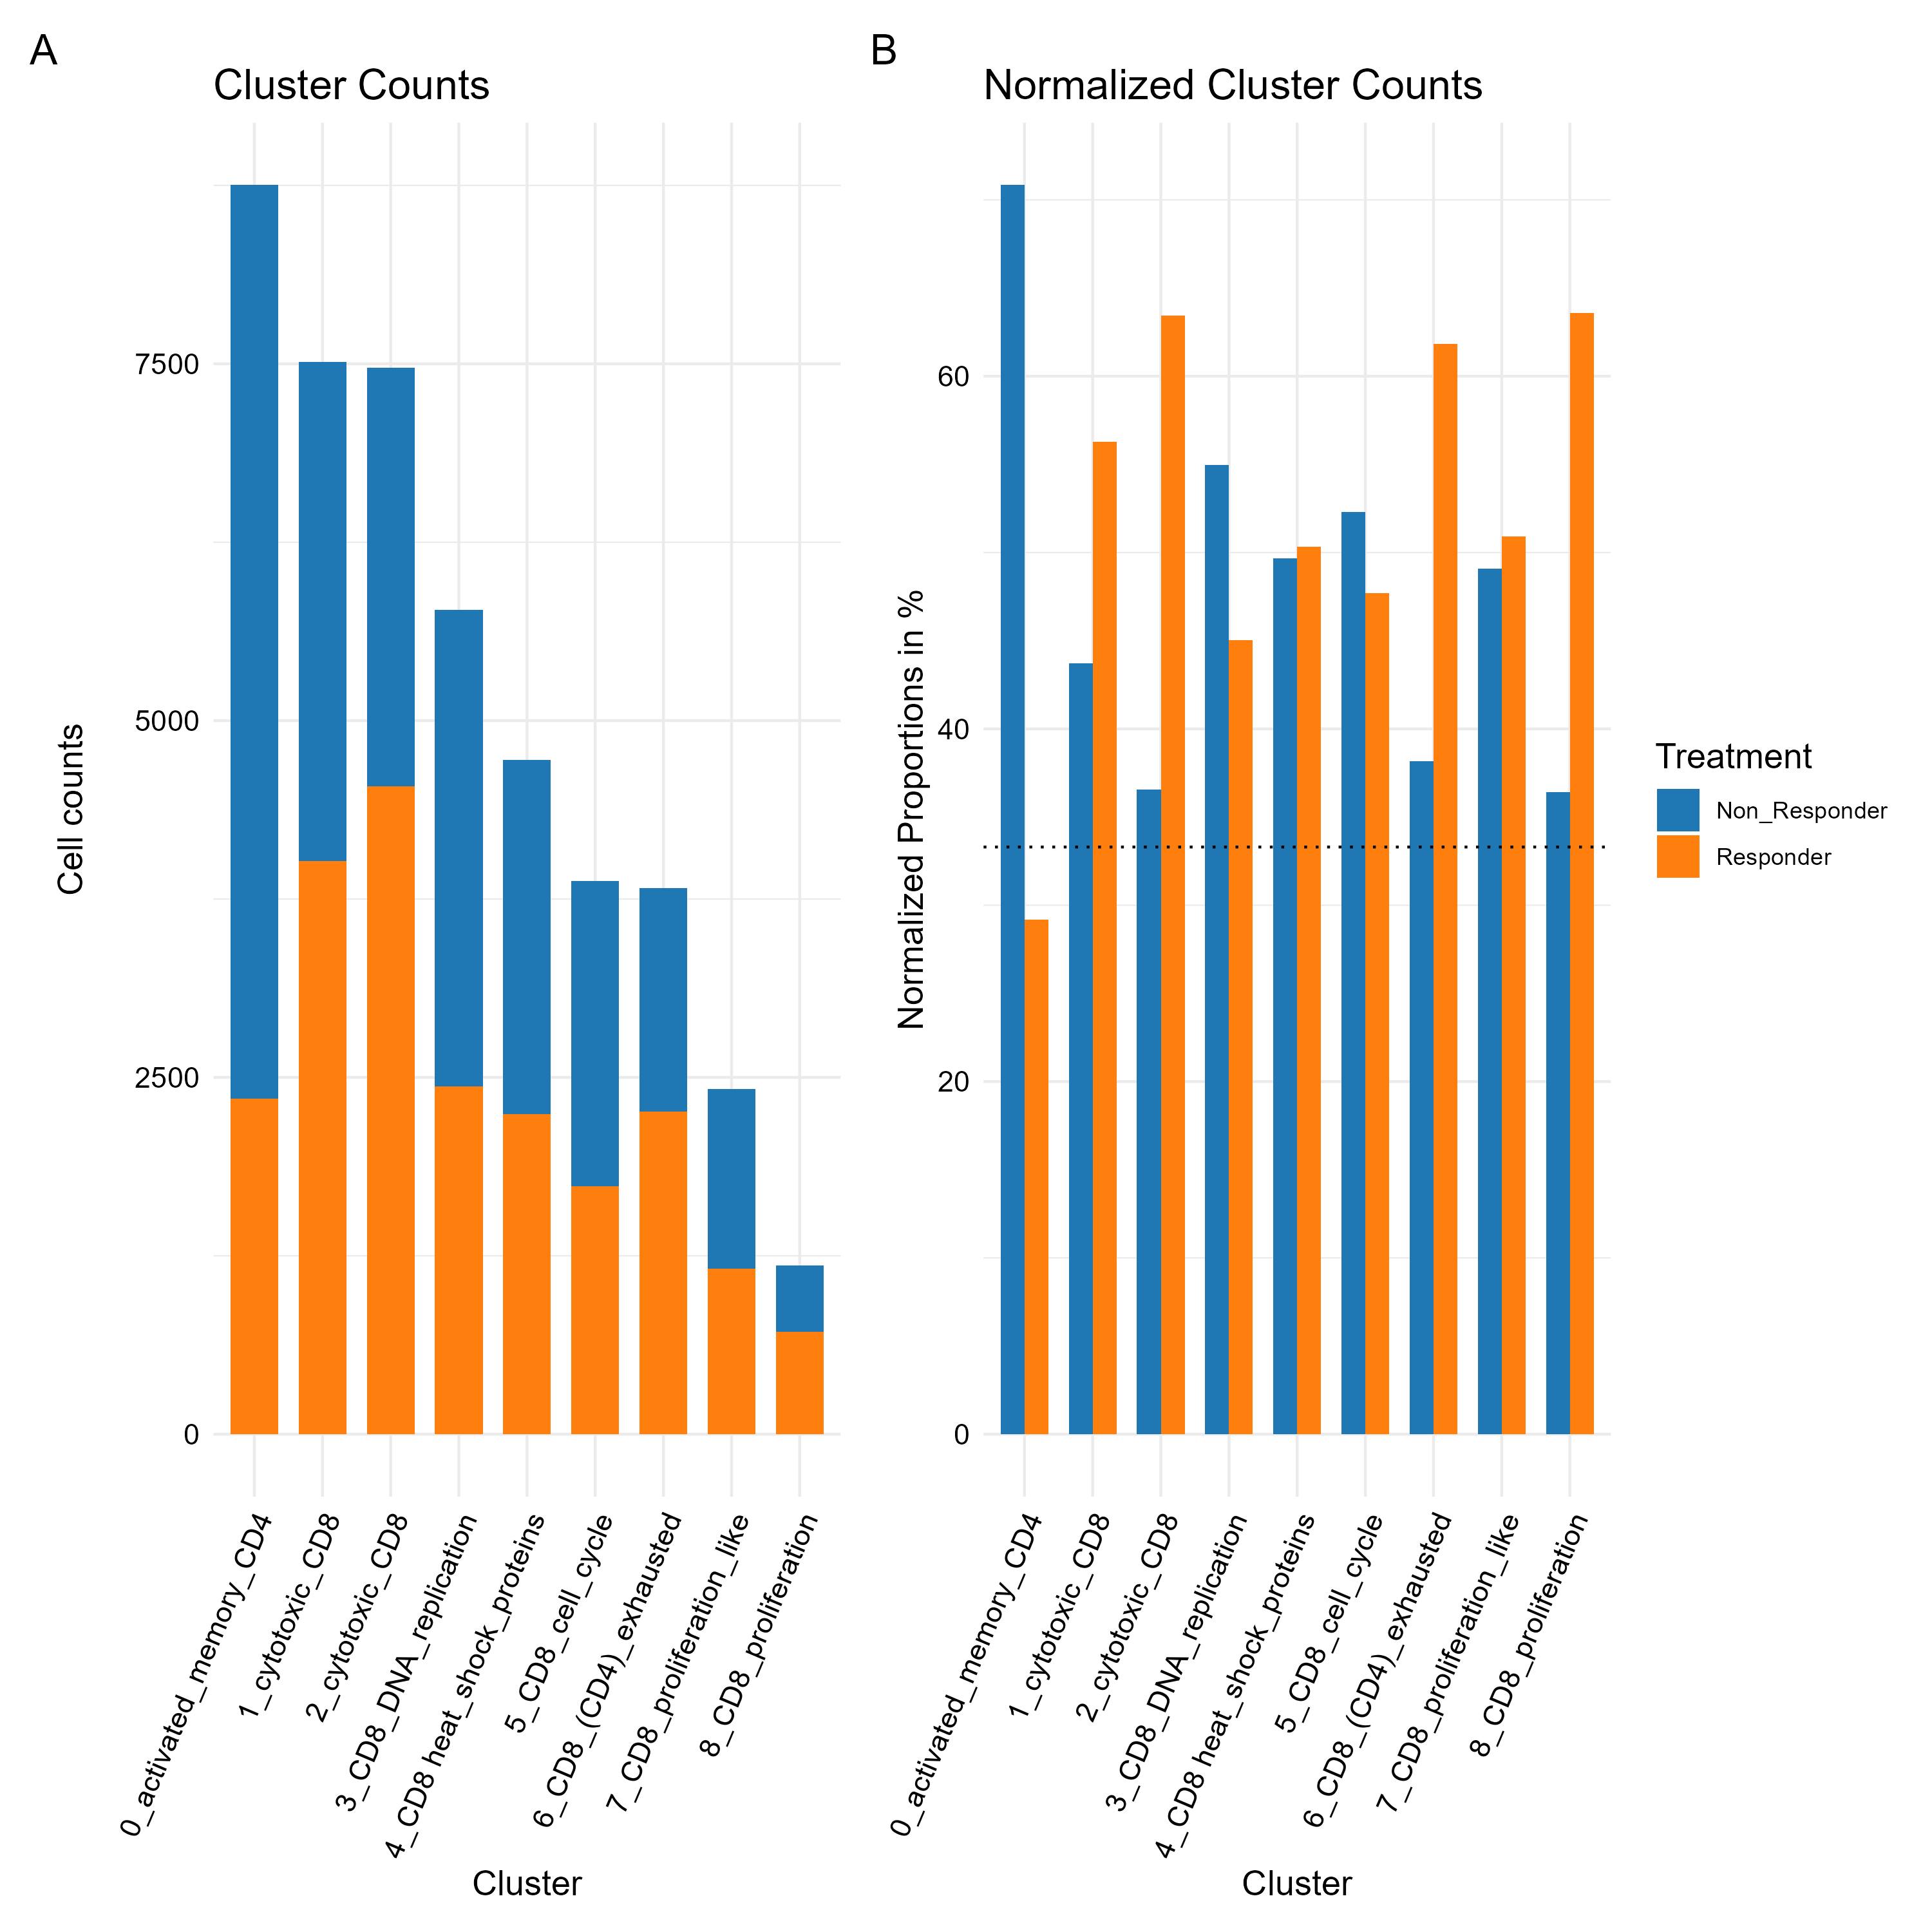
Cluster 0 (CD4/non responders)
zoom in analysis

Slide 19
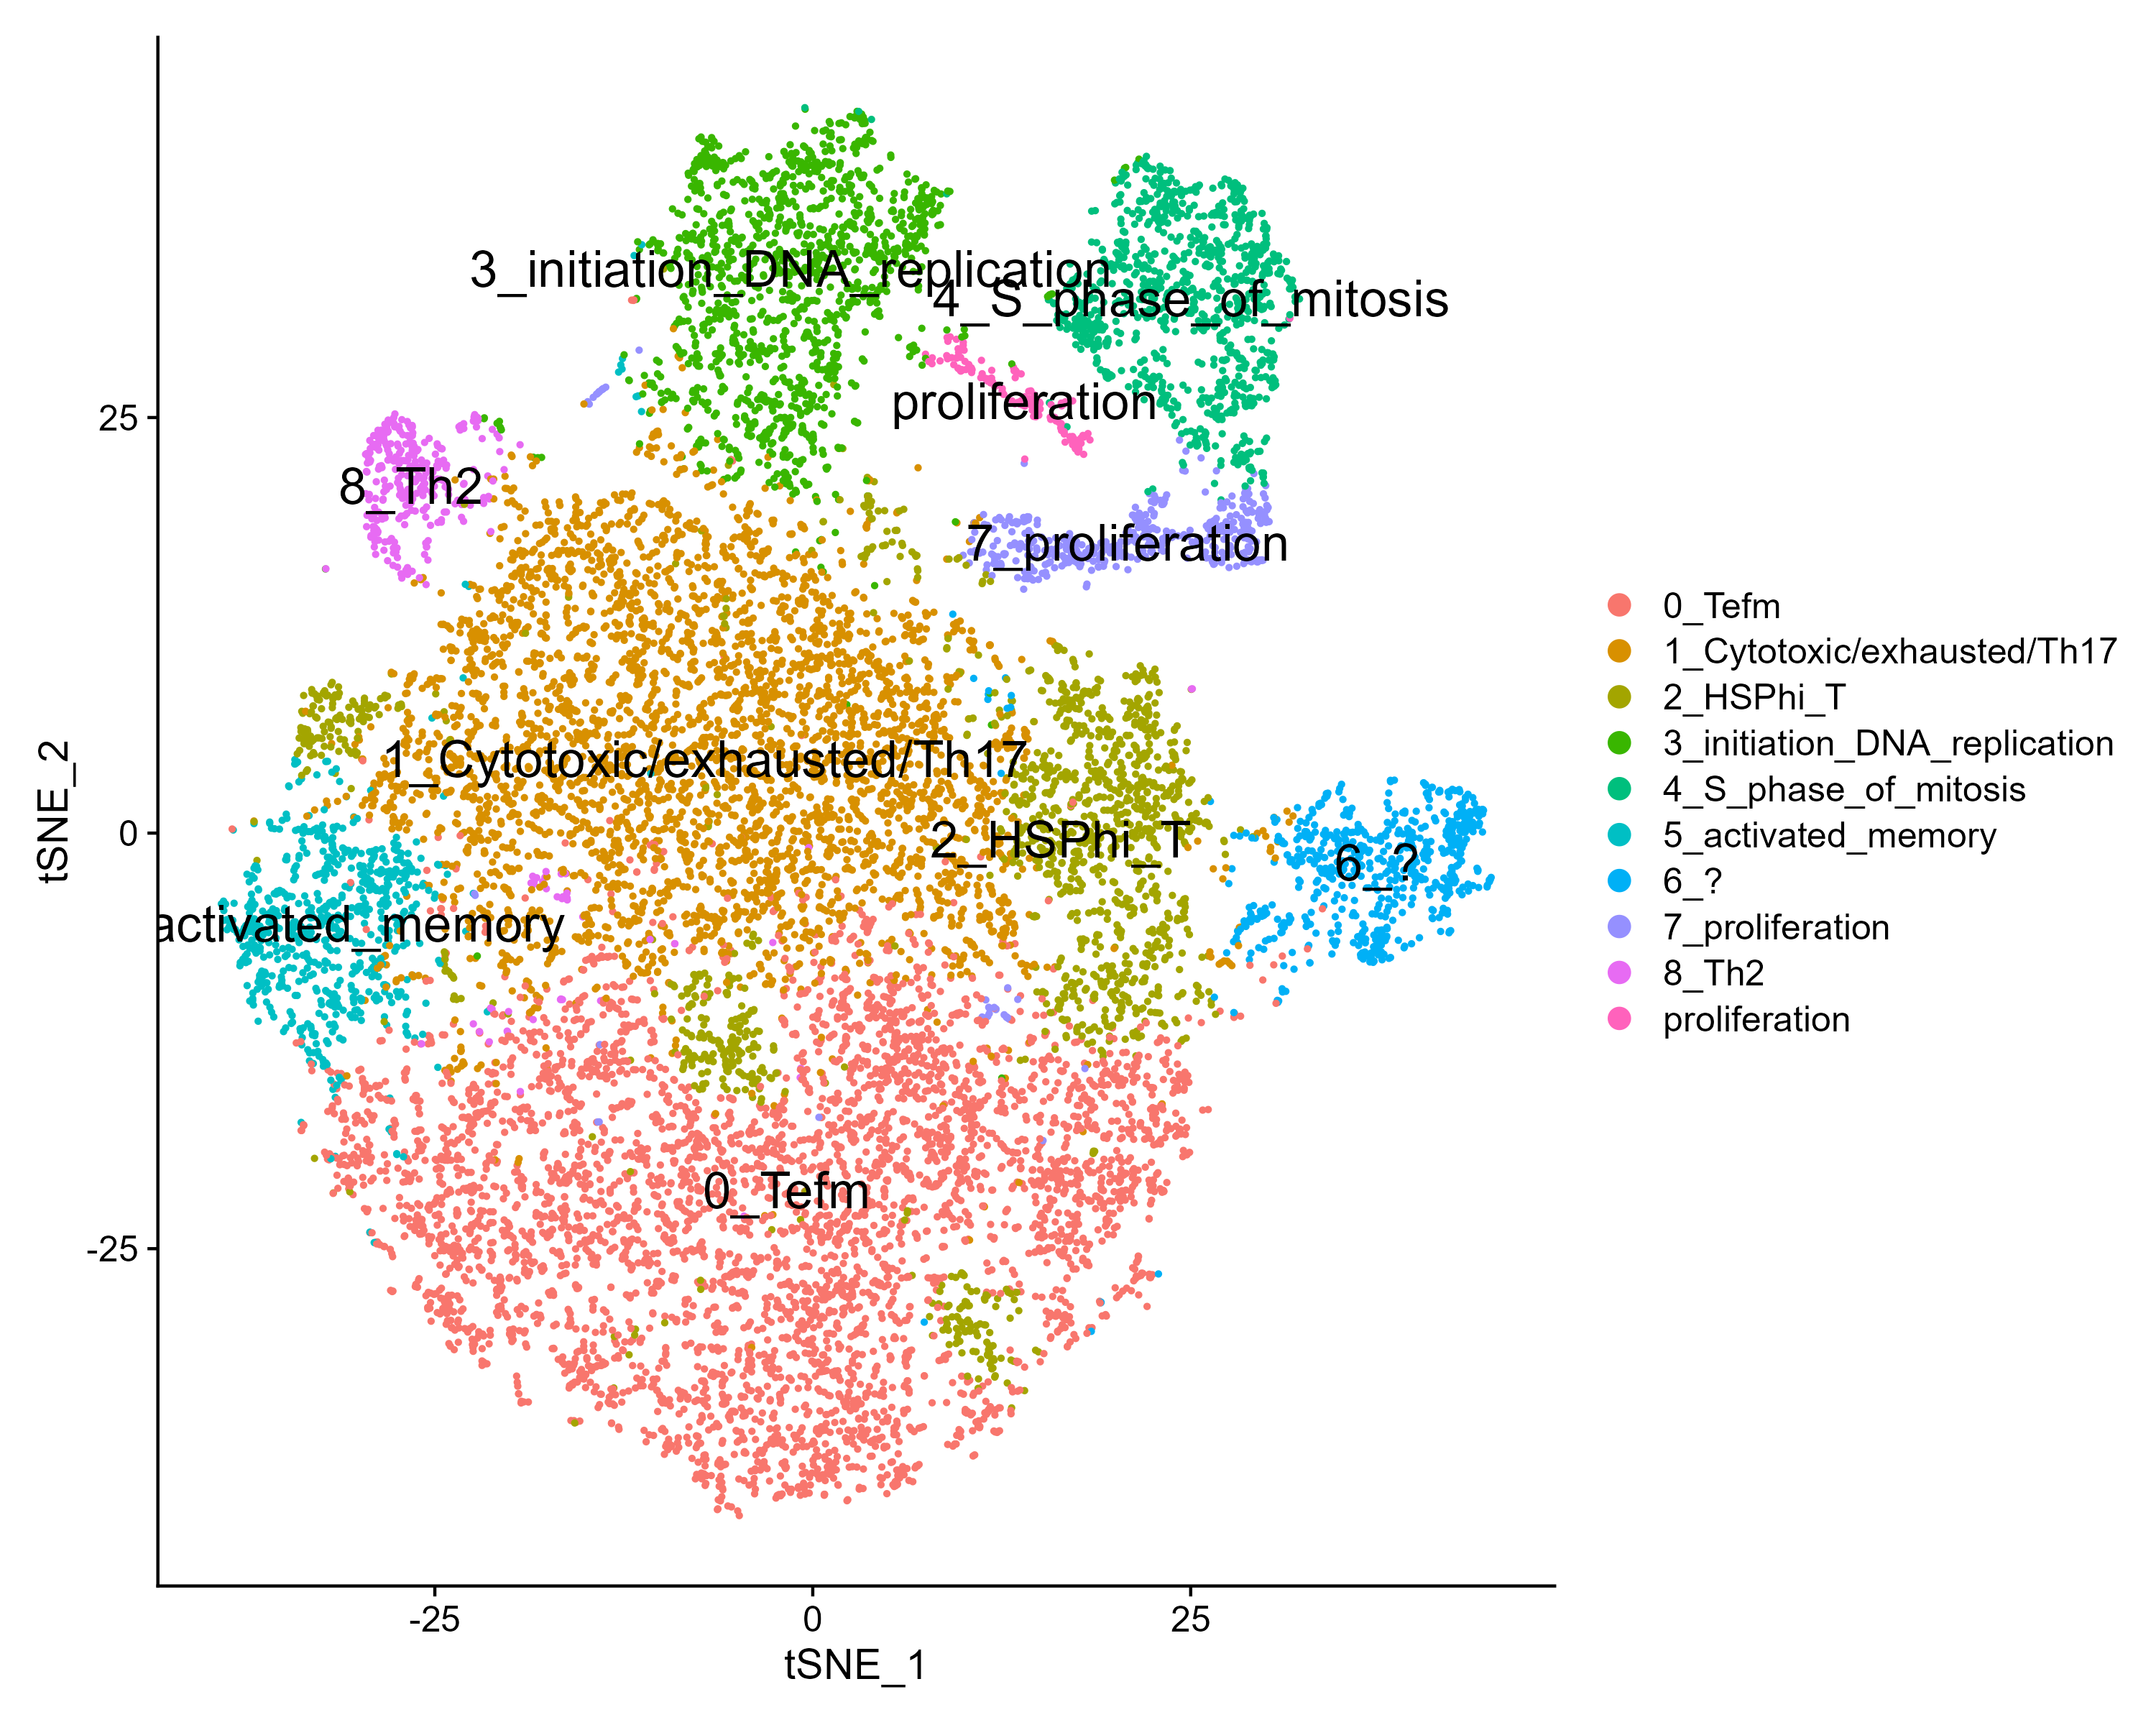
tSNE

Slide 20
Cluster 0 annotation

Slide 21
Cluster 1 annotation

Slide 22
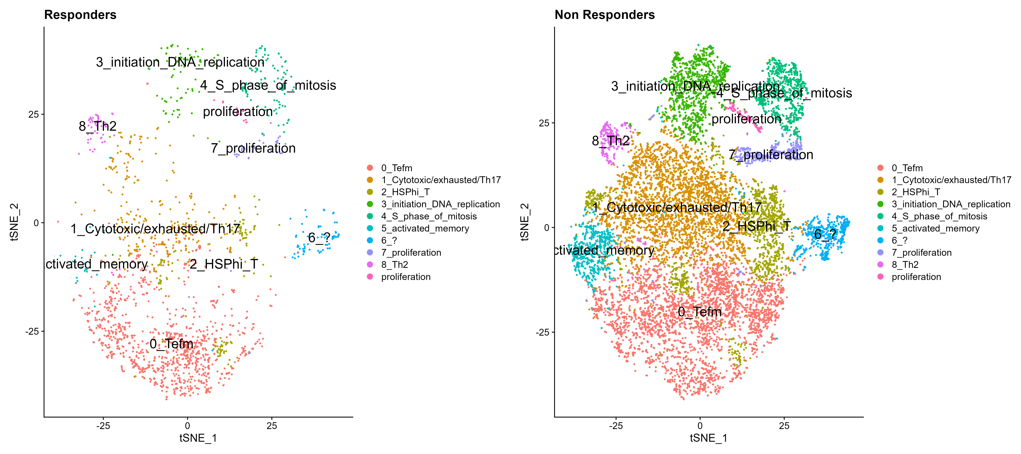
tSNE by response

Slide 23
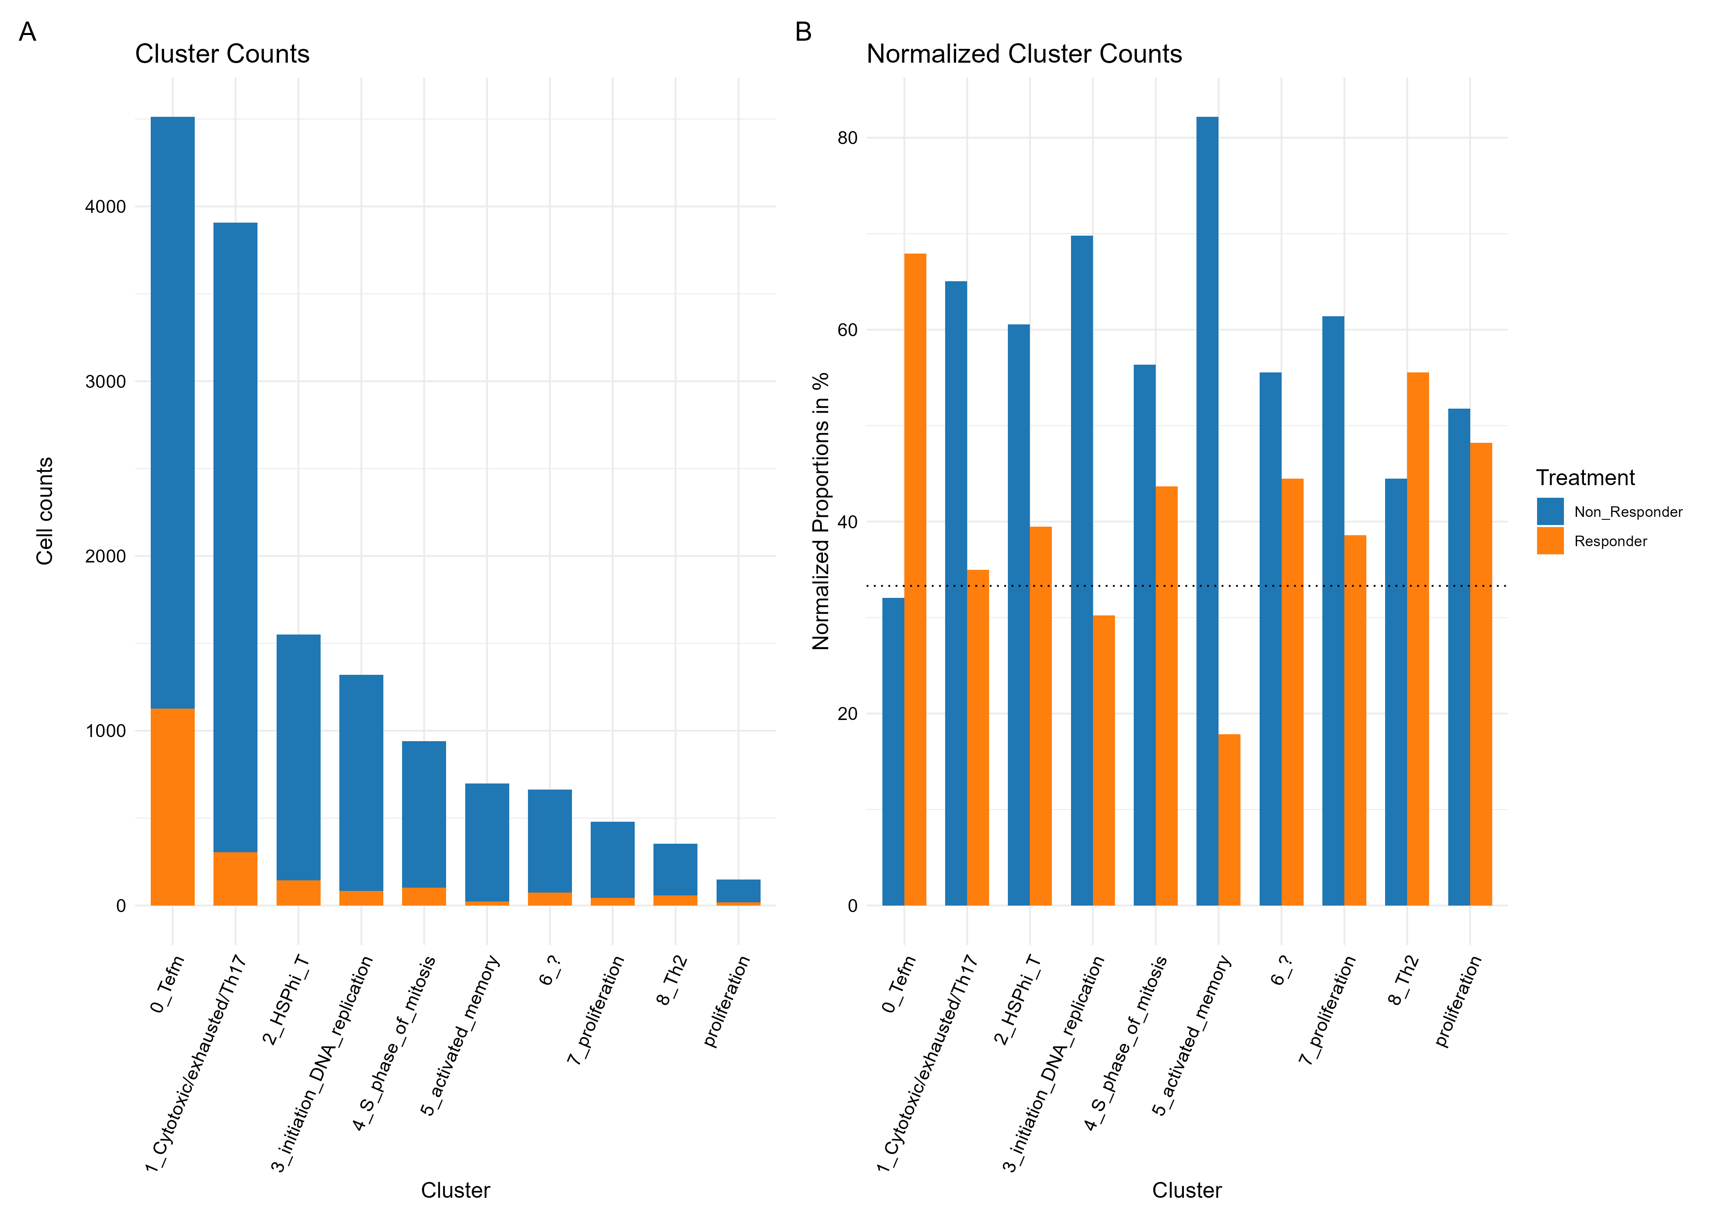

Slide 24
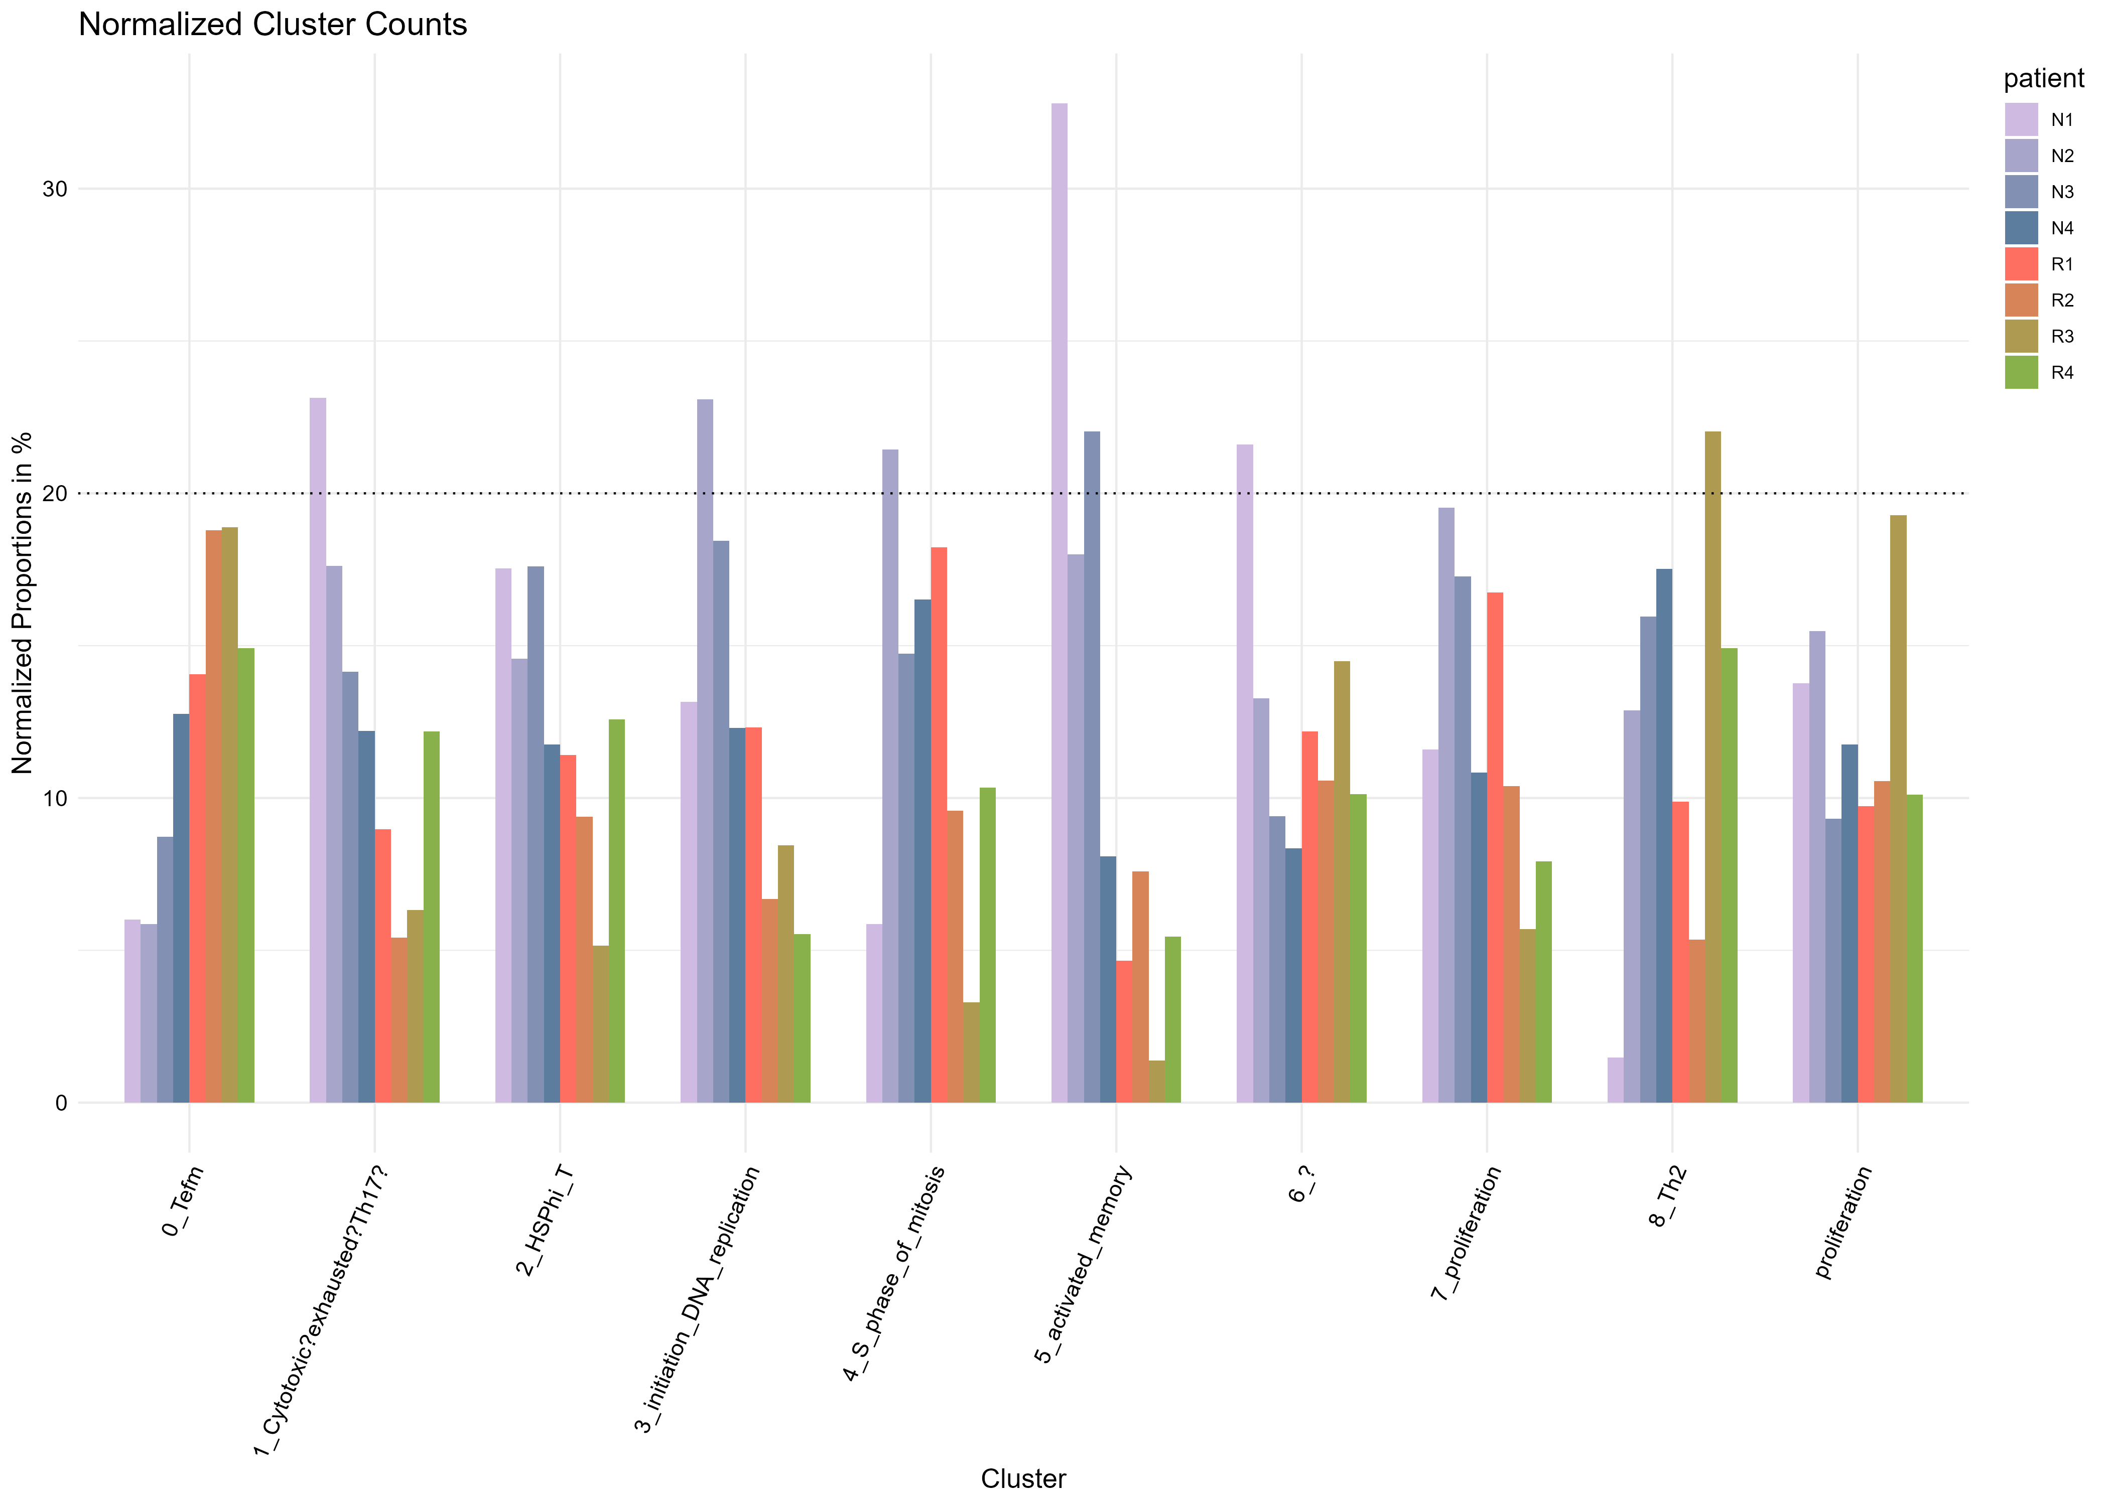
Contribution per patient

Slide 25
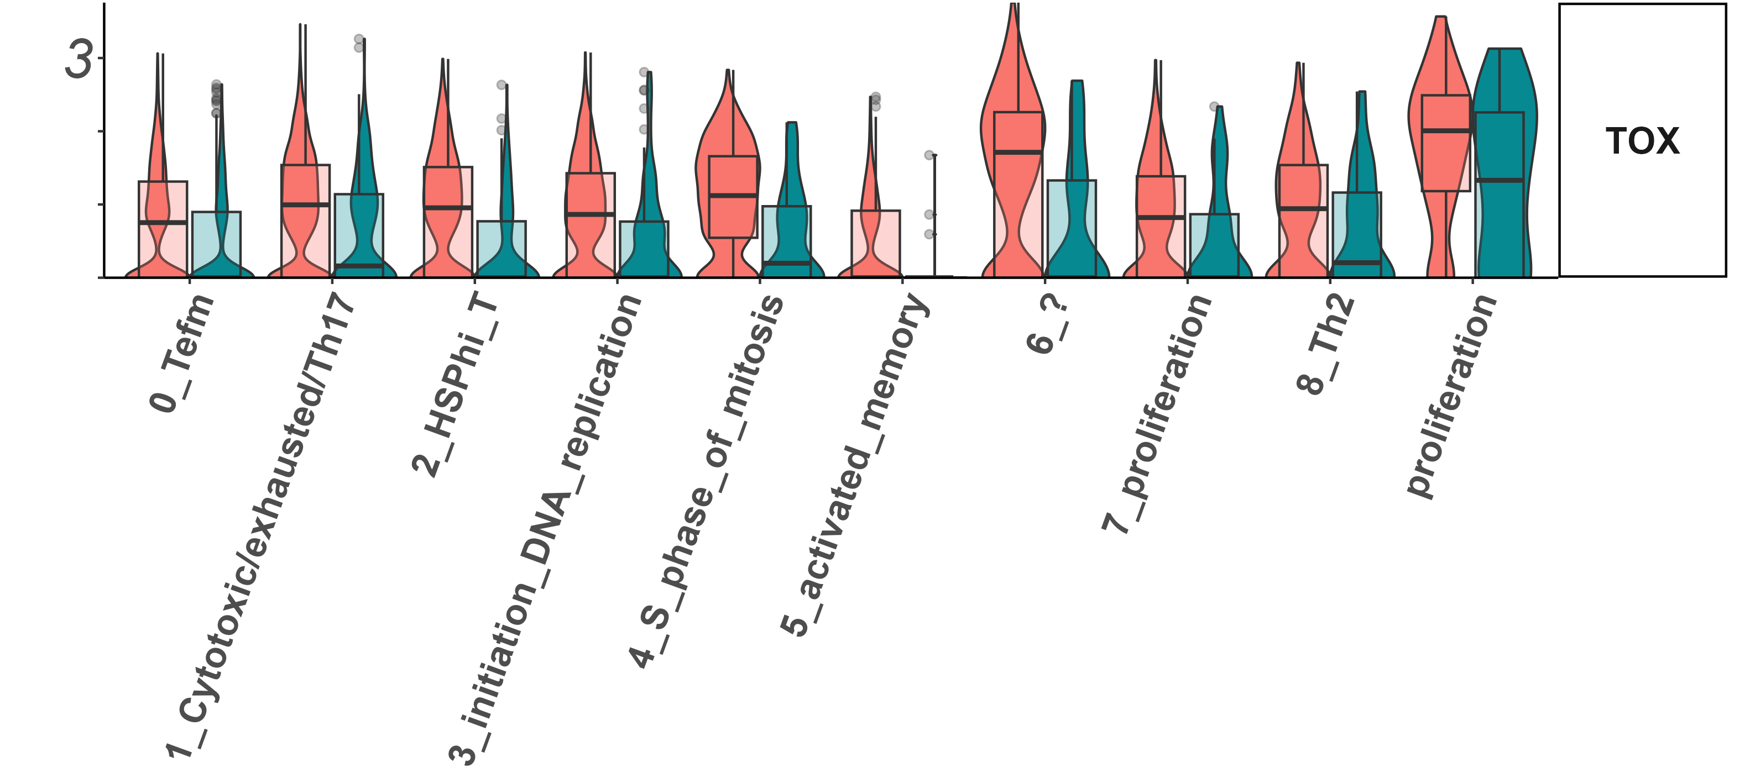
exhaustion markers
Tox

Slide 26
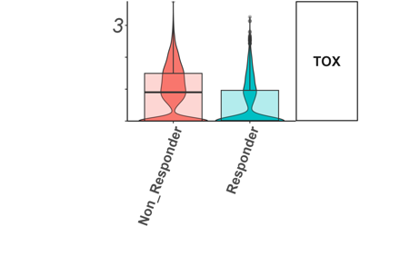

Slide 27
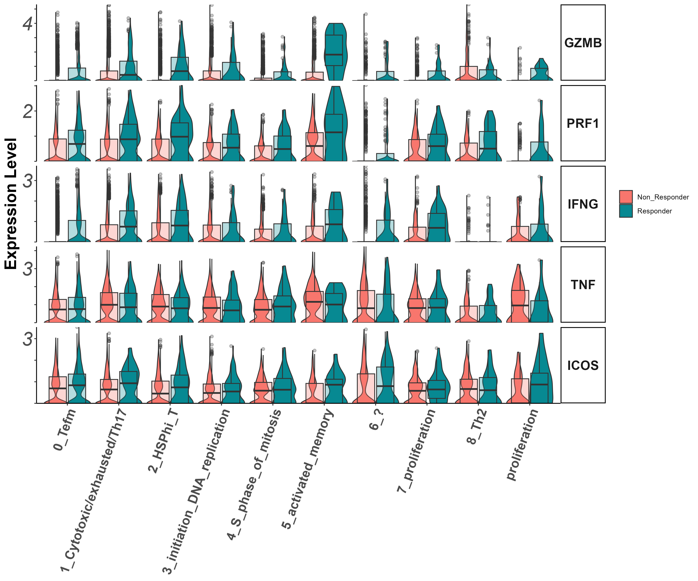
Effector markers
Gzmb, Prf1, Ifng, Tnf, Icos

Slide 28
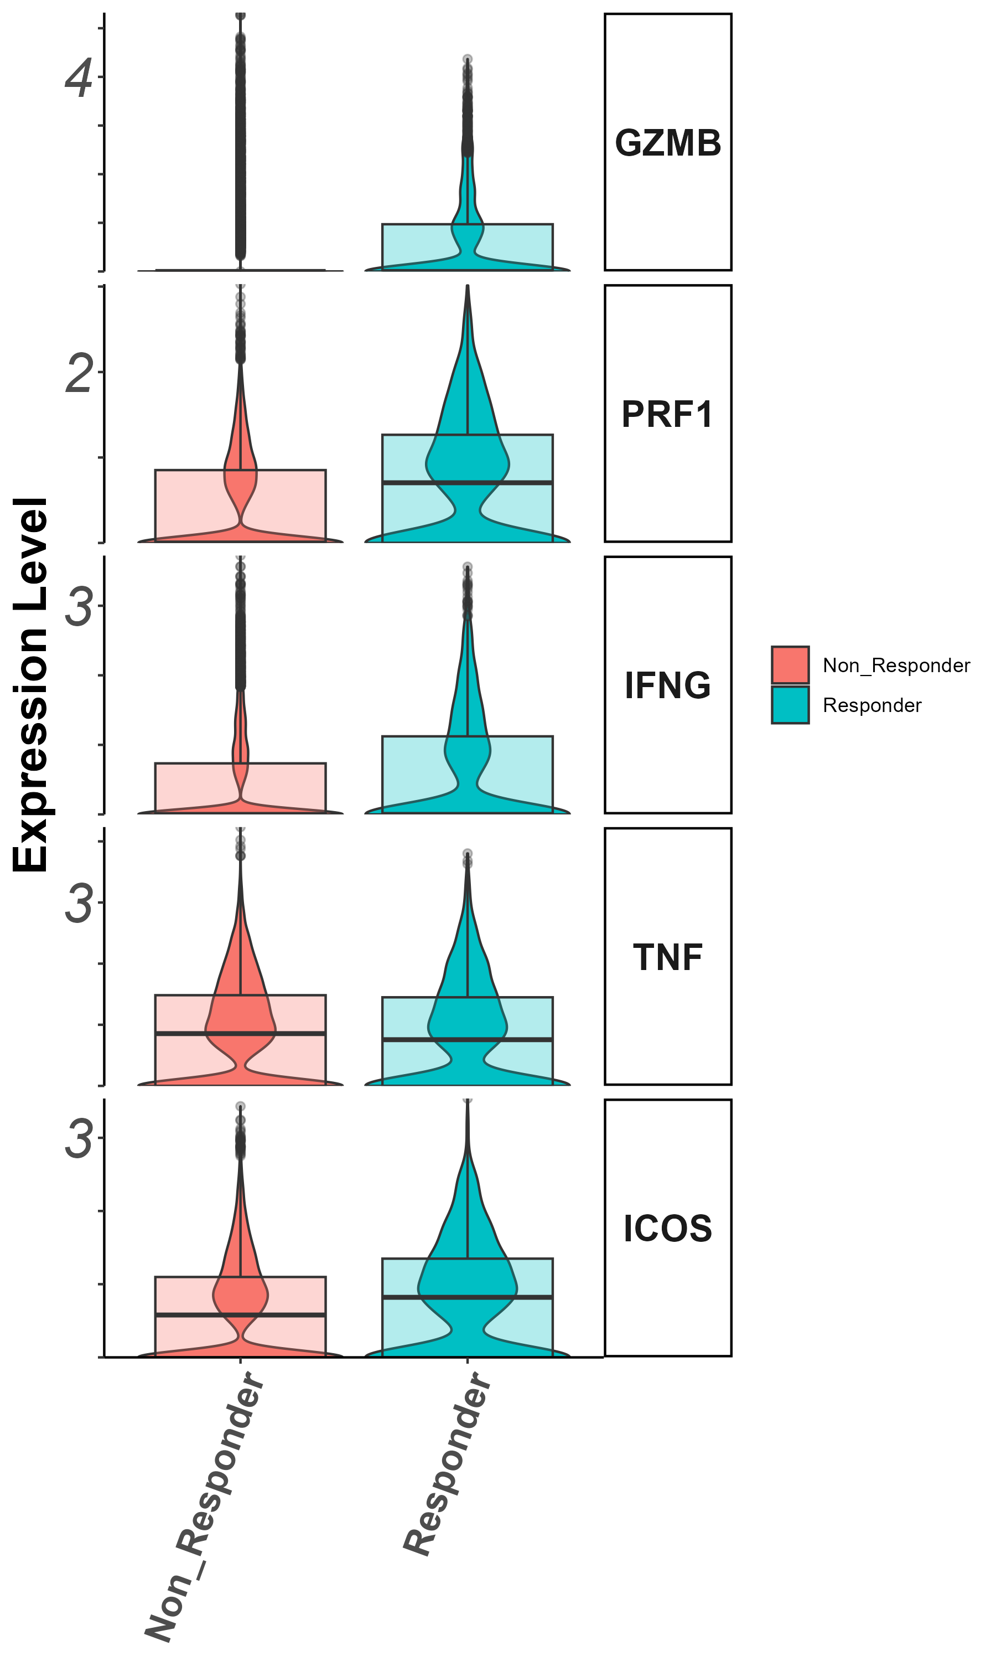
Effector markers

Slide 29
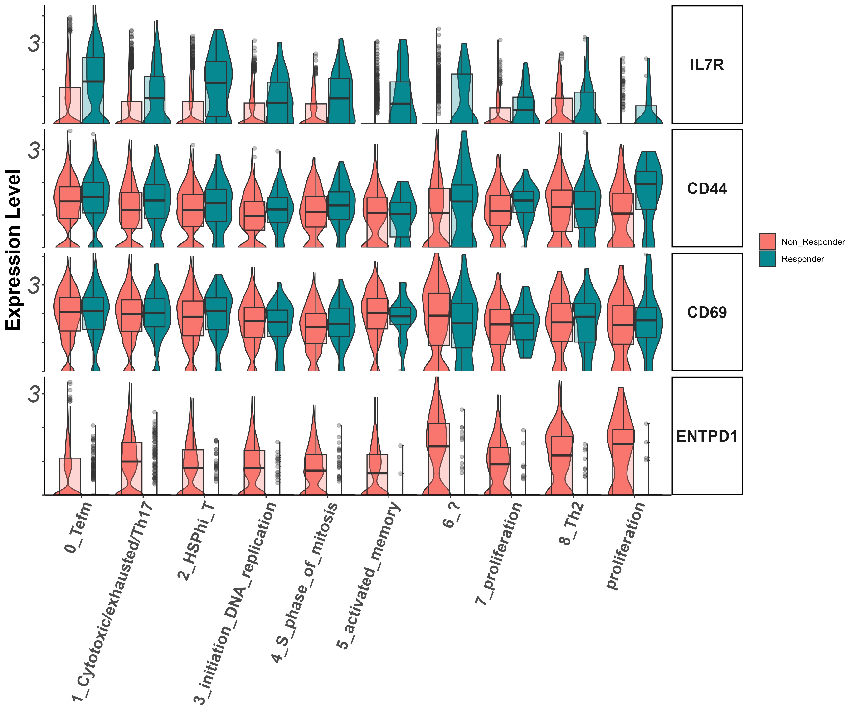
Stem/persister/naïve markers
Il7r, CD44, CD39, CD69

Slide 30
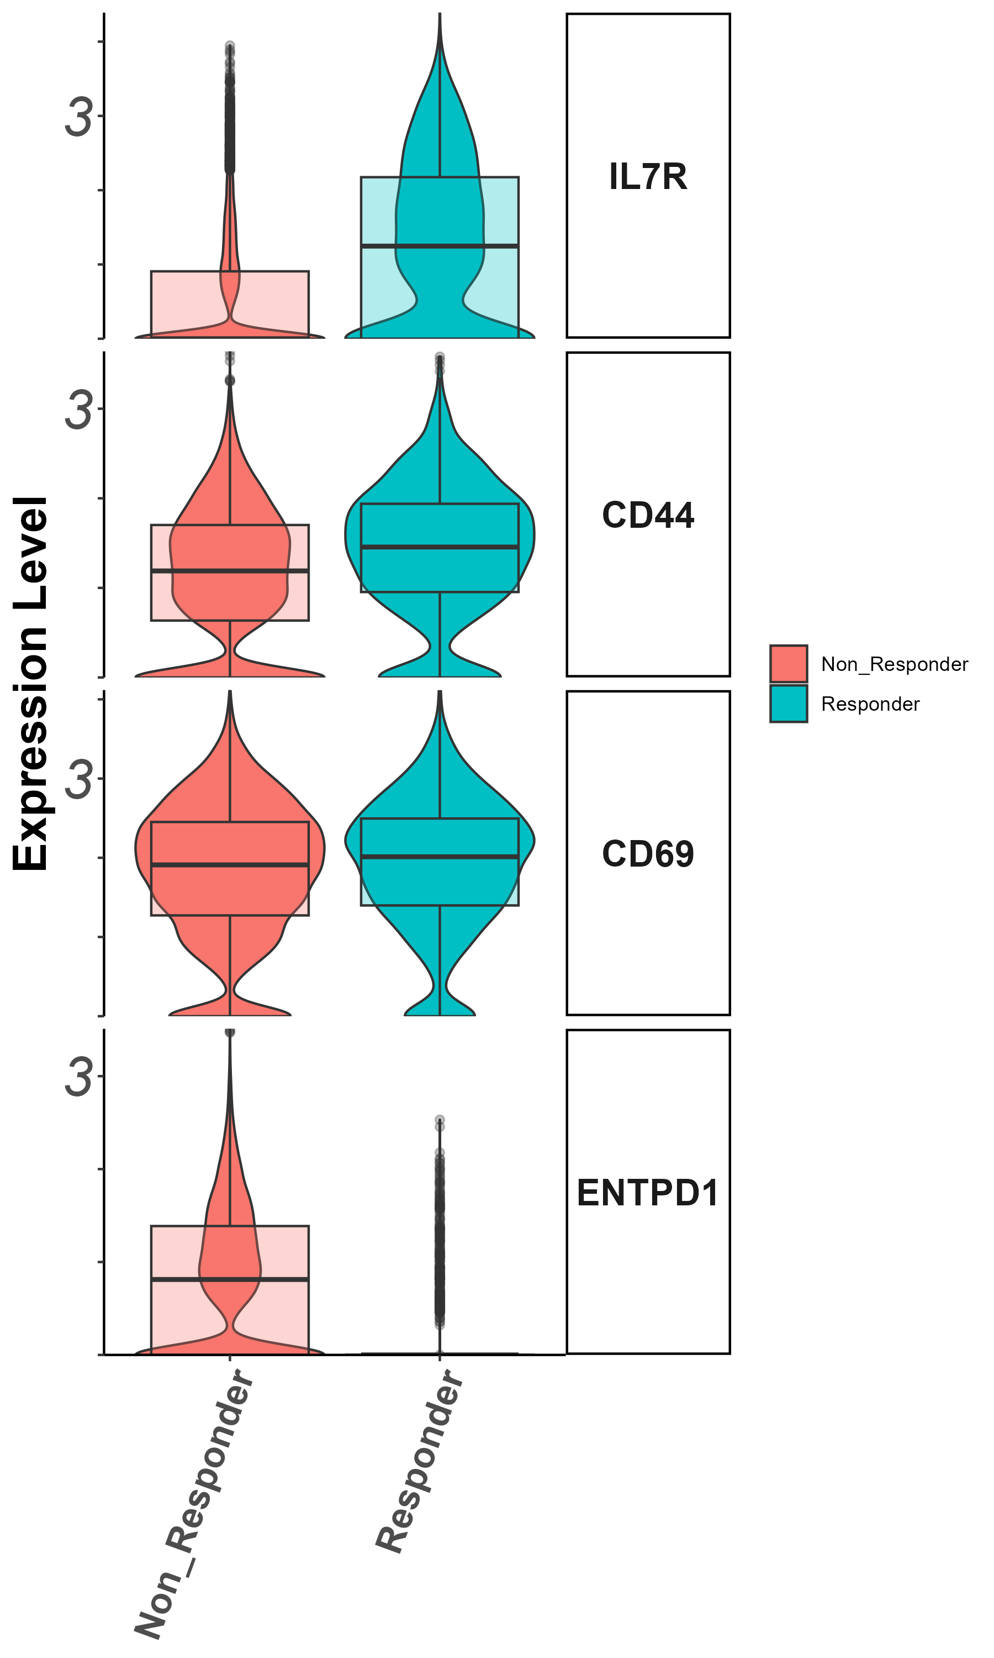
Stem/persister/naïve markers

Slide 31
Summary cluster 0
Il7r : higher in responders – important anchor

Slide 32
Cluster 1 (cytotoxic CD8)
zoom in analysis

Slide 33
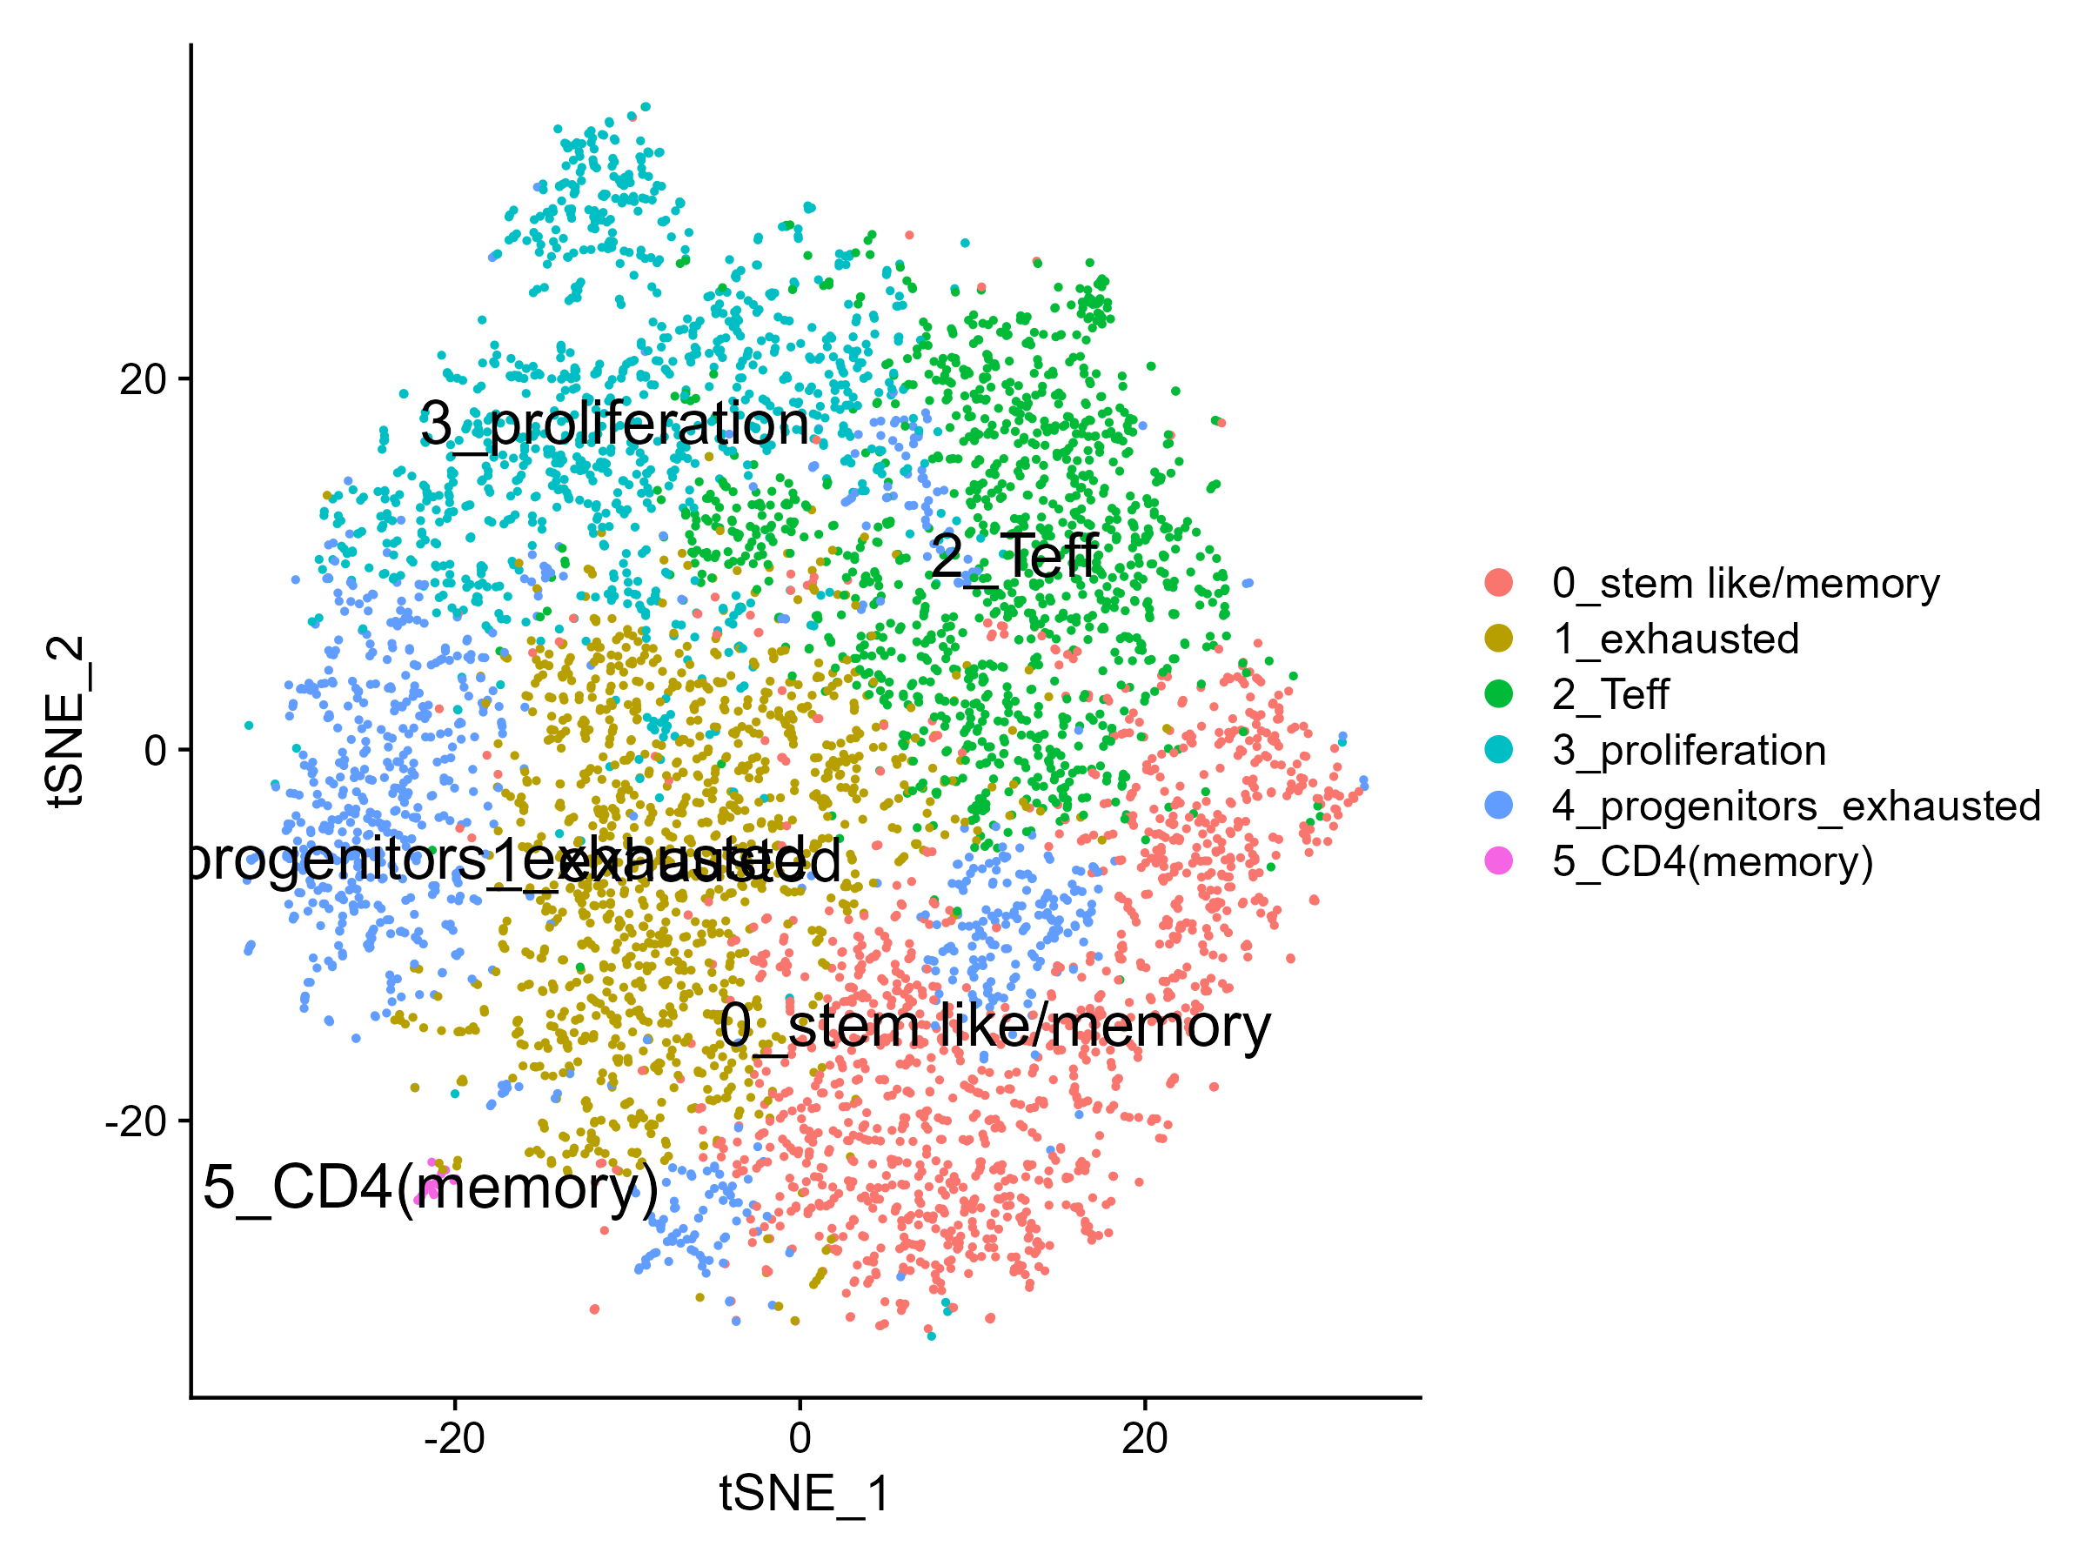
tSNE

Slide 34
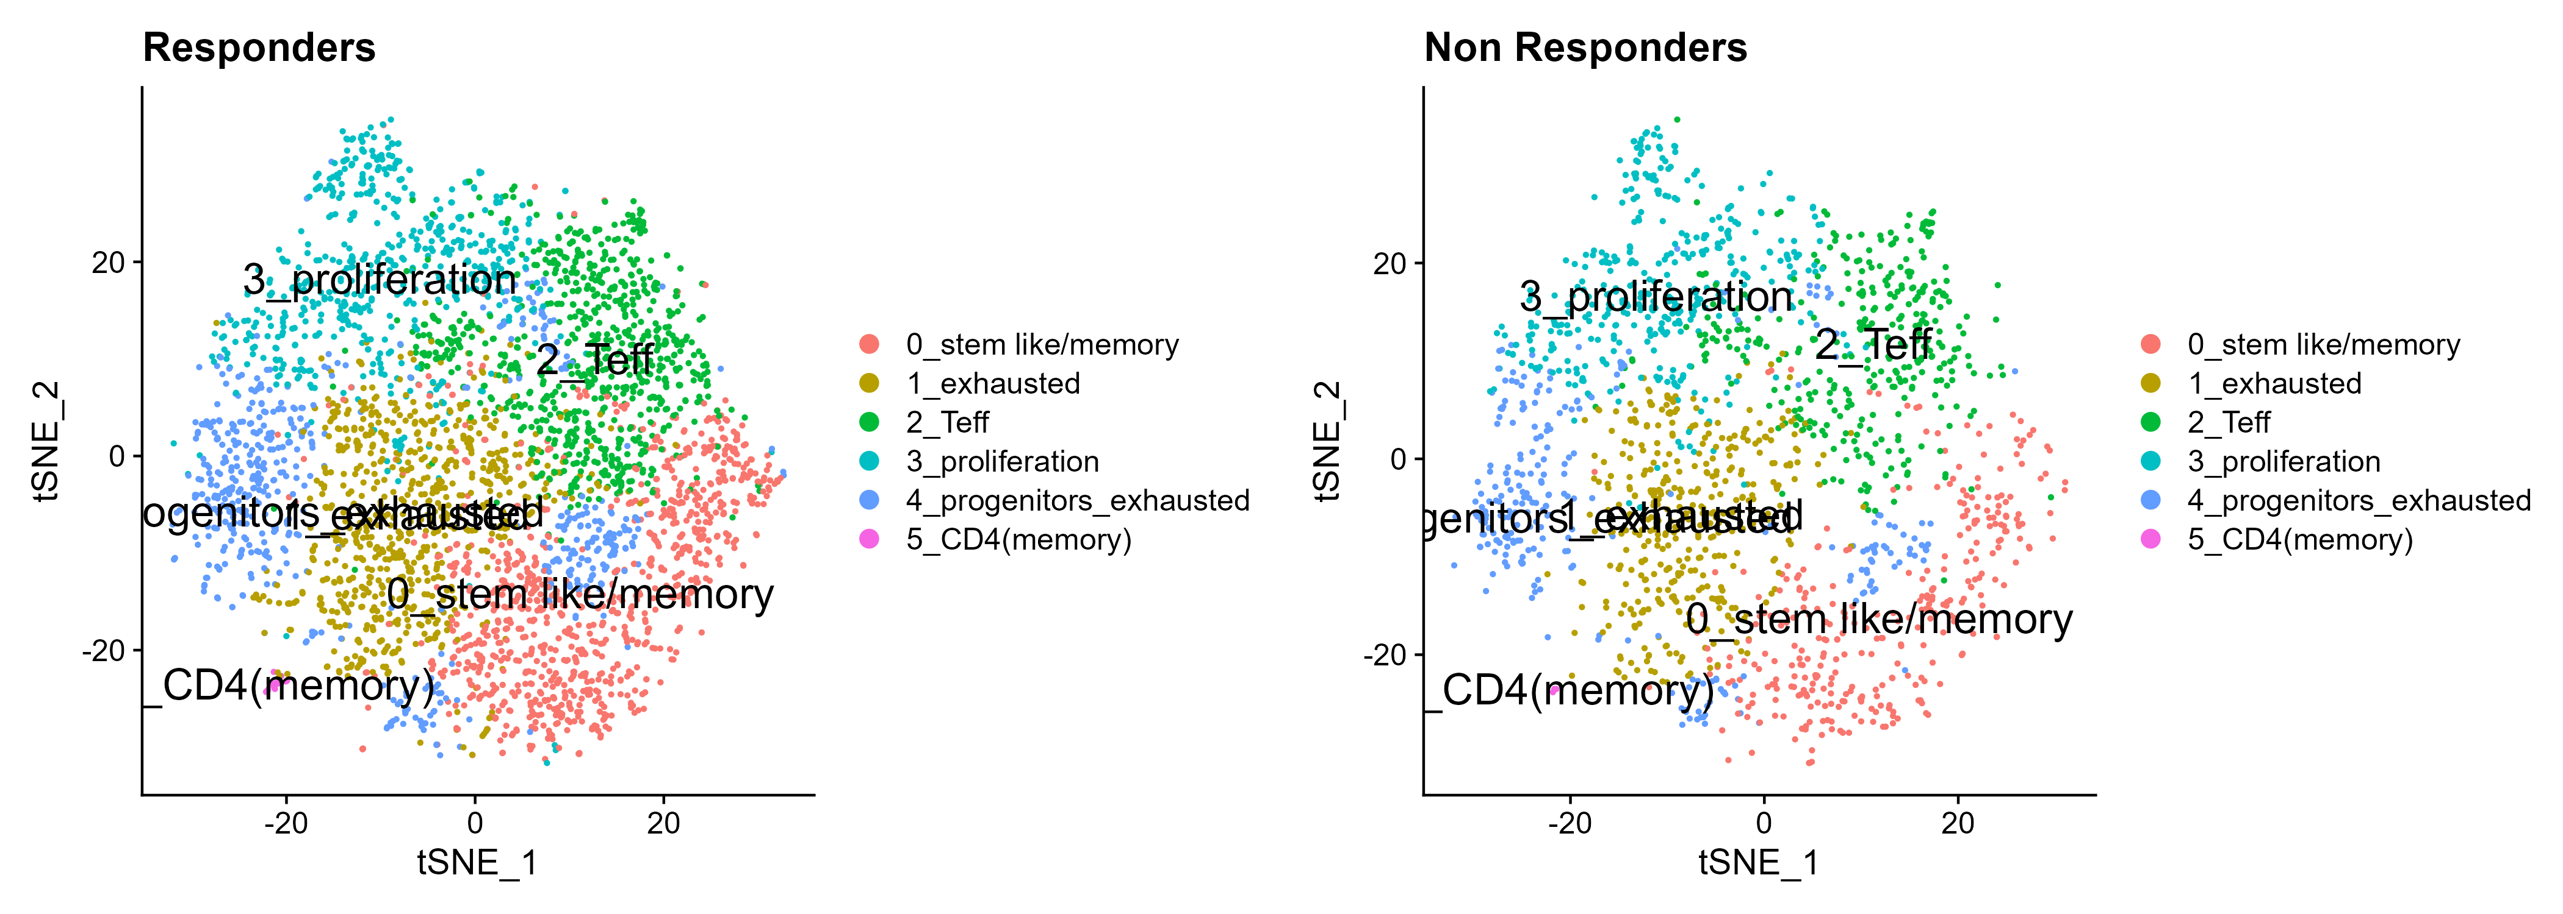
tSNE by response

Slide 35
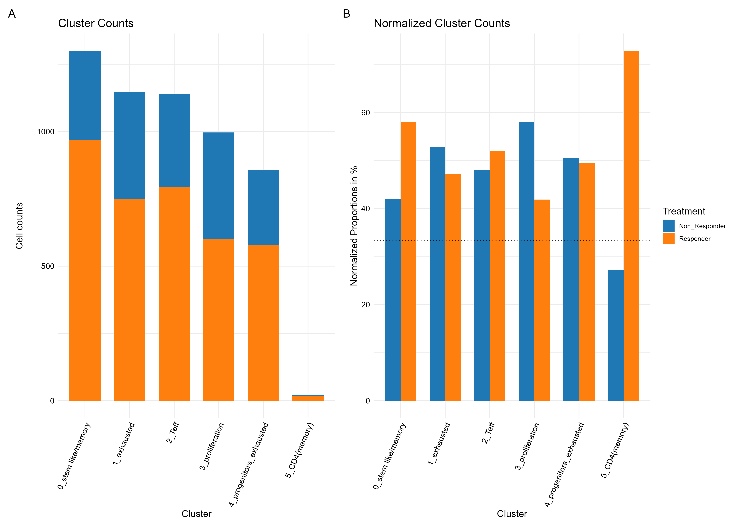

Slide 36
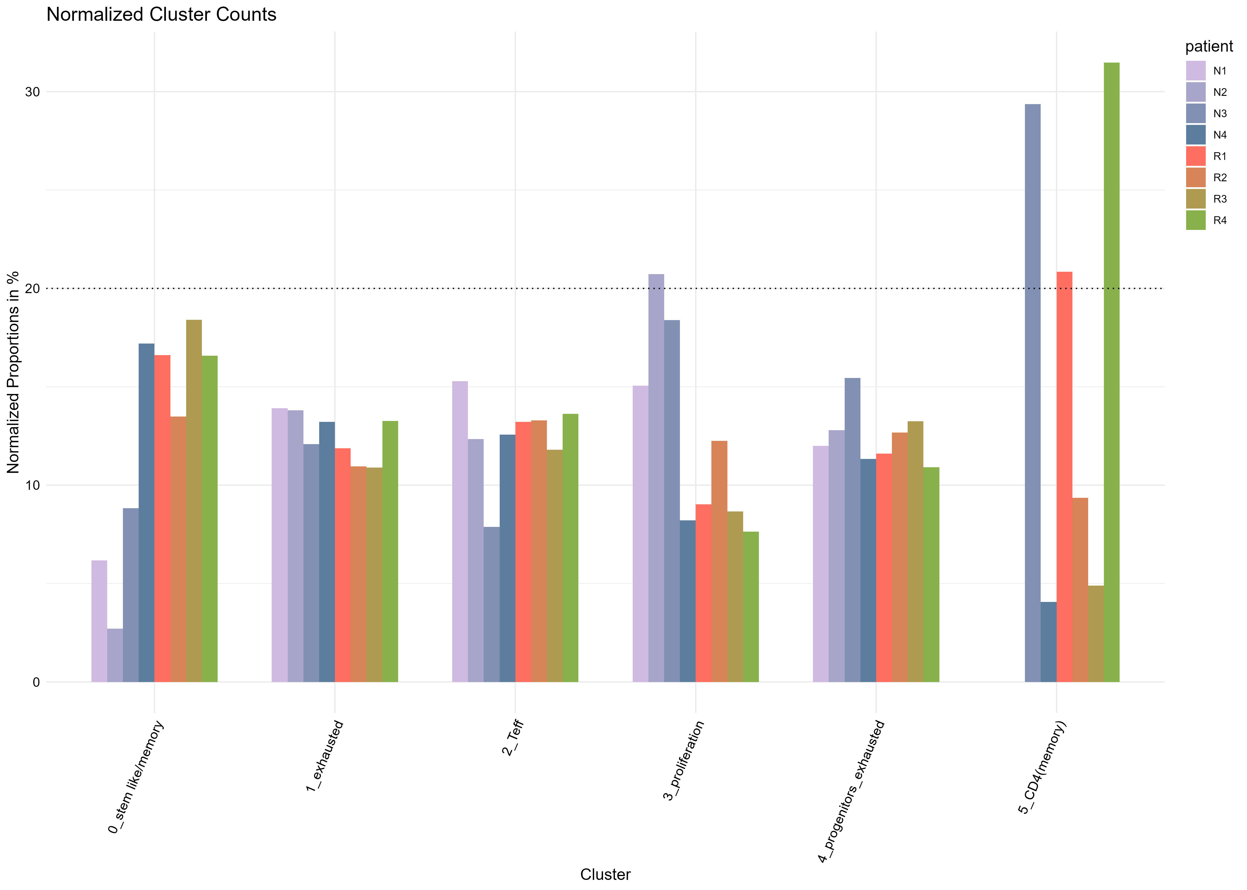
Contribution per patient

Slide 37
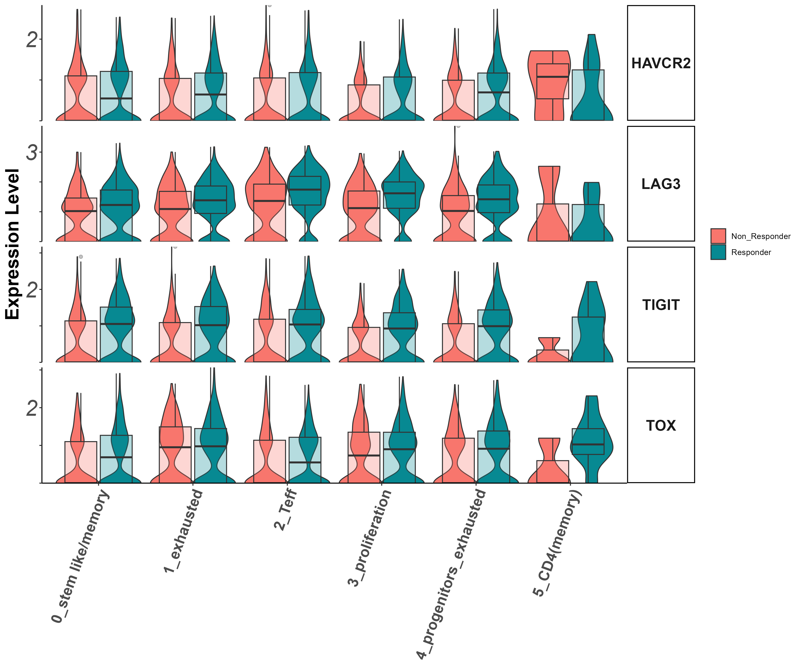
exhaustion markers
Tigit, Lag3, Havcr2, Tox

Slide 38
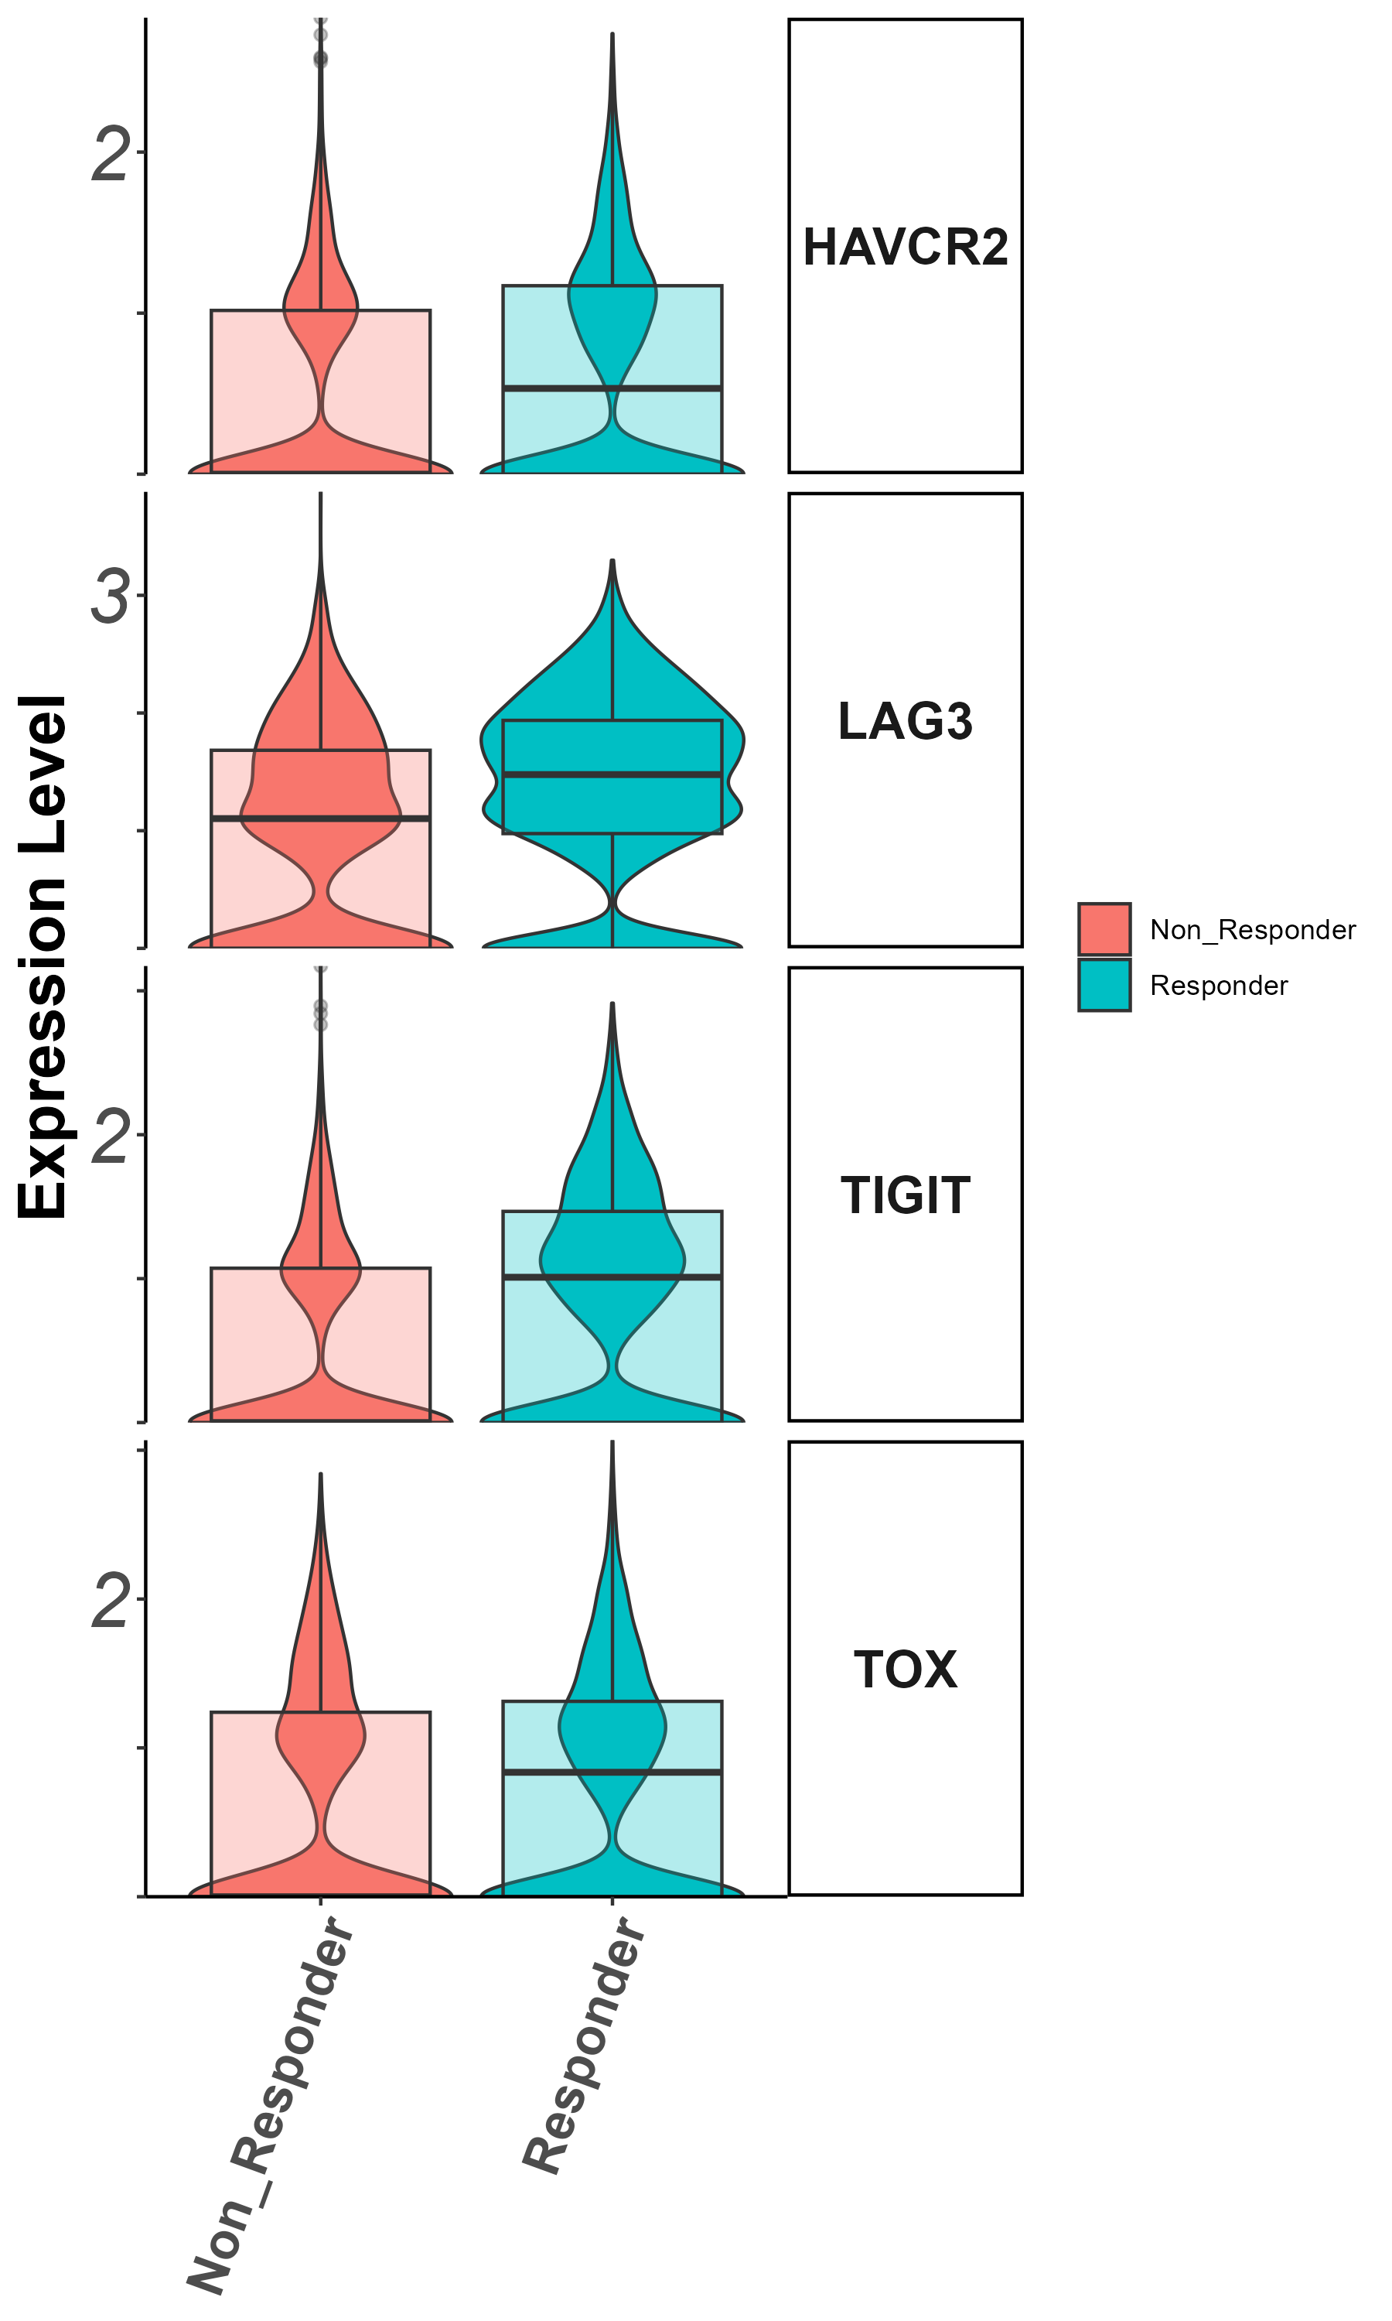
exhaustion markers

Slide 39
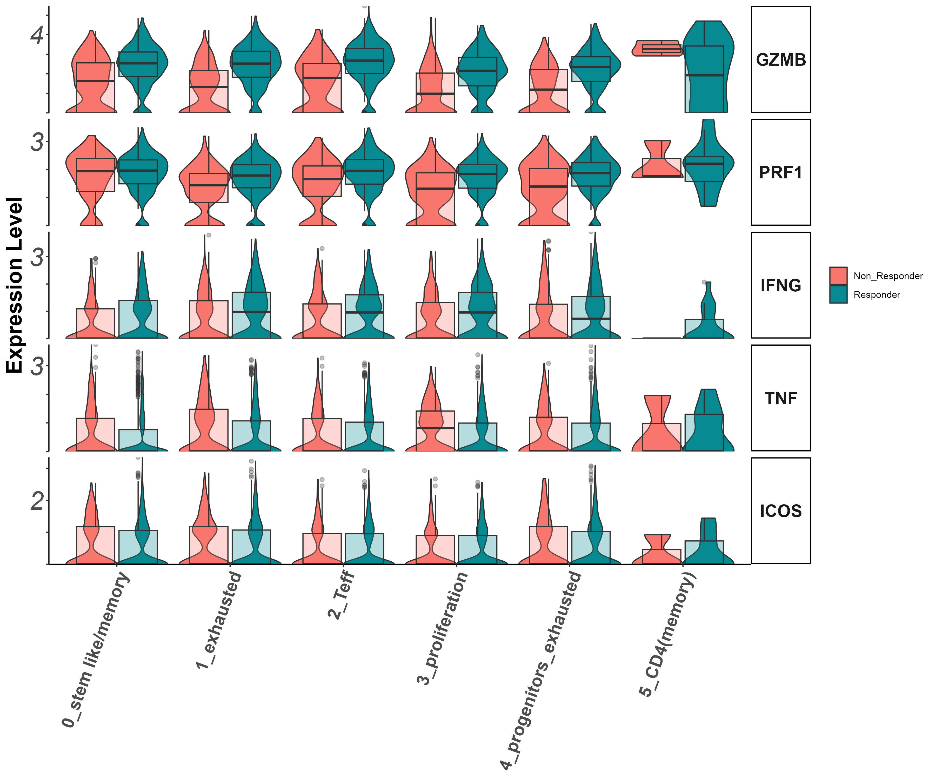
Effector markers
Gzmb, Prf1, Ifng, Tnf, Icos

Slide 40
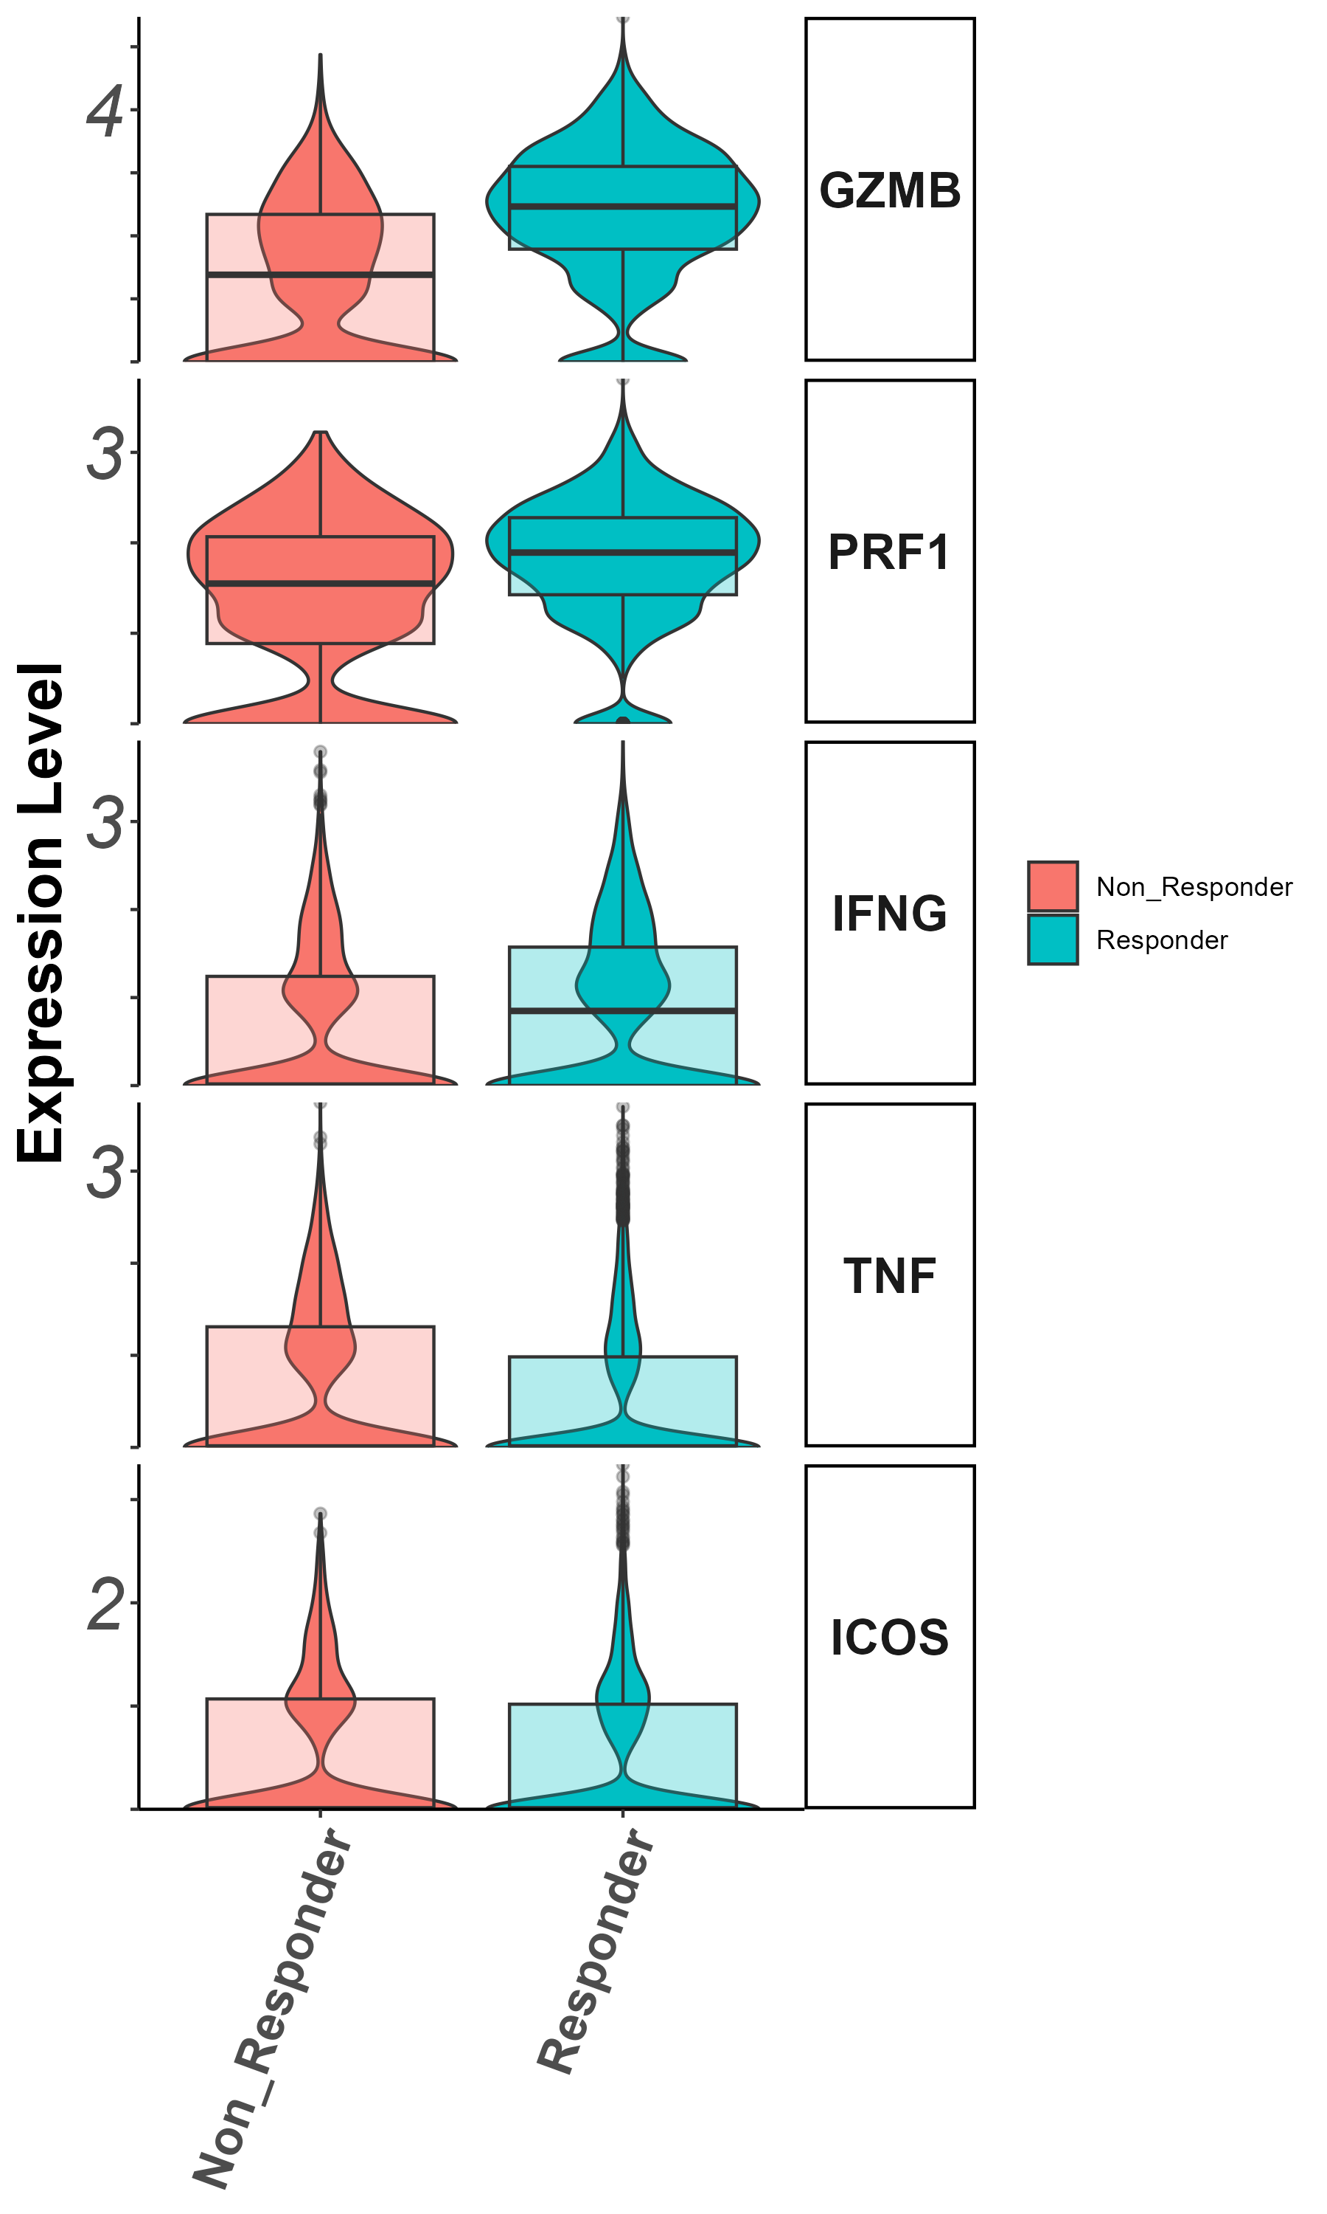

Slide 41
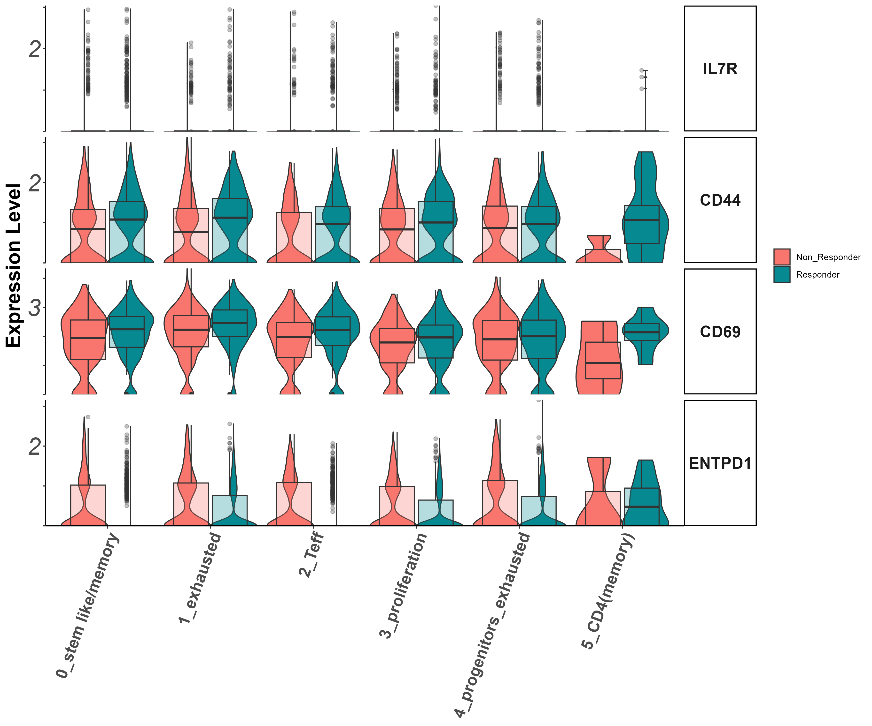
Stem/persister/naïve markers
Il7r, CD44, CD39, CD69

Slide 42
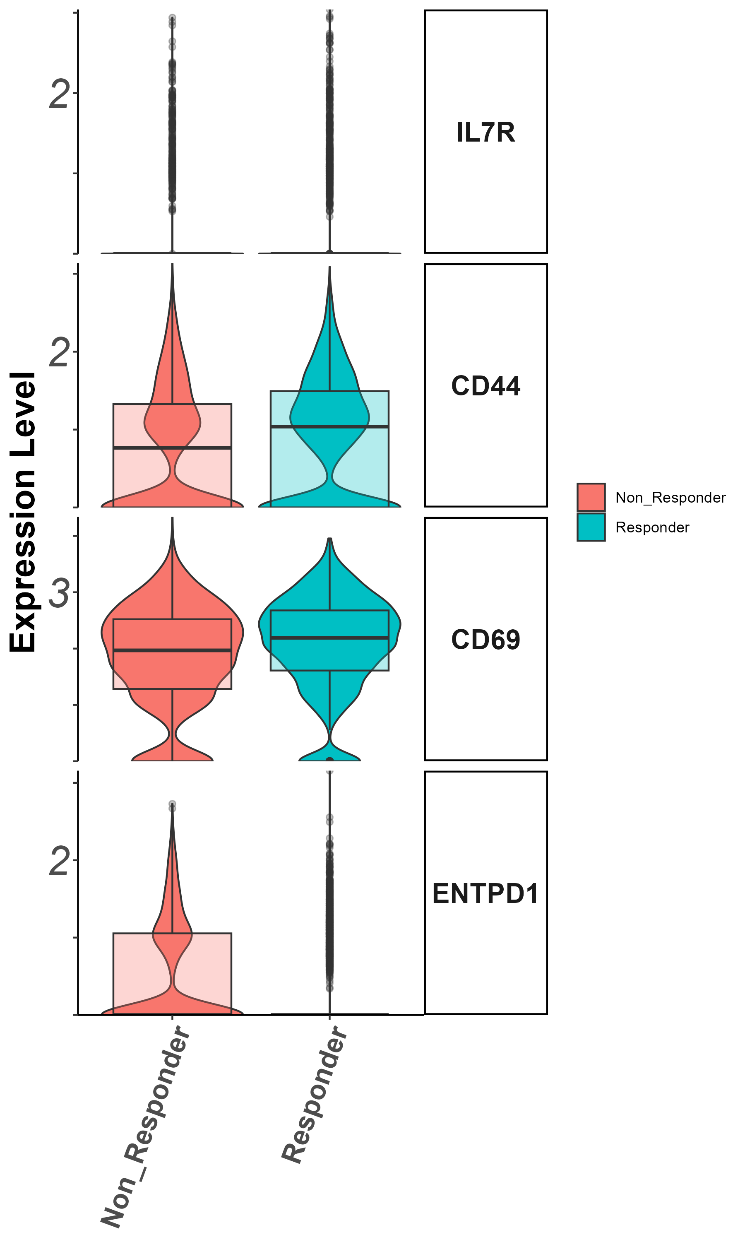
Stem/persister/naïve markers
Il7r, CD44, CD39, CD69

Slide 43
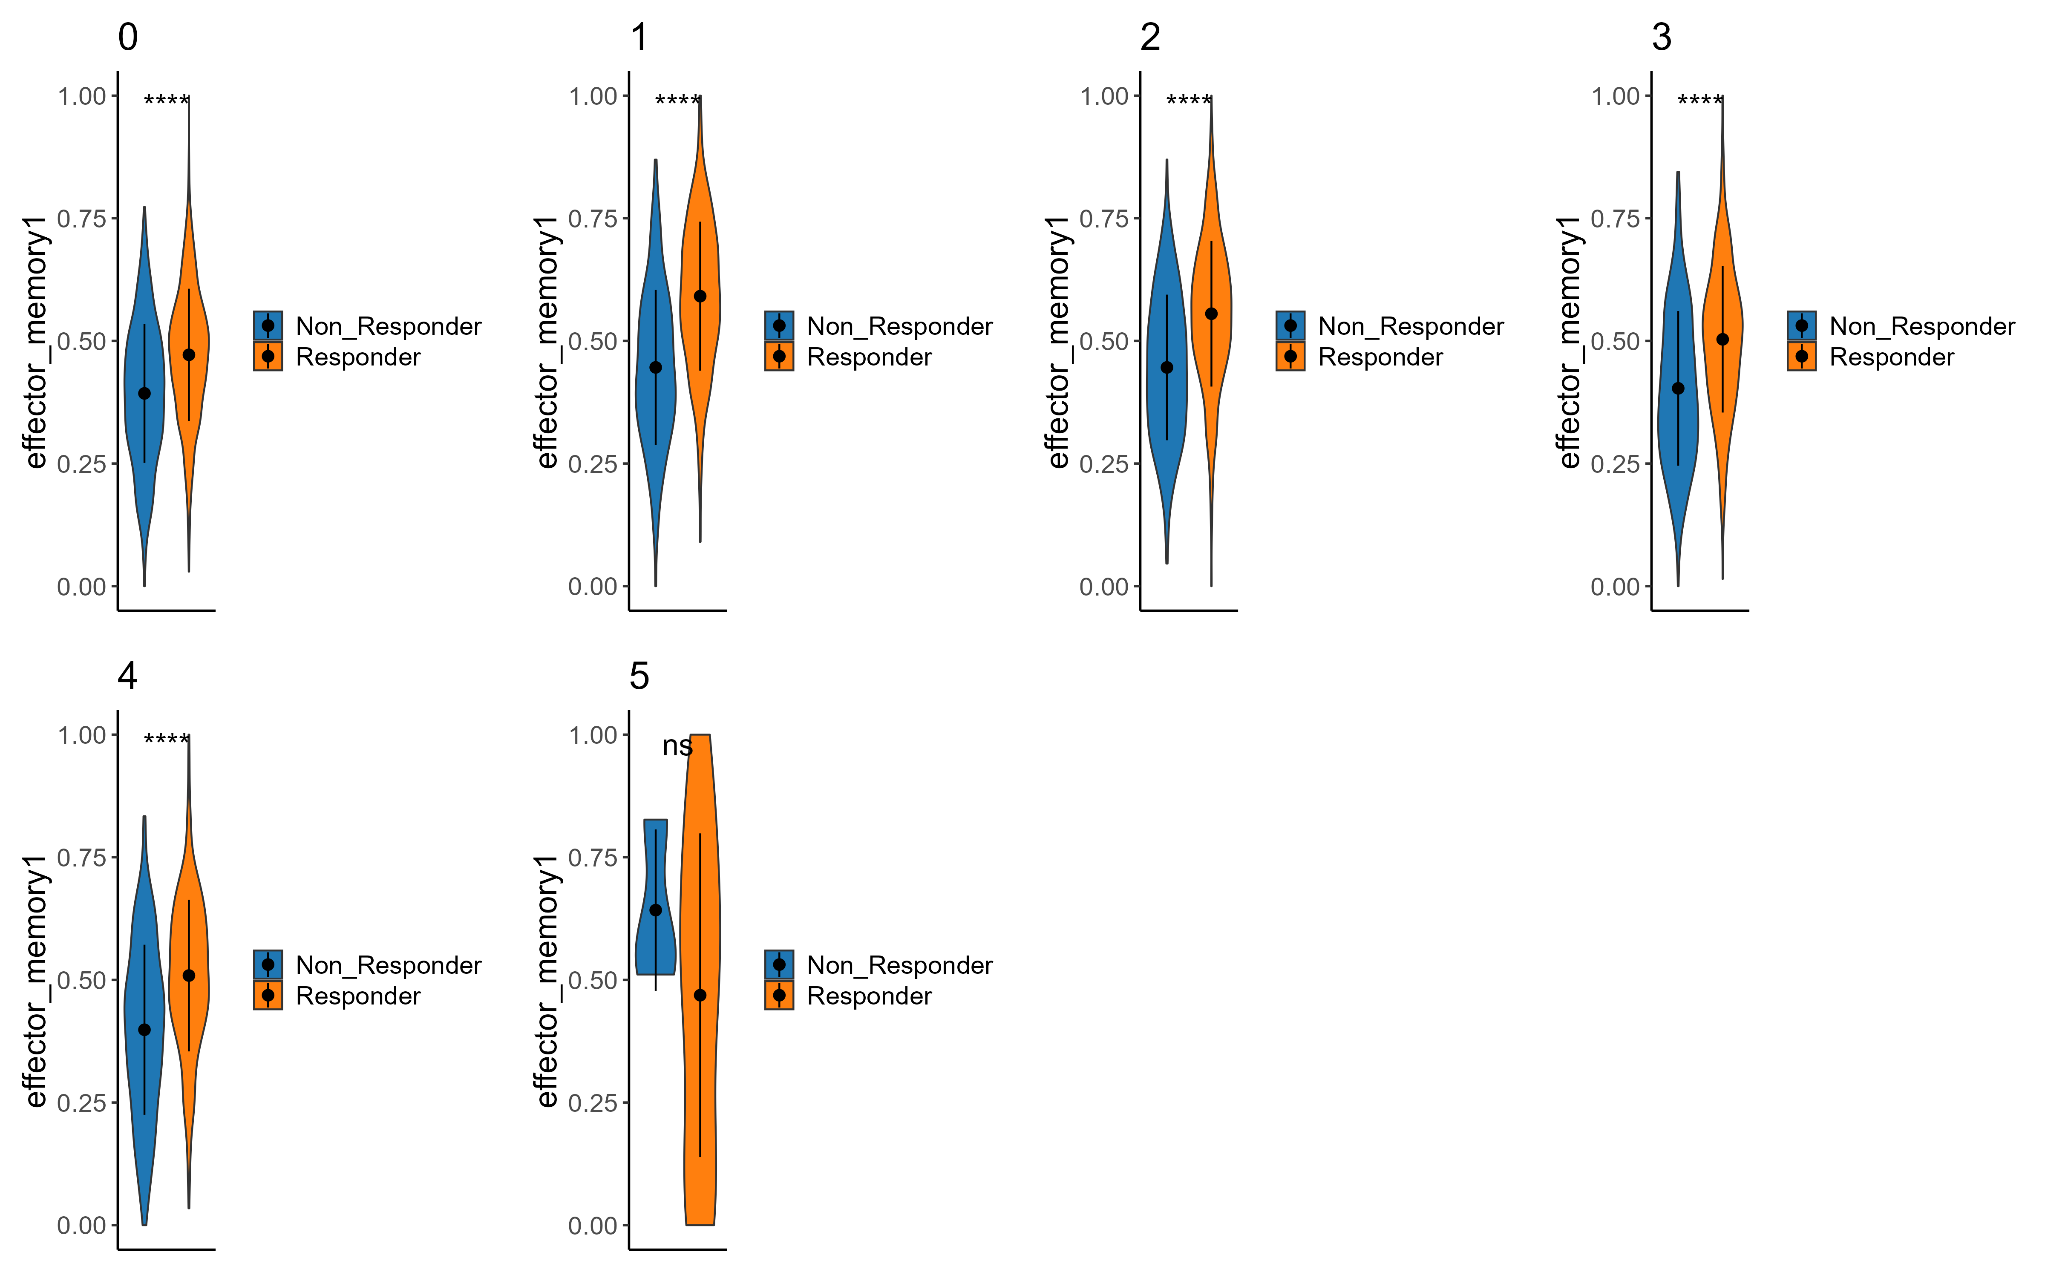
Signatures
Effector memory
Effector memory

Slide 44
Summary cluster 1
Activation markers higher in responders
Exhaustion markers higher in responders, but not all of them.
CD44 higher in responders
Signatures: effector memory

Slide 45
Cluster 2 (cytotoxic CD8)
zoom in analysis

Slide 46
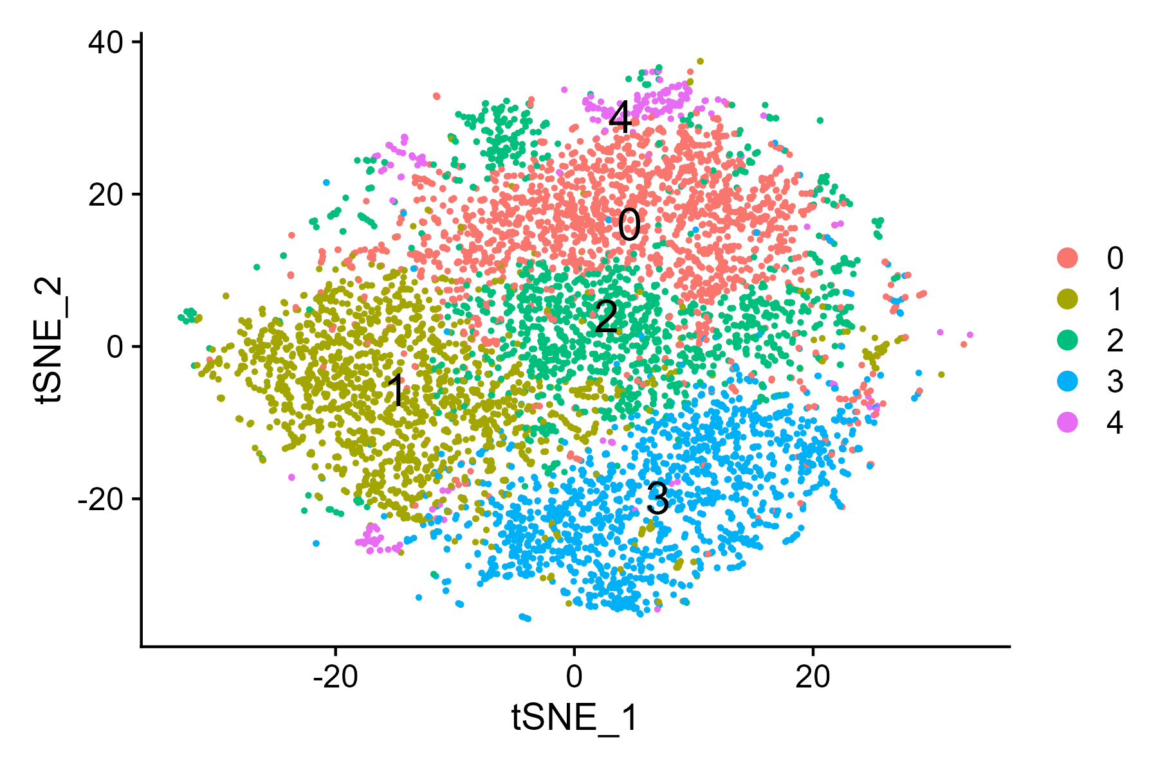
tSNE

Slide 47
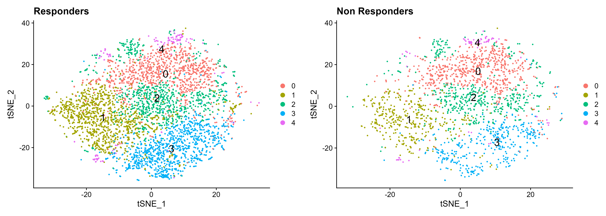
tSNE by response

Slide 48
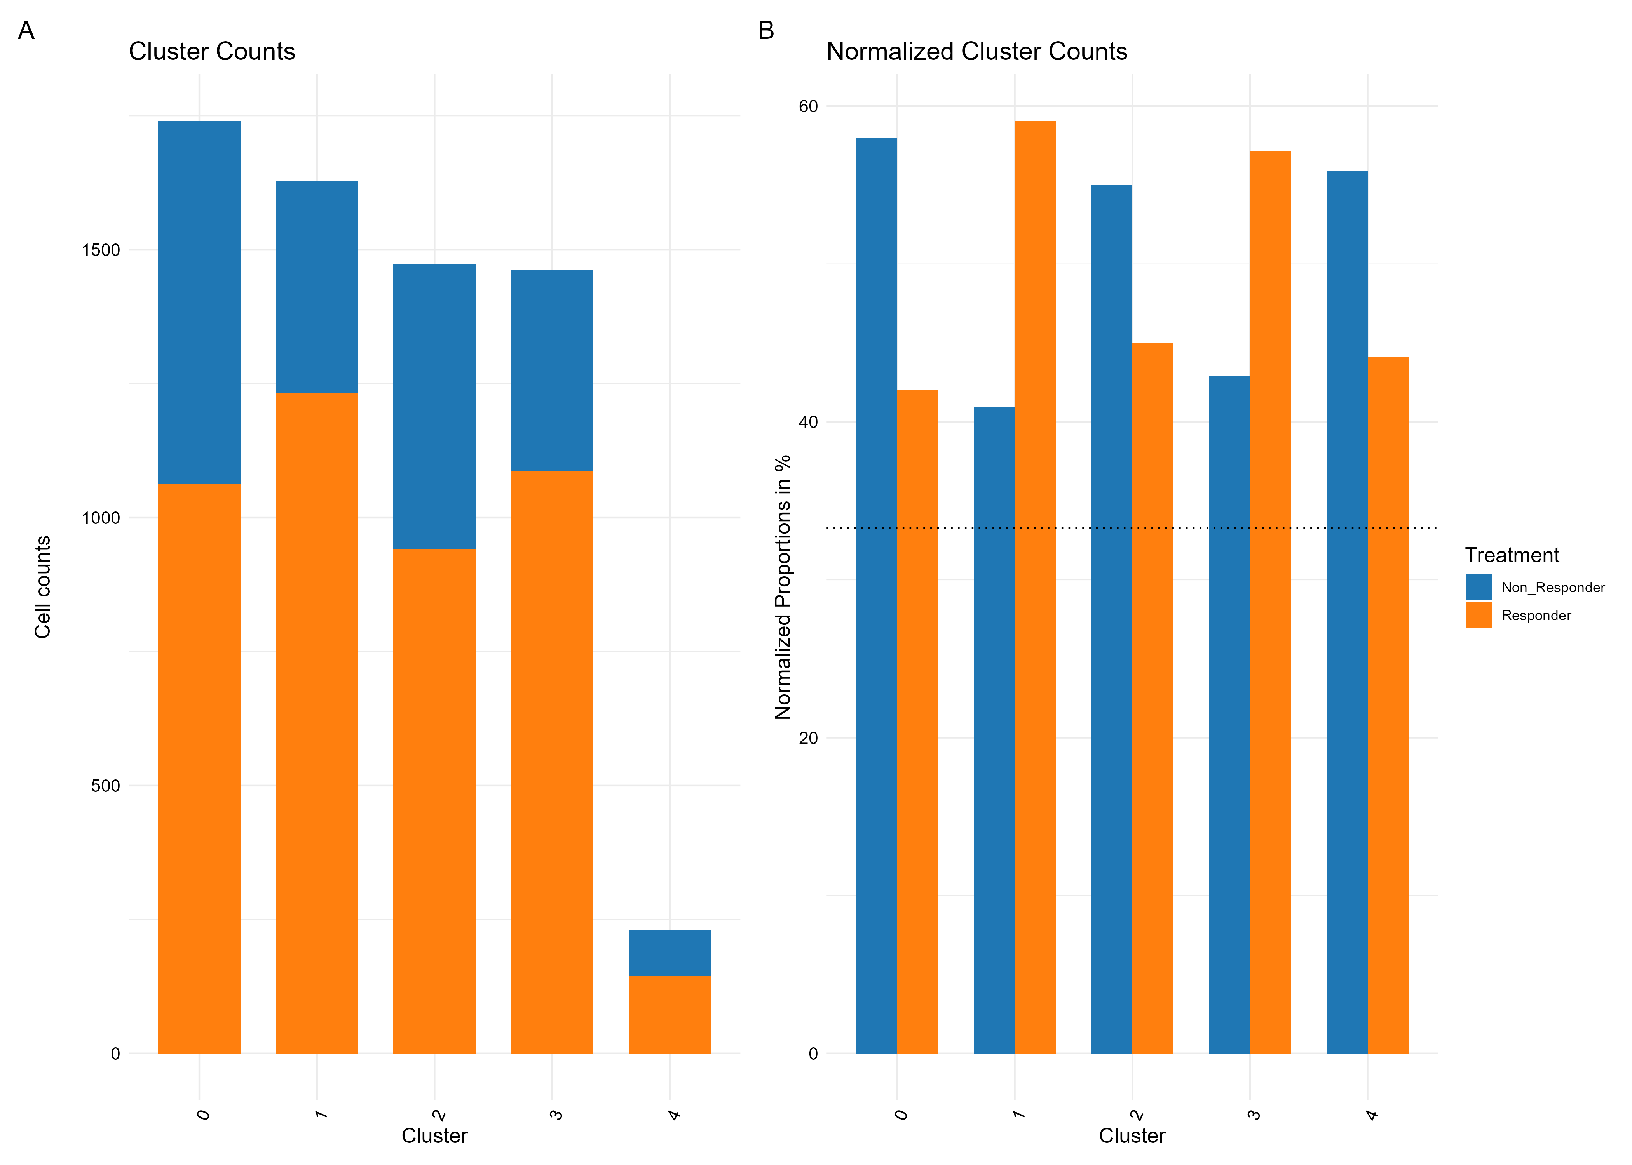

Slide 49
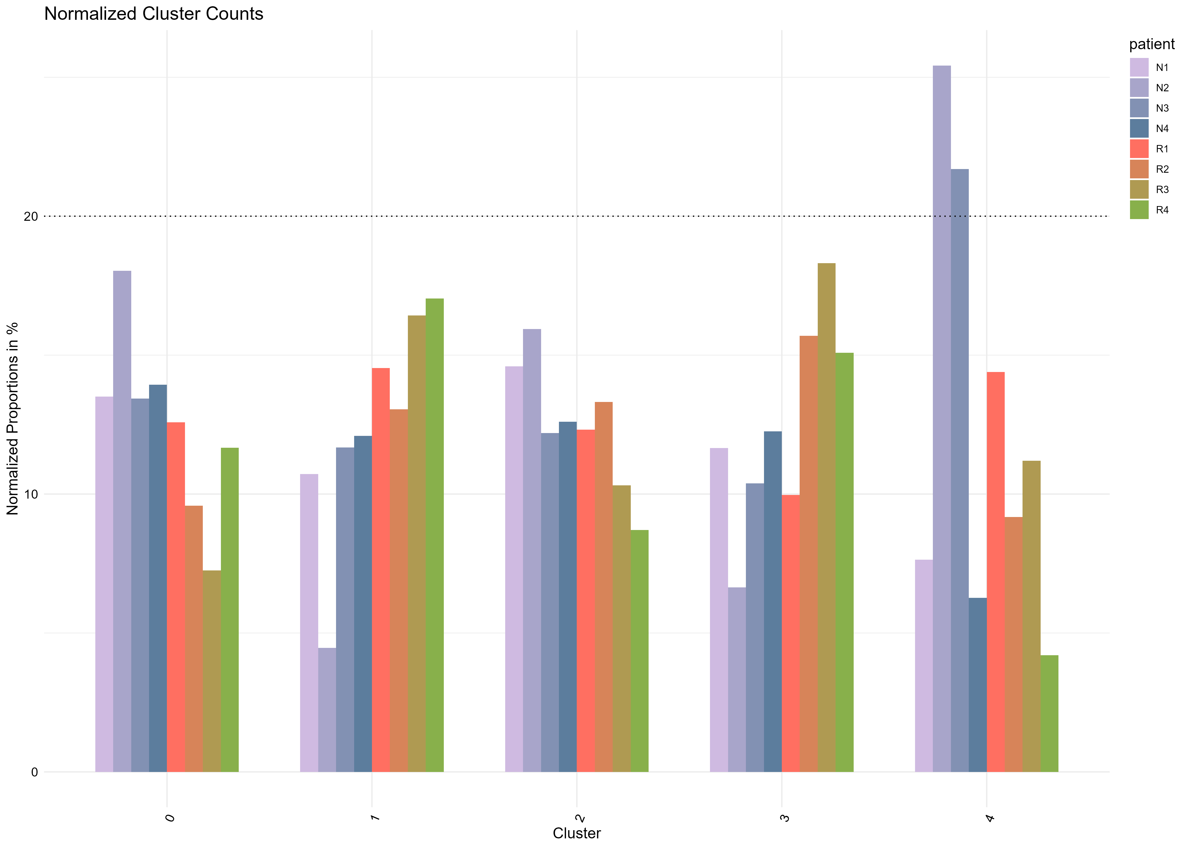
Contribution per patient

Slide 50
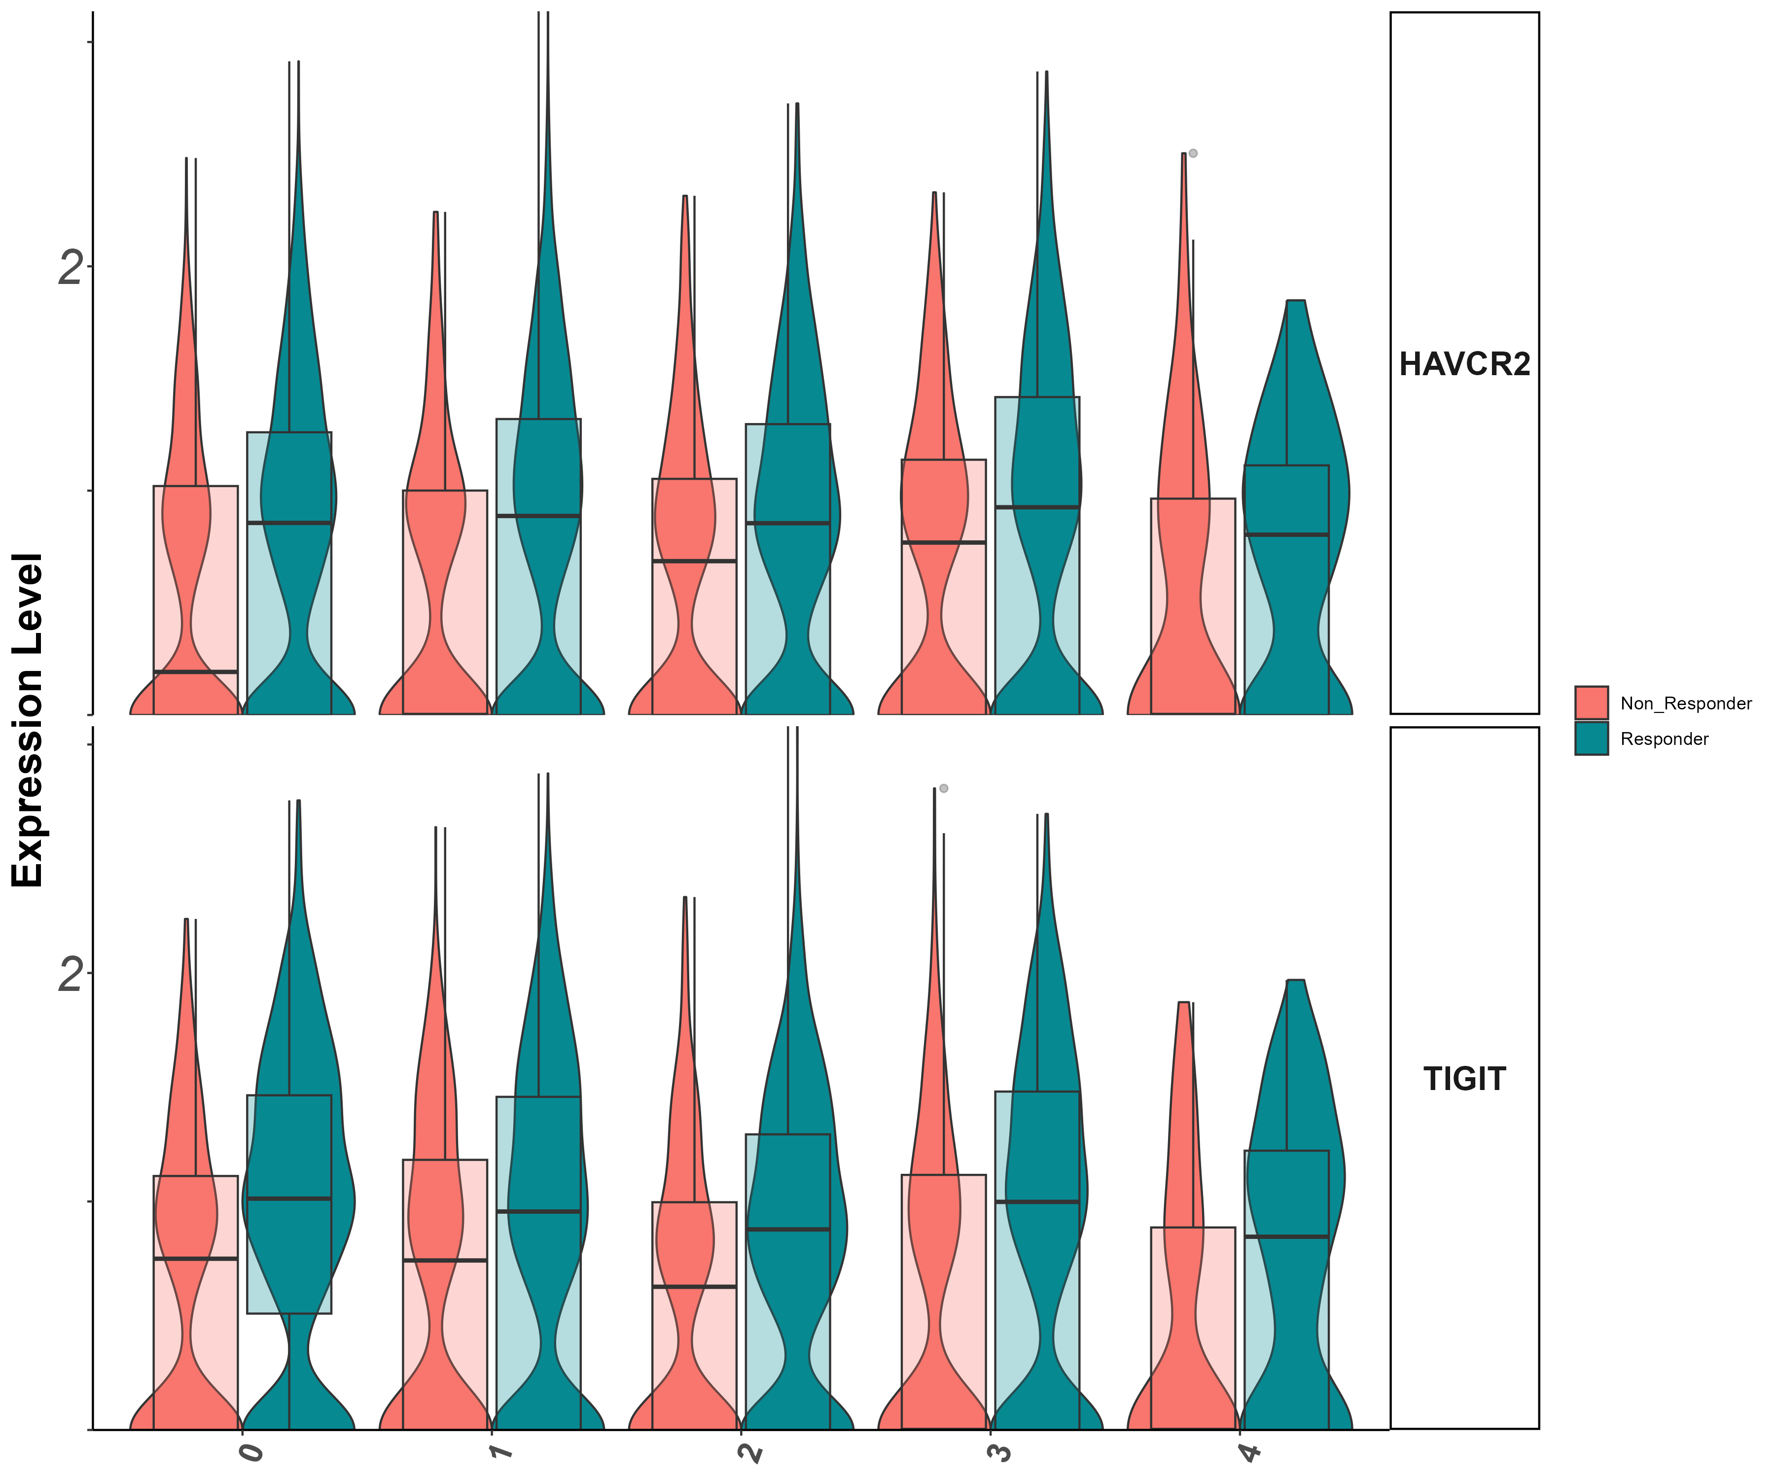
exhaustion markers
Tigit, Havcr2

Slide 51
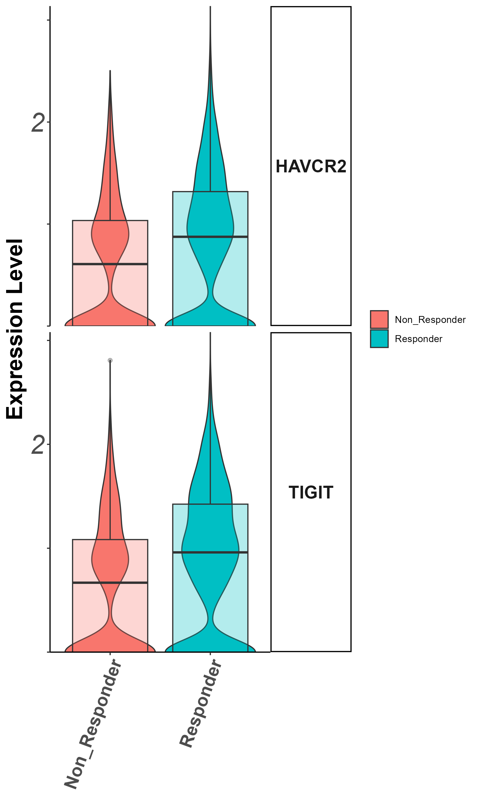
exhaustion markers
Tigit, Havcr2

Slide 52
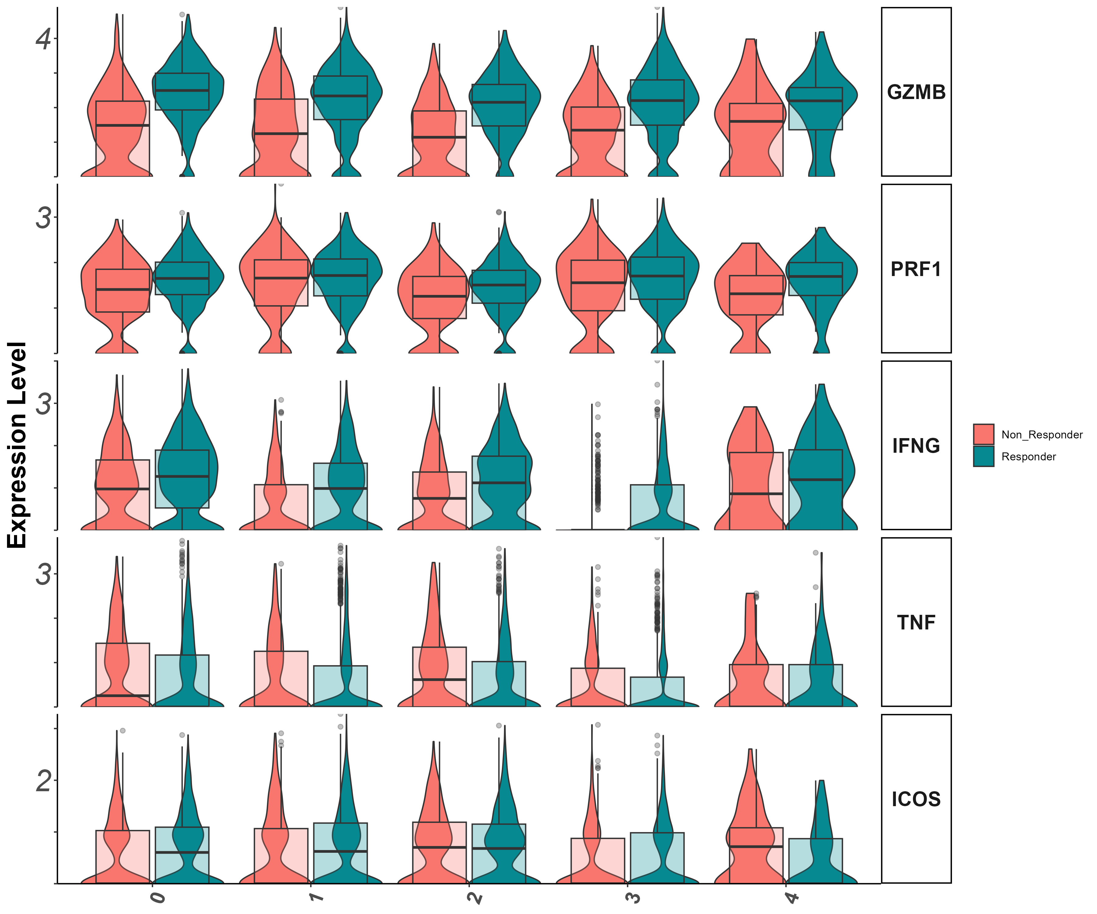
Effector markers
Gzmb, Prf1, Ifng, Tnf, Icos

Slide 53
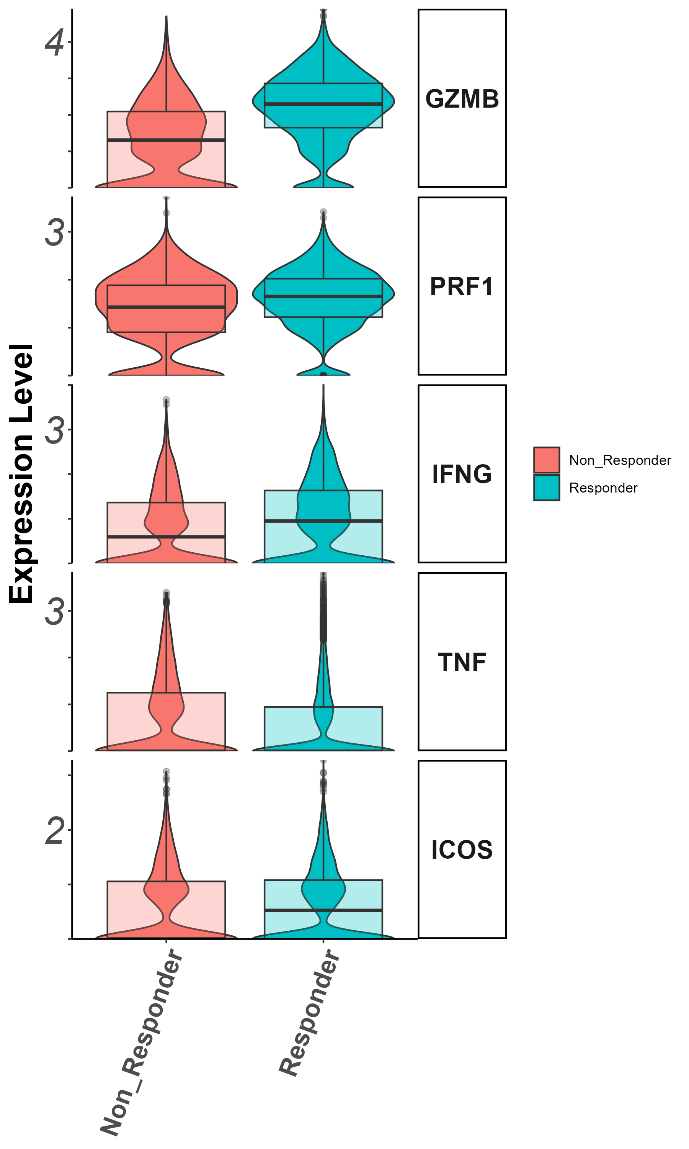
Effector markers
Gzmb, Prf1, Ifng, Tnf, Icos

Slide 54
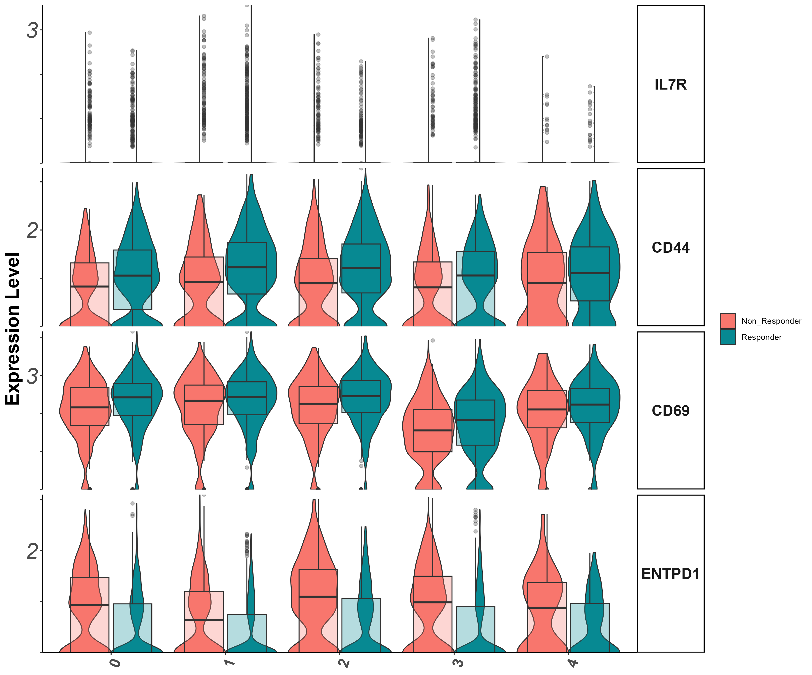
Stem/persister/naïve markers
Il7r, CD44 , CD39, CD69

Slide 55
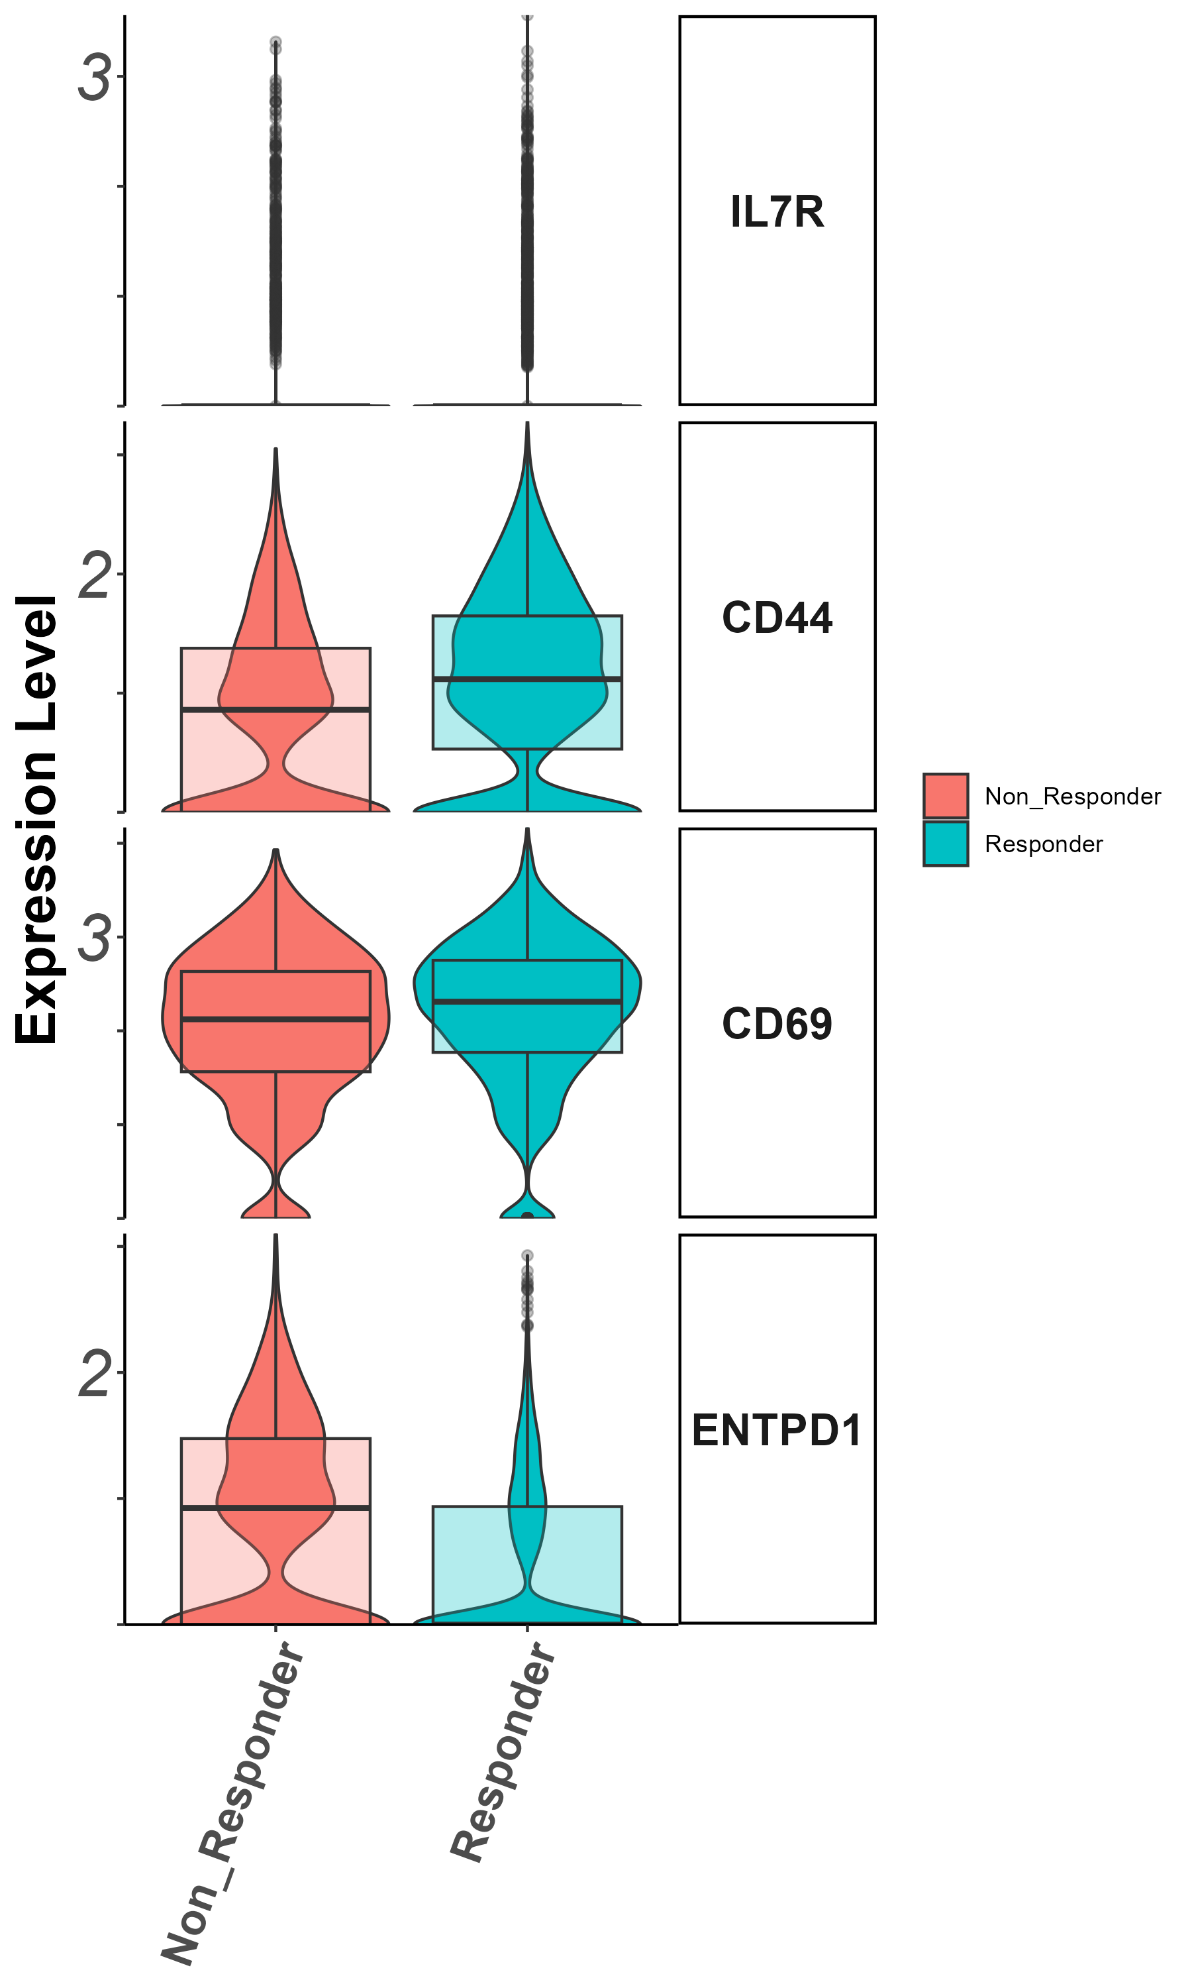
Stem/persister/naïve markers
Il7r, CD44 , CD39, CD69

Slide 56
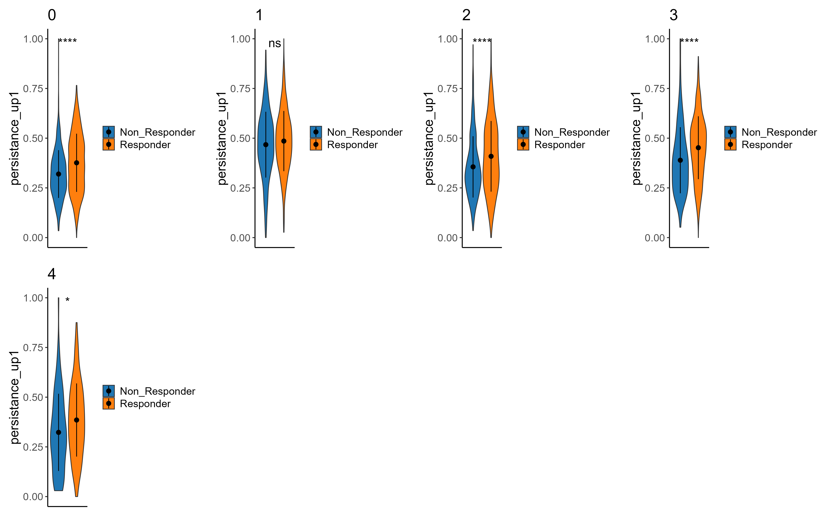
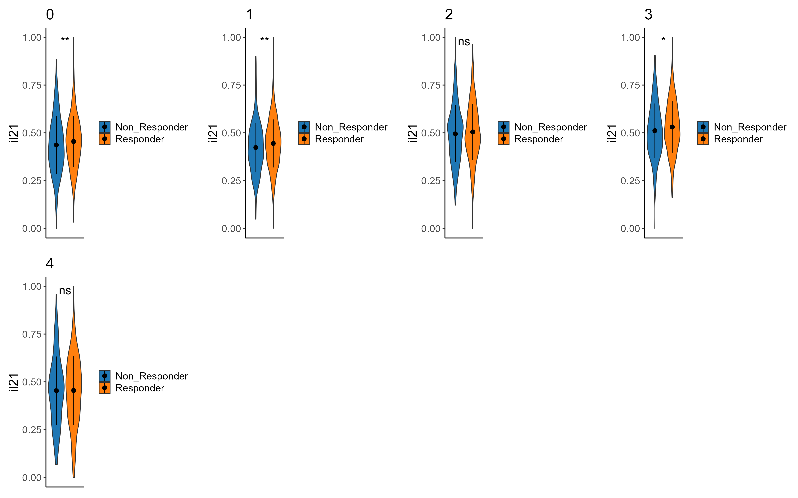
signatures
Persistance, il2
Persistance_upregulated
il2

Slide 57
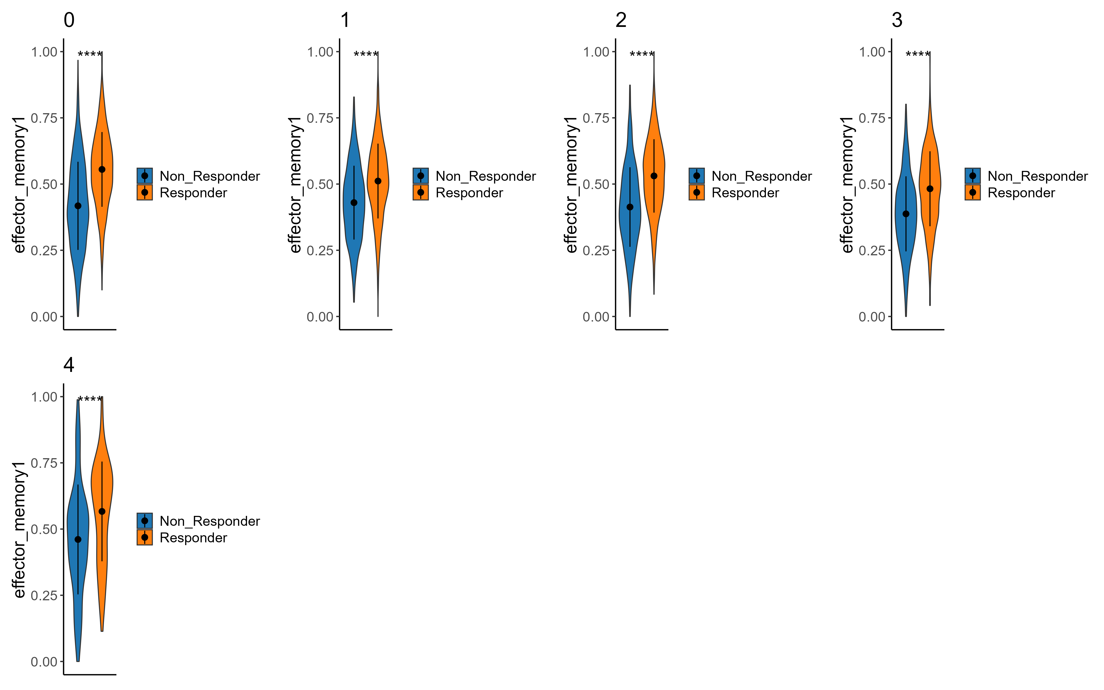
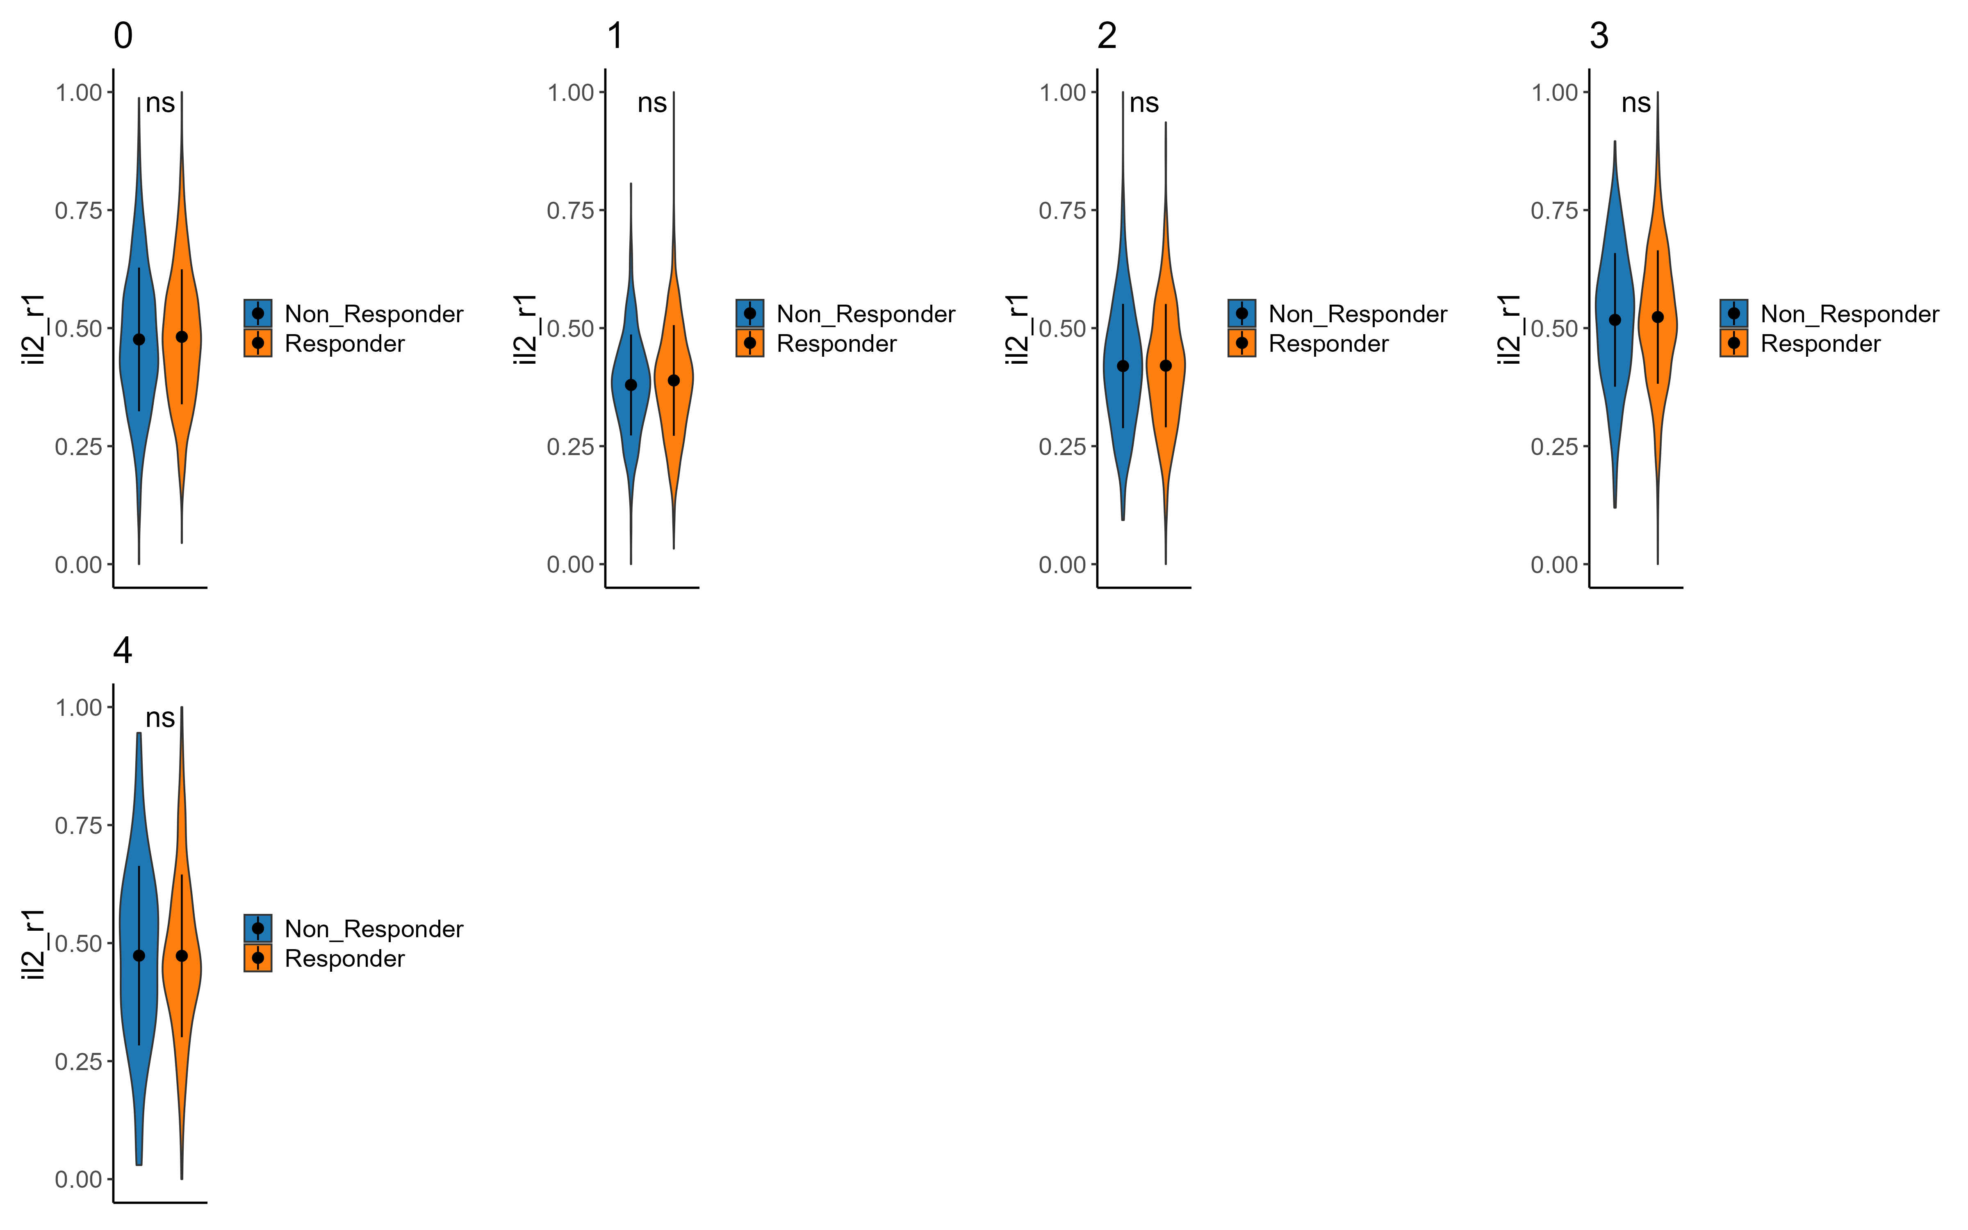
signatures
Effector memory, il2r
Effector memory
il2r

Slide 58
Summary cluster 2
cluster 0,2 (inside clus2 analysis) more non-responders
cluster 1,3 more responders
CD40LG, ENTPD1, : higher in non responders
GZMB, prf1, IFNG, GZMK, CD27, : higher in responders
exhaustion : TIM3, TIGIT, TNF higher in respondesr
naive-like/memory : CD44, higher in responders
effector/memory : KLF2, higher in responders
Signatures: persistence
Il2
effector memory

Slide 59
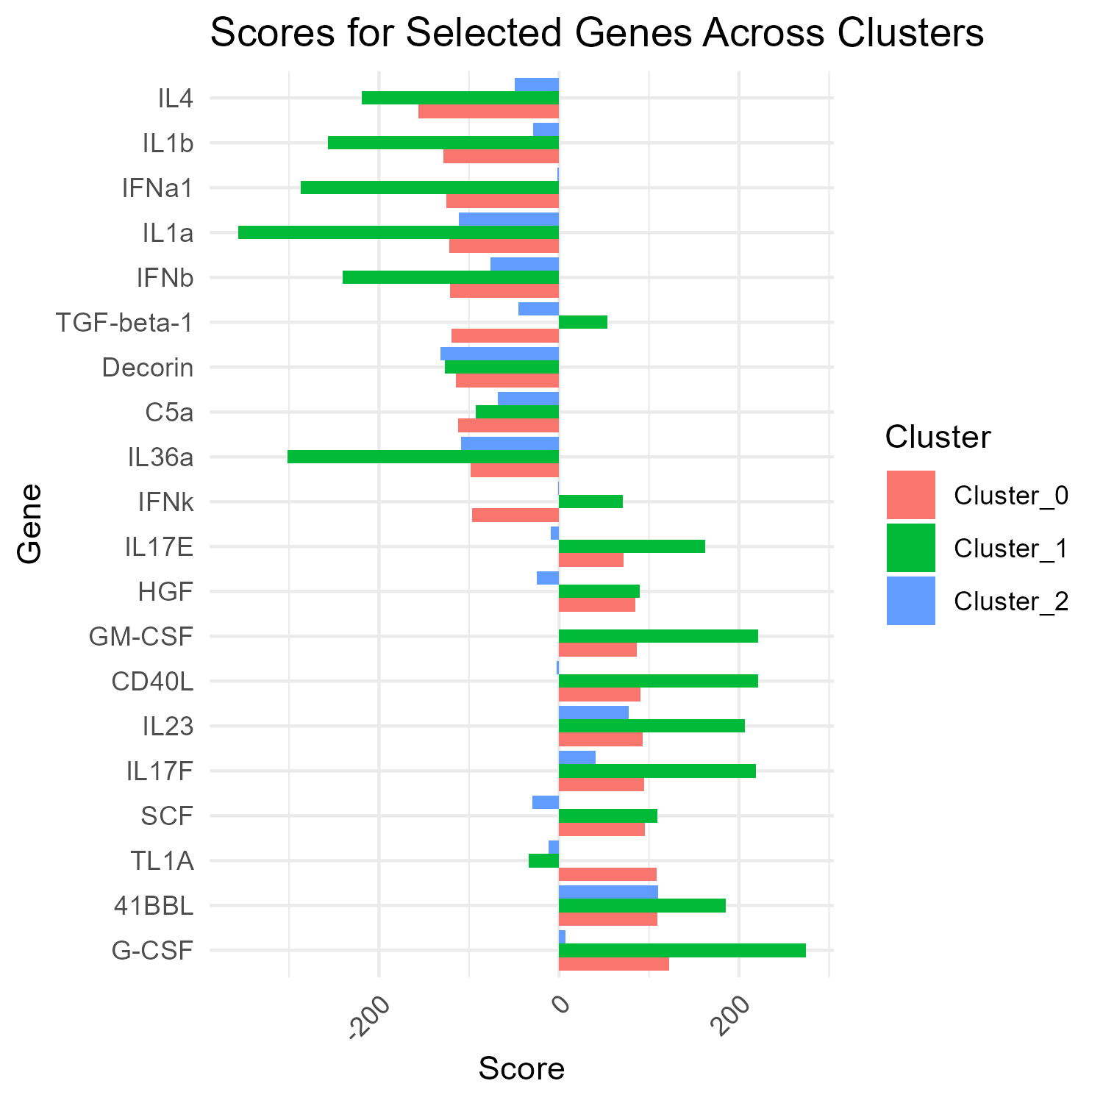
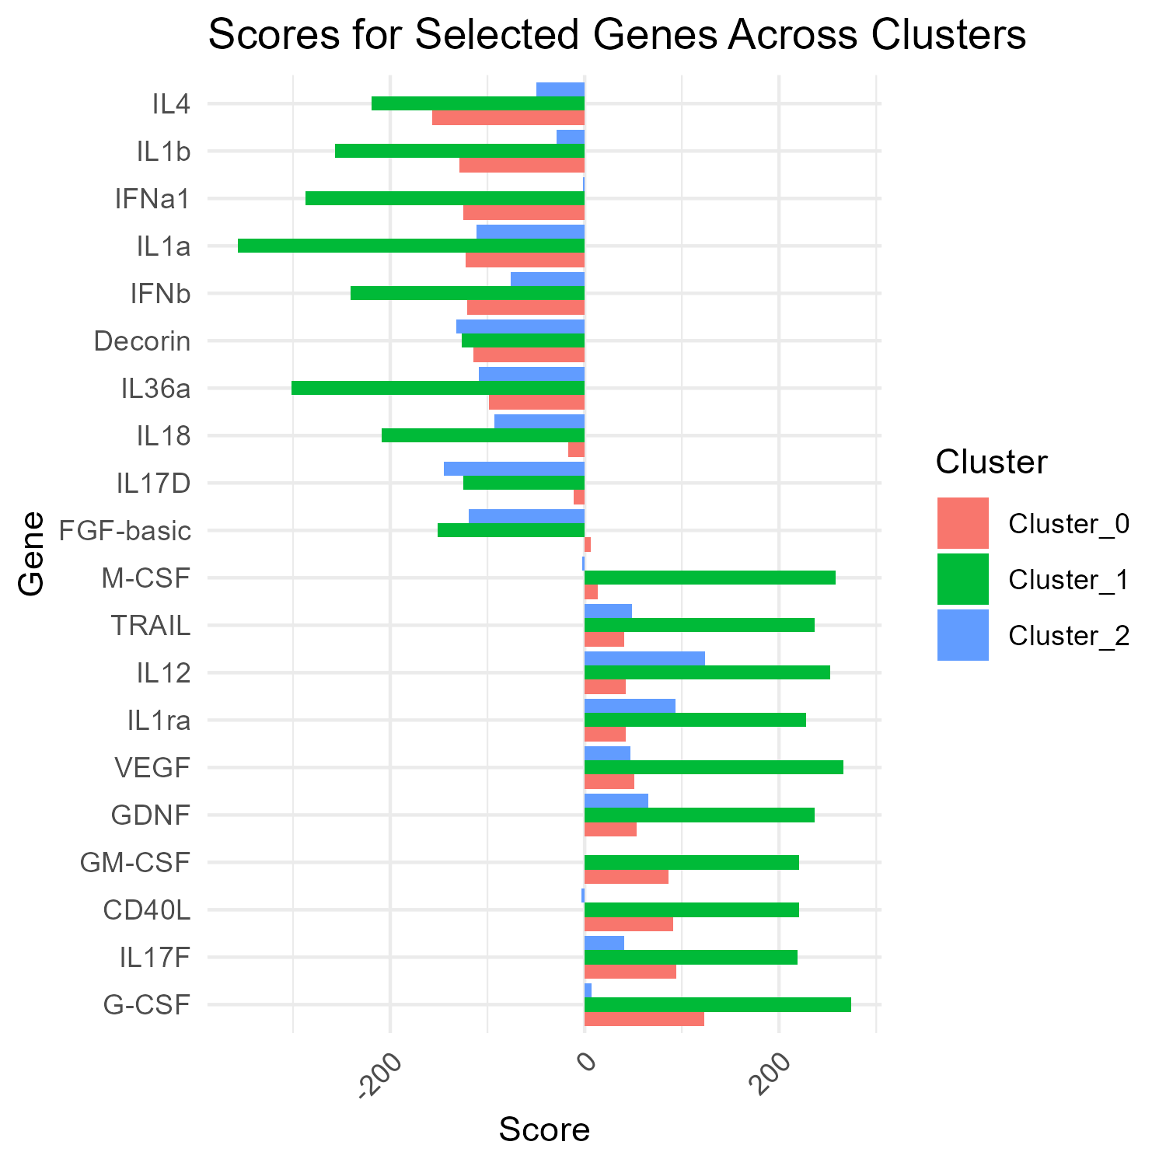

cytokine analysis
Cluster 0
Cluster 1
Cluster 2
Cui, A., Huang, T., Li, S. et al. Dictionary of immune responses to cytokines at single-cell resolution. Nature 625, 377–384 (2024). https://doi.org/10.1038/s41586-023-06816-9

Slide 60
cytokine analysis
il-2 high only in cluster 2, not in cluster 1
CD40L high in both cluster 0 & 1. seemed like not responder trait, but cluster 1 seemed as responder cluster. maybe cluster 1 is less "responsive" than cluster 2
some cytokines show linkage of cluster 0,1, and 2 is different. may tell some more about cluster identities

Slide 61
CD40LG
CD40 receptor? (for me)

Slide 62




Signatures – cluster 0 - telomere length associated
downregulated signature
Upregulated signature

Slide 63




Signatures – cluster 1 - telomere length associated
downregulated signature
Upregulated signature

Slide 64




Signatures – cluster 2 - telomere length associated
downregulated signature
Upregulated signature

Slide 65
Telomere signature summary
In cluster 0 we see higher expression of negatively correlated genes in responders than non-responders.
in clusters 1,2 we see lower expression of downregulated genes and higher expression of upregulated genes correlated with longer telomers.

Slide 66
Observations - summary
ILR7 higher in responders (strongly aligns with literature) in cluster 0 only
Effector markers (GZMB, prf1, IFNG, GZMK, CD27) : higher in responders
effector/memory : KLF2 higher in responders
lower expression of ENTPD1 in responders both in CD8 & CD4 cells(exhausted-like).
CD40LG higher in non responders
N4 acts like responders in cluster 0, 1(a bit in 2 aswell) of all_cells(maybe interesting that he is not a responder ? )
- il2 signature significant between responders & non in cluster 2 sub analysis, but not in cluster 1 - il2r not significant between responders & non in both clusters 1&2
Longer telomers in responders in clusters 1,2 indicating naïve-like qualities.
DE between responders and non-respondesr in all_cells : SELL, CD27, GZMK, TRAV5
N4 acts like responders in cluster 0, 1(a bit in 2 aswell) of all_cells(maybe interesting that he is not a responder ? )

Slide 67
conclusions
upregulate effector marker
cd4\cd8 ratio ? persister cd4 traits ?

Slide 68
Next steps

Slide 69



The team Contact: asafmadi@tauex.tau.ac.il

